Slide 1
2025 Membership Renewal & Unit Recharter
Starting 3/1/24, Membership Renewal & Unit Recharter are decoupled
Individuals renew their membership annually on their joining anniversary
Units approve or reject members who request to renew
Units recharter without members annually on 12/31 (no grace period)

Slide 2
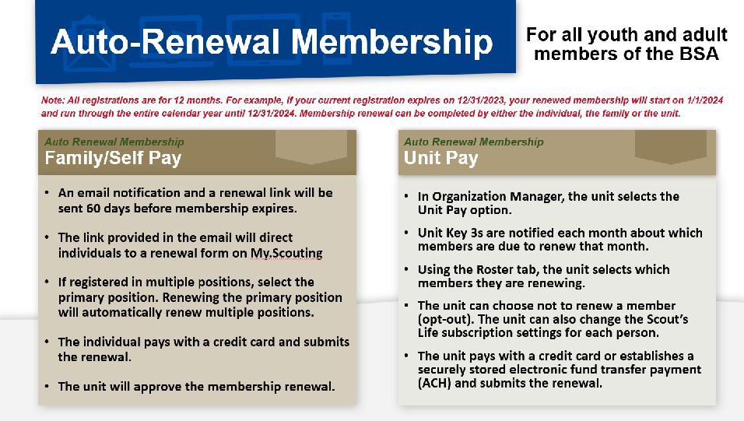

Slide 3
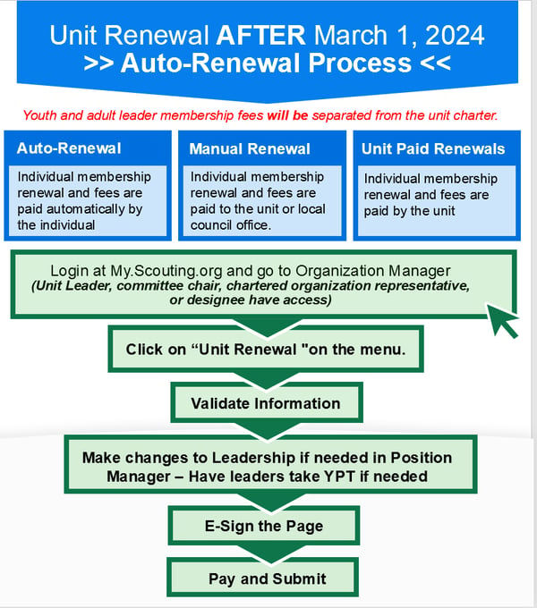

Slide 4

Individual Membership Renewal

Slide 5
2025 Membership Renewal
✤
Personal registration is annual (not called recharter), date of first joining
✤
Members prior to August 1, 2023 have 12/31 as expiration
✤
Must have valid email address on in my.scouting

Slide 6
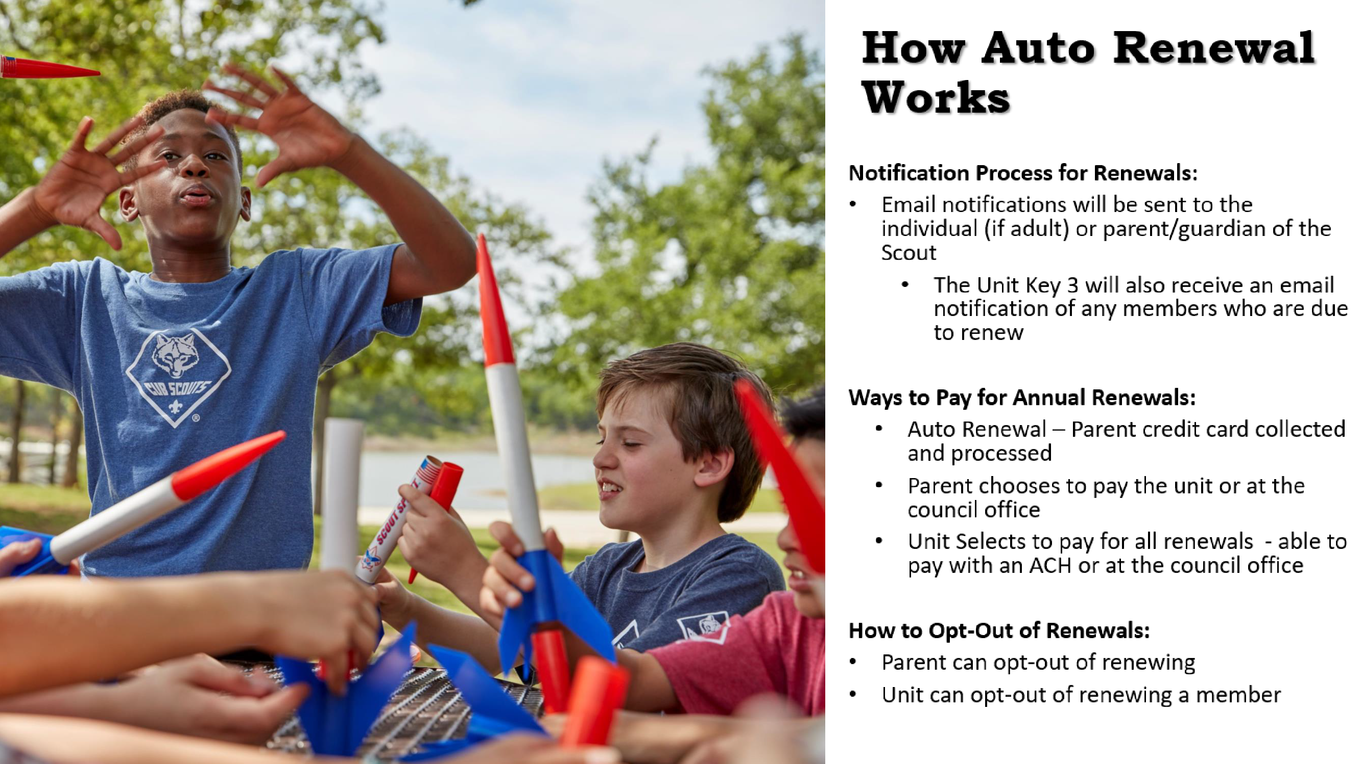


How Auto Renewal Works
Notification Process for Renewals:
• Email notifications will be sent to the individual (if adult) or parent/guardian of the Scout
• The Unit Key 3 will also receive an email notification of any members who are due to renew
Ways to Pay for Annual Renewals:
• Auto Renewal – Parent credit card collected and processed
• Parent chooses to pay the unit or at the council office
• Unit Selects to pay for all renewals - able to pay with an ACH or at the council office
How to Opt-Out of Renewals:
• Parent can opt-out of renewing
• Unit can opt-out of renewing a member

Slide 7

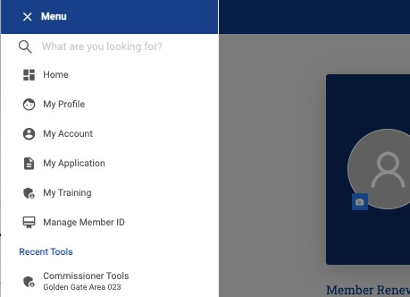


Slide 8
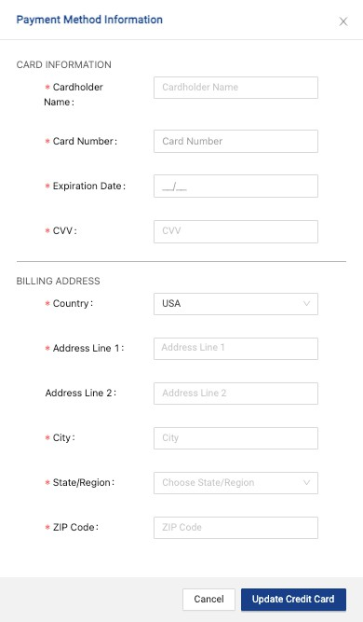





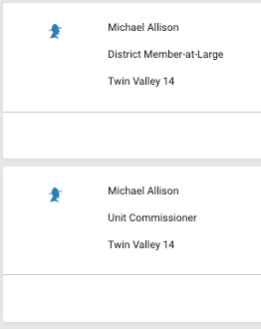

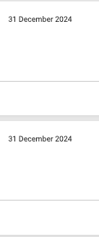
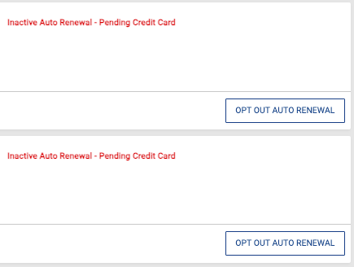

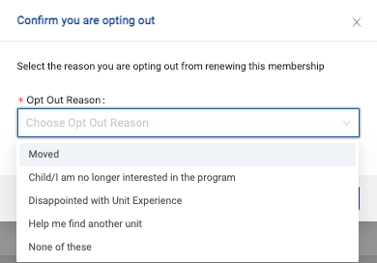
View all pending applications Renewal: two types
✤
✤
✤
Manual
Automatic (annual)
✤
✤
Annual requires credit card on file
Opt out if:
2
✤
1
Don’t want annual Unit pays
Leaving the program
✤
✤
3
✤
✤
Don’t know what youth applications look like… yet
✤
Probably similar

Slide 9
2025 Unit Recharter

Slide 10
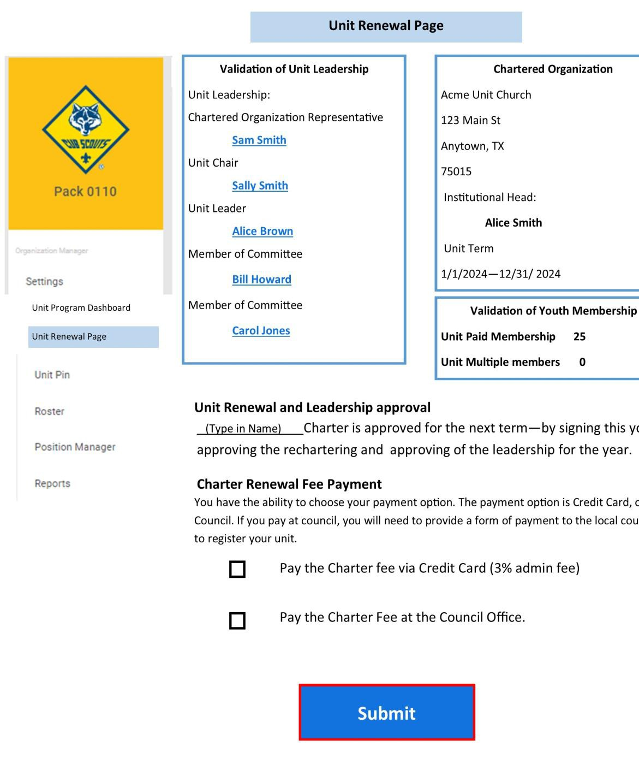
Unit Recharter 2025
✤
2025:
✤
Largely on line
✤
Key 3 electronically sign form
✤
Unit cuts check for $100
✤
Deadline is 12/31
✤
Unit Dropped on 1/2 - no lapse, no “grace”
✤
No member renewal included in this process

Slide 11

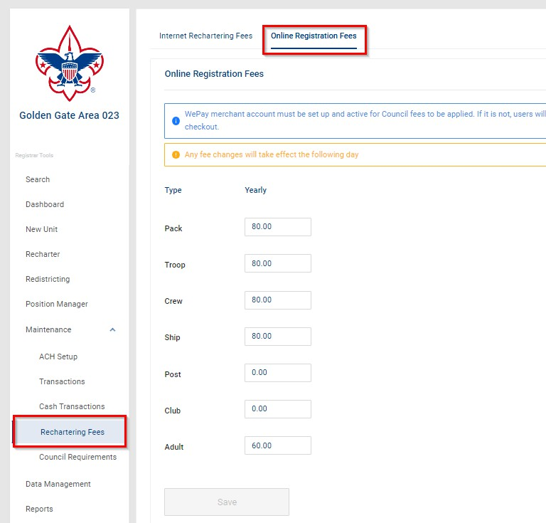

Slide 12
Backup

Slide 13
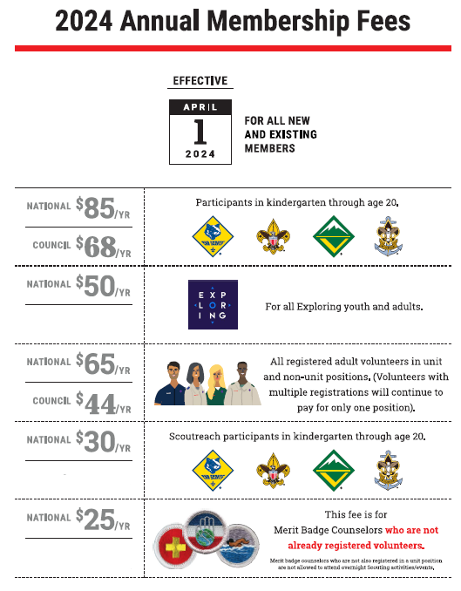

Slide 14
