Slide 1
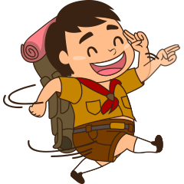
March Roundtable
March 9, 2022

Slide 2
Save the date
our
March 19th Outdoor Rally in Irvington Park
March 19th Fingerprinting Opportunity @ Outdoor Rally
April 2nd GGAC Volunteer Recognition 2pm-5pm at Alameda County Fairgrounds
April 14th April Roundtable Meeting
April 30th ACORN Training – Session 1 or 2 at Kennedy
May 1st ACORN Training - at the Elks Lodge
May 5th Eagle Scout Event
May 7th Merit Badge Extravaganza
May 12th Spring Mixer at Swiss Park
May 13-15th ACORN Training Camping- at Ranchos Los Mochos
May 20th Webelos Woods
June 12-18 NYLT Training Course at Los Mochos
June 13-17th Cub Scout Day Camp at Ardenwood Farm
Sept 16-18th Fall Camporee at Los Mochos
4c6ab901-6462-47db-aeb6-294ec448faf0 (missionpeakscouts.com)

Slide 3
April RoundTable Meeting April 14th
Upcoming….
Presented by:
Rebeca Rafael

Slide 4
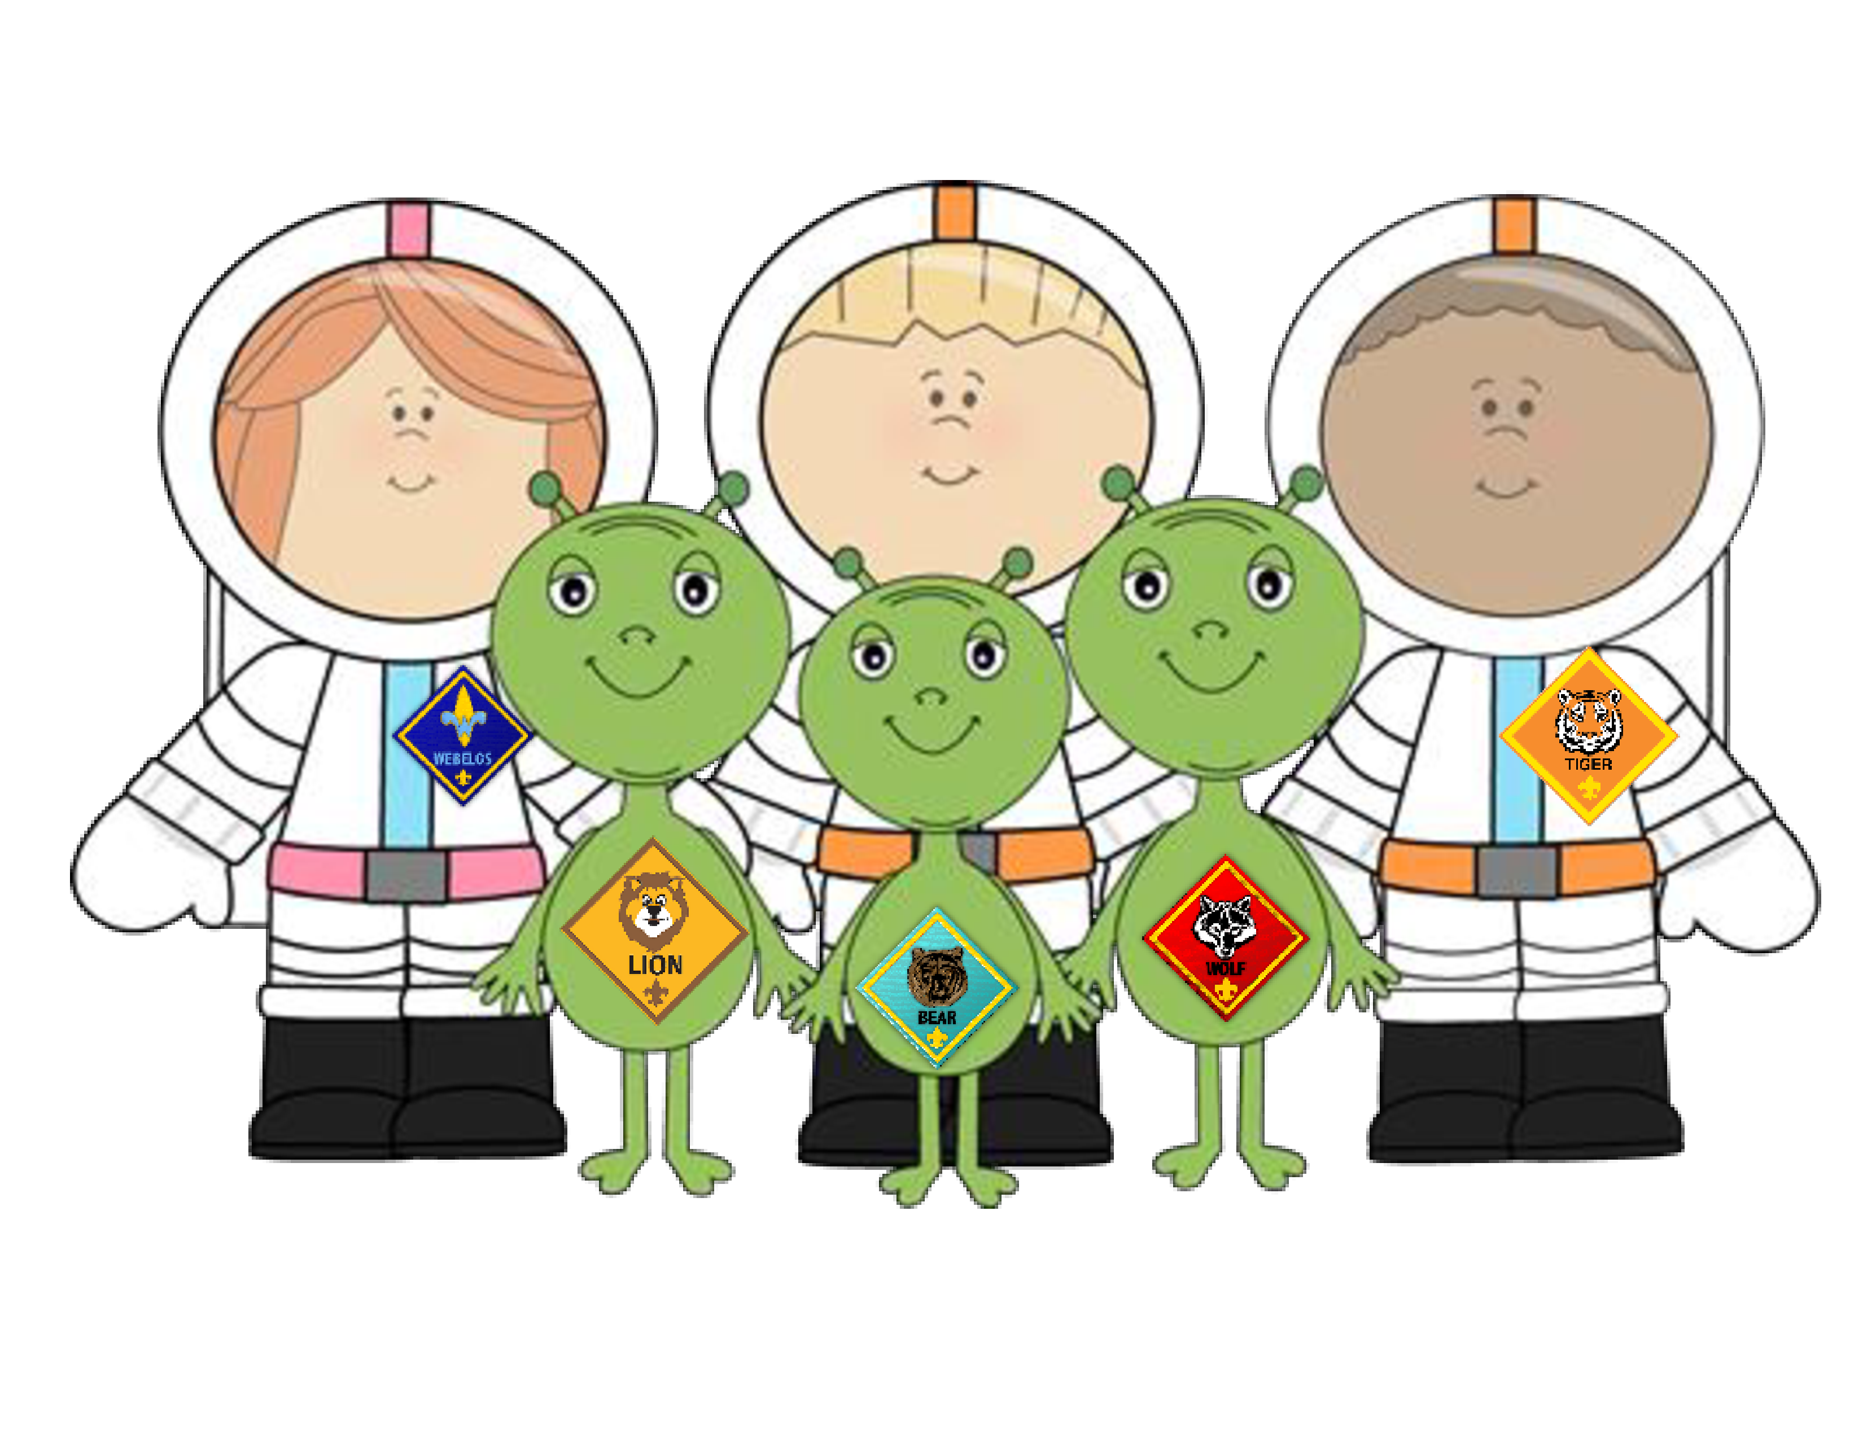
Save the Date Mission Peak Cub Scout Day Camp June 13 – 17, 2022 Ardenwood Farm
Pioneers
in Space:
STEM on the Farm
Come have your Cub Scouts join us at Ardenwood Farm as we learn more about the stars, galaxies, planet, STEM, and, of course, the farm!
Limited spaces so please sign up as soon as registration is open!

Slide 5
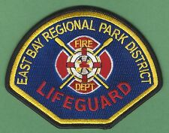
East Bay Park District is looking to hire scouts for lifeguards this summer!
The link to the job posting/application is where everything can be found: www.eblifeguard.org/job
Tyler Waespi
Aquatic Assistant | Fire Department/ Lifeguard Services
East Bay Regional Park District
17930 Lake Chabot Road, Castro Valley, CA 94546
T: 510-690-6625| M: 510-520-4384
TWaespi@ebparks.org | www.ebparks.org

Slide 6
NYLT: National Youth Leadership Training
First Presentation….
Second Presentation….
GGAC Cub Scout Camping this summer

