Slide 1
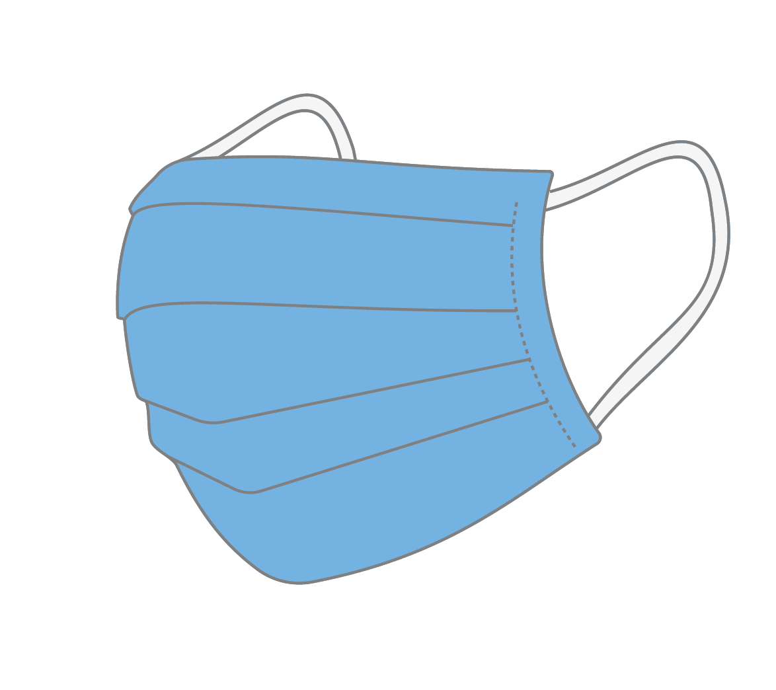
Things are getting back to Normal… What does that mean for Summer Camps?
Eve Marie Ruhlman
May Presentation

Slide 2
COVID CASES ARE GOING DOWN…….

Slide 3
Update on the Vaccine Situation

Slide 4
Updated Changes with the CDC Guidelines
18-64 Adults have been able to get their first rounds/second rounds of vaccines for about a month.
CDC recommends COVID-19 vaccination for everyone 12 years of age and older to help protect against COVID-19. Children 12 years of age and older are able to get the Pfizer-BioNTech COVID-19 Vaccine.
Earlier today, the CDC Guidelines said vaccinated people do not need to wear masks indoors anymore….will California follow the same guidelines?

Slide 5
Fully vaccinated people no longer need to wear masks or physically distance indoors or outdoors in most circumstances to protect themselves against the coronavirus, federal health officials said Thursday — setting the stage for California to loosen its mask mandates and distancing guidelines for vaccinated residents.
“If you are fully vaccinated, you can start doing the things that you had stopped doing because of the pandemic,” Dr. Rochelle Walensky, director of the federal Centers for Disease Control and Prevention, said during a White House COVID-19 briefing. “We have all longed for this moment when we can get back to some sense of normalcy.”
She added, “Anyone who is fully vaccinated can participate in indoor and outdoor activities — large or small — without wearing a mask or physically distancing.”
The California Department of Public Health did not immediately respond to questions Thursday about whether or when it would adopt the new federal guidelines. The state typically follows the CDC’s COVID-19 recommendations. But with masking rules, the Bay Area and state have previously gone further than the federal government, instituting local mandates in the absence of a federal one.
The CDC’s change came one day after Gov. Gavin Newsom appeared to walk back a comment that “businesses large and small” would be able to let in people without masks when the state lifts its pandemic restrictions on June 15. On Wednesday, the governor said that some indoor mask mandates and guidelines would probably still be in effect.
California currently does not require vaccinated people to wear masks outdoors, except at crowded settings such as sporting events.
Fully vaccinated people do not have to wear masks indoors or outdoors with other fully vaccinated people, or when visiting unvaccinated low-risk people from a single household, under the current California guidelines. People are considered fully vaccinated two weeks after the second shot of the two-dose Pfizer and Moderna vaccines, or two weeks after the single shot of the Johnson & Johnson vaccine.
The CDC’s Walensky said unvaccinated people will have to keep their masks on for the time being.

Slide 6
So what can vaccinateD people do?
Fully vaccinated people can:
Spend time with other fully vaccinated people, including indoors, without wearing masks or physical distancing (outside a workplace setting).
Spend time with unvaccinated people from a single household who are at low risk for severe COVID-19 disease indoors without wearing masks or physical distancing.
Refrain from wearing face coverings outdoors except when attending crowded outdoor events, such as live performances, parades, fairs, festivals, sports events, or other similar settings.
Refrain from quarantine and testing following a known exposure if asymptomatic [2].
Following a known exposure at work, fully vaccinated workers do not need to quarantine if asymptomatic.
In the workplace, employers subject to the Cal/OSHA COVID-19 Prevention Emergency Temporary Standards (ETS) must ensure that employees are following the current ETS face covering and testing requirements.

Slide 7
For Now, Fully Vaccinated People should continue to:
Take precautions in public including wearing a well-fitted mask indoors, and when attending crowded outdoor events, as described above.
Check CDPH guidance for face coverings for updates.
Follow CDPH's Guidance for Gatherings when gathering with people who are not vaccinated, groups with both vaccinated and unvaccinated people, and persons of unknown status. Maintain physical distancing and adhere to other prevention measures when visiting with unvaccinated people who are at increased risk for severe COVID-19 disease or who have an unvaccinated household member who is at increased risk for severe COVID-19 disease.
Get tested if experiencing COVID-19 symptoms.
If fully vaccinated people test positive for SARS-CoV-2, they should follow CDPH and local health department guidance regarding isolation and/or exclusion from high risk settings.
For workplace settings, employers should follow the exclusion provisions of the Cal/OSHA COVID-19 Emergency Temporary Standards.
Follow CDC, local and state health department travel requirements and recommendations.

Slide 8
The EOP should address, at a minimum, the following topics:
Strongly encouraging vaccination for all eligible people
Health screening for symptoms of COVID-19 and diagnostic or screening testing for COVID-19
Using multiple prevention strategies including masks, physical distancing and cohorting, residential housing arrangements for overnight camps, and improved ventilation
Reviewing safety protocols for staff and campers who might be at higher-risk of serious health effects if they contract COVID-19
Modifying camp activities to promote outdoor and other lower-risk activities
Traveling to and from overnight camp
Cleaning facilities and equipment
Proper use of personal protective equipment by any healthcare staff
Policies and practices that enable staff to stay home when they are sick, have been exposed, or are caring for someone who is sick
Policies and practices that allow families flexibility if campers have symptoms or test positive before arriving at camp
Managing suspect or confirmed case(s), including contact tracing efforts
Planning for an outbreak
For additional recommendations when developing the EOP, please see CDC’s Guidance for Operating Child Care Programs During COVID-19.

Slide 9
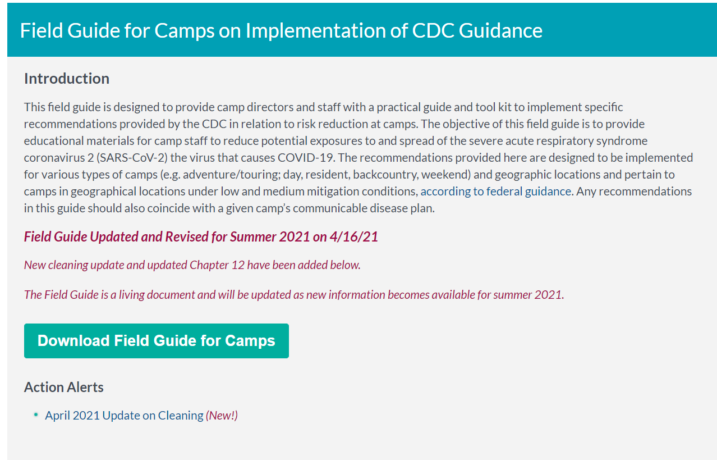

Slide 10
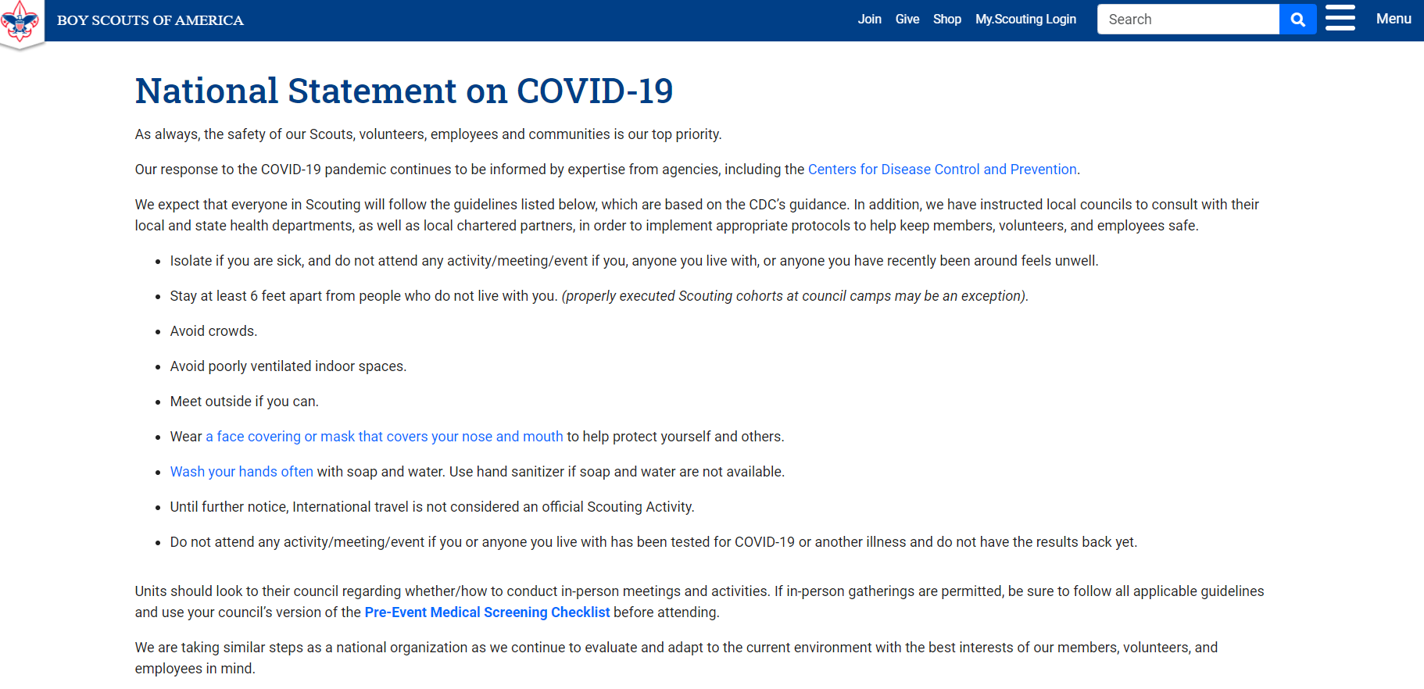

Slide 11
CASE STUDY: City of Fremont Summer Camps

Slide 14
Frequently Asked Questions with Fremont

Slide 15
Presentation Sources
https://www.cdph.ca.gov/Programs/CID/DCDC/Pages/COVID-19/COVID-19-Public-Health-Recommendations-for-Fully-Vaccinated-People.aspx
https://covid-19.acgov.org/index.page
https://covid-19.acgov.org/covid19-assets/docs/press/press-release-2021.05.13.pdf
https://dig.abclocal.go.com/kabc/covid-tier-tracker/index.html
https://www.fremont.gov/DocumentCenter/View/45223/Camp-2021---COVID-19-Information---Spring-2021?bidId=
https://fremont.gov/Faq.aspx?QID=629
https://www.sfchronicle.com/health/article/Vaccinated-people-can-mostly-lose-the-masks-CDC-16174979.php
National Statement on COVID-19 | Boy Scouts of America (scouting.org)
Guidance for Operating Youth and Summer Camps During COVID-19 (cdc.gov)

