Slide 1
Upcoming Dates
May 1 – Acorn Training
May 13 – May Roundtable Meeting – Getting your scouts ready for this summer
June 17 – Official “Unofficial” Welcome back Meet and Greet mixer
August 2-6 – Mission Peak Cub Scout Day Camp – Ardenwood Farms

Slide 2
Ardenwood Cub Scout Day Camp Registration is open!
August 2-6, 2021
9am-3:30pm
Ardenwood Farms
Register at:
Golden Gate Area Council - Mission Peak Day Camp 2021 (scoutingevent.com)

Slide 3
Recruiting New Scouts After the Pandemic
Eve Marie Ruhlman & Steve Conn
April 15, 2021

Slide 4
Agenda
Introduction
Recruiting/Membership Team
In-Person Events
Social Media
Be Found on the Internet
Summary

Slide 5
COVID has…. Well, sucked.
Difficult to keep everyone engaged
Scouts (everyone) is zoomed out
Scouts & families don’t want/afraid to attend activities
Activities are being canceled left & right
Units are losing scouts, some are even closing down

Slide 6
But, Things are beginning to Look Better

Slide 7
Why recruit now?
People are longing to get out of the house
Families are looking for extracurricular activities
Kids are starting with a “clean plate” and looking for new things

Slide 8
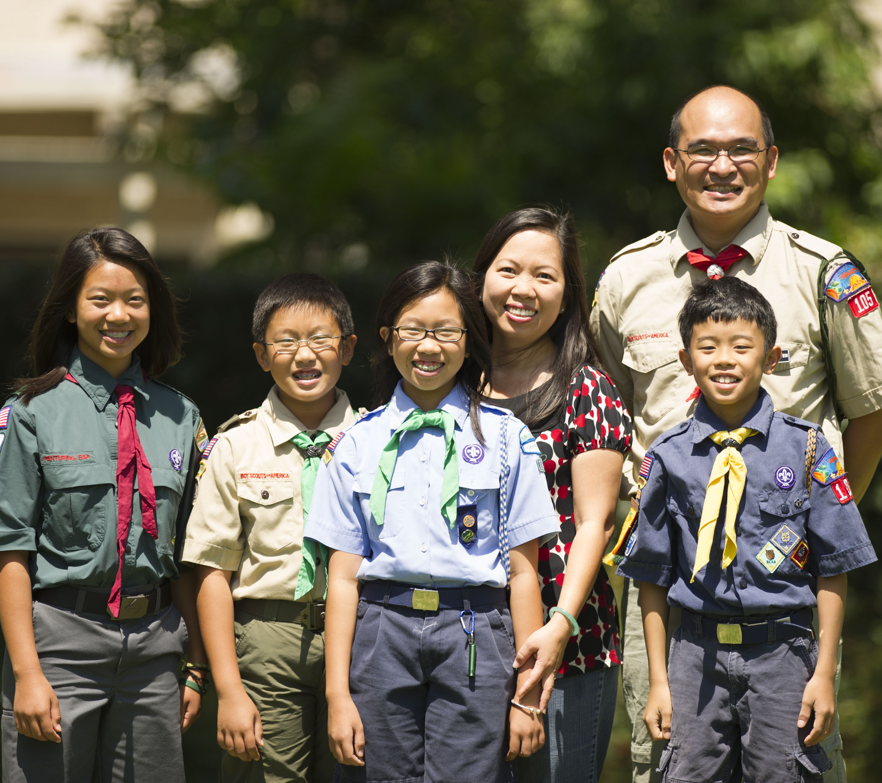
How to reach families?
Three main Options:
In-person, social media, and on-Line!

Slide 9
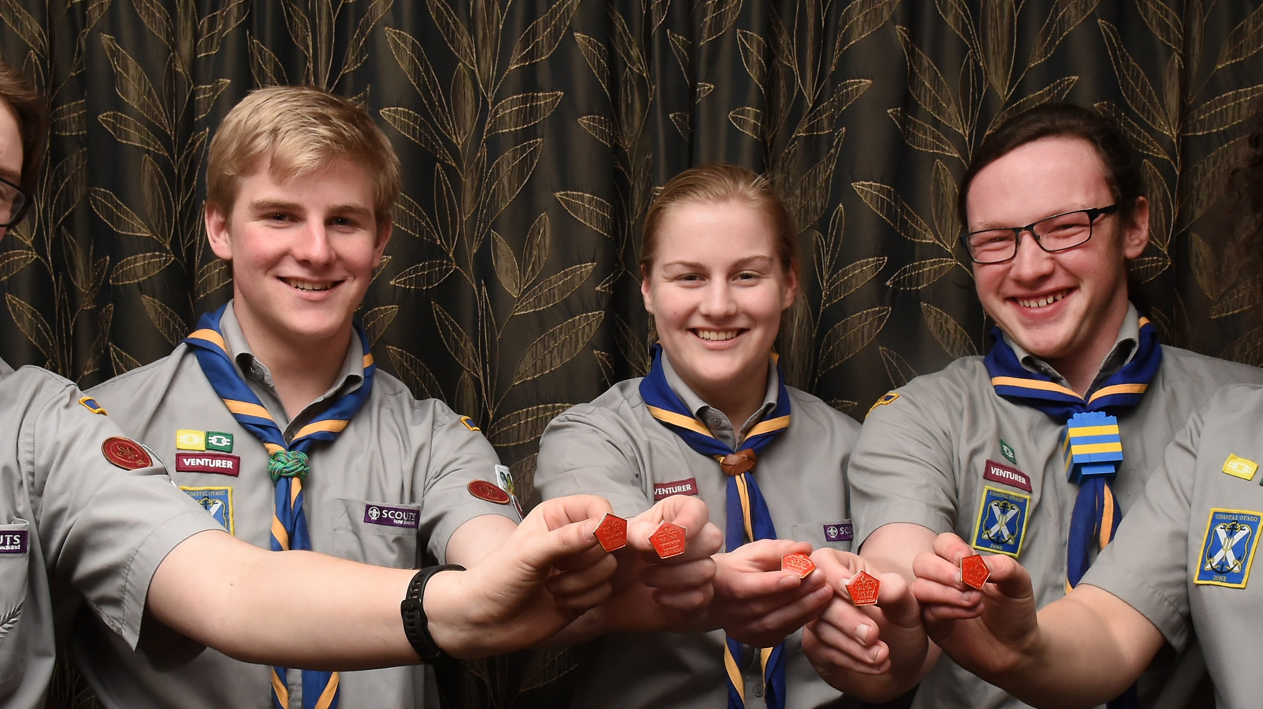
Have a defined Welcome Committee and Plan
Have a basic email address for your organization that can be passed on to other such as Pack441_membership@gmail.com
Welcome emails set up to send to interested people as well as someone who does follow-ups and invitations.
Well-Built Website and social media accounts set-up with someone in charge of managing these venues.

Slide 10
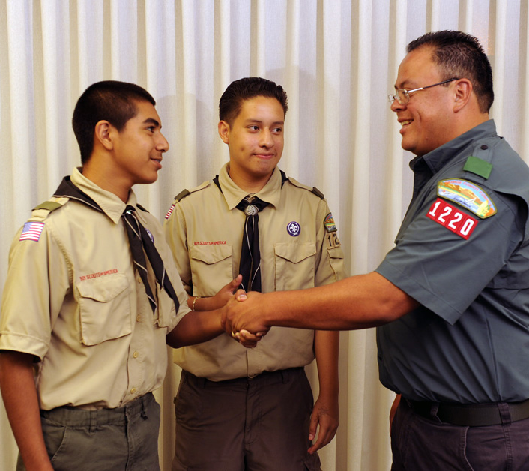
In-person events Recruiting

Slide 11
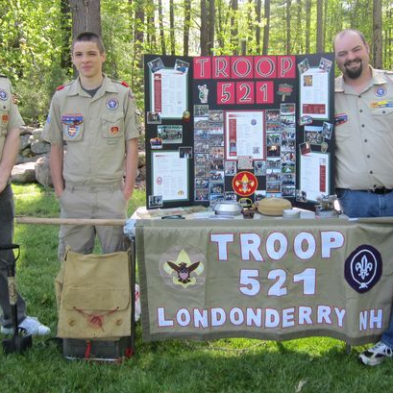
In-Person RECRUITING ideas
Host an event in a city park
booth during city/municipal events
booth at welcome back to school events
Invite Potentials to attend an event
Blue & Gold or Court of Honor or hike
Give out information During Popcorn Sales
Sports and Scouting can co-Exist. Don’t forget to promote scouts with your sports teammates

Slide 12
Figure out your Marketing techniques: Keywords and phrases
Avoid using the word “Recruit” and “Join” in the advertising, instead use “get to know, Find out, & Explore”
Find a good vision statement for our troop/pack:
“Young people, leading skillfully, making good choices, serving others!”
“Scouts having fun, enjoying adventures, making friends and achieving.”

Slide 13
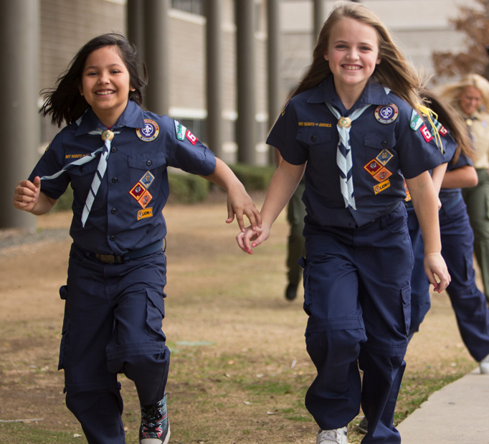
Biggest marketing SEcret: Open-House Welcome Meeting
plan a “fun and Open House” meeting to invite potential Scouts an “open house” outdoor type event with games and have posters of past events.
Have students invite classmates - Kids want to have fun with their friends!
Guests who attend are given pack/troop Memorabilia after attending the event. That requires advance planning, but this instant gratification is worth.
After the meeting, the Scoutmaster or specific leader follows up with a call to the parents to explain the program. This is important, because sometimes there is more resistance from the parents than from the middle schoolers.

Slide 14
CASE STUDIES
A Case Study from the North Florida Council
The North Florida Council did Join Scouting nights a little differently, and it worked. They used a station-to-station format instead of the more-sedentary presentation style. They gave every family a great first Scouting experience.
The result: An 18 percent increase in fall Cub Scout recruiting over the previous year.
More info about this case study at Best Practices Success Story - Scouting Wire : Scouting Wire

Slide 16
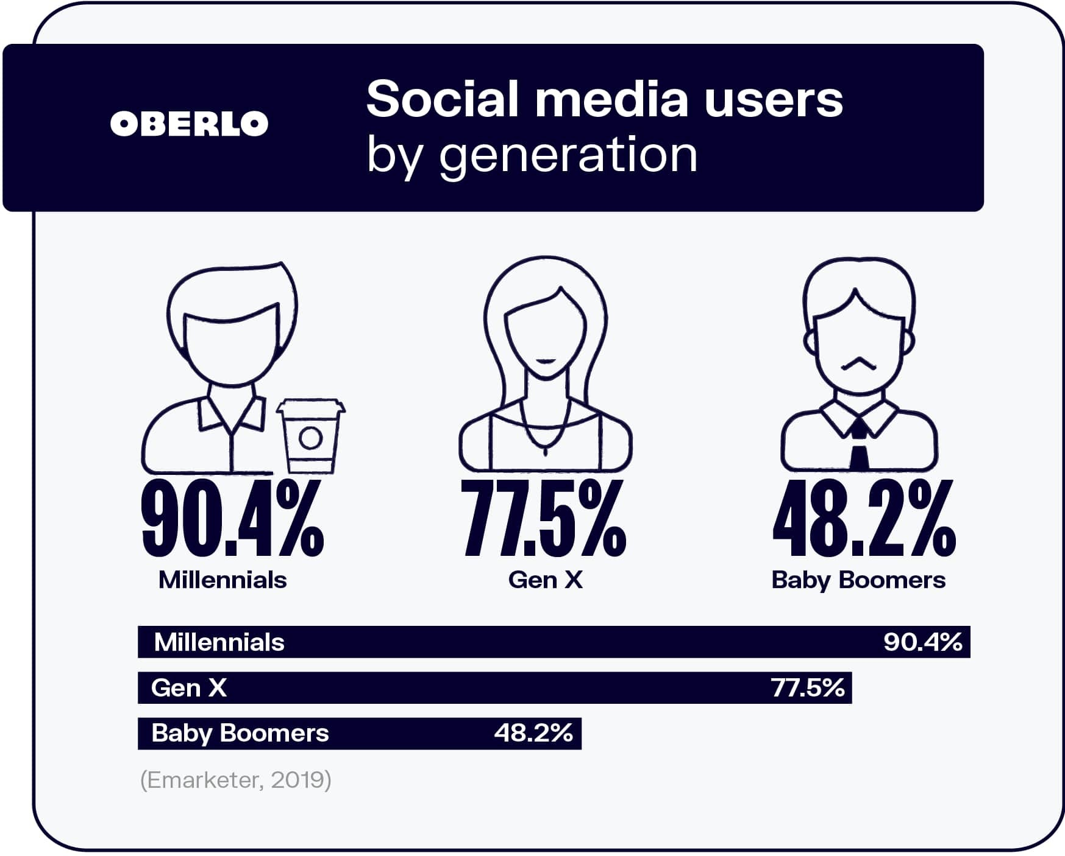

Slide 17
Facebook should be your #1 Target
Create a public Unit Facebook page
Post at least weekly, but aim for daily
Post a combination of content
Original content you create
Re-post from national, GGAc, & Mission peak
Include Promotion of your upcoming events
Cross promote on your personal Facebook feed

Slide 18
Get to know other Marketing Allies
Other online Venues are great too – NextDoor App, Craigslist, etc
SCHOOL RECRUITING – Peach Jar, in-person, or classroom flyers, etc
Place ads in Local Newspapers – Tri-City Voice and East Bay times
Reach out to the City’s Municipal Department such as Fremont Parks and Recreation and Sillman Center

Slide 19
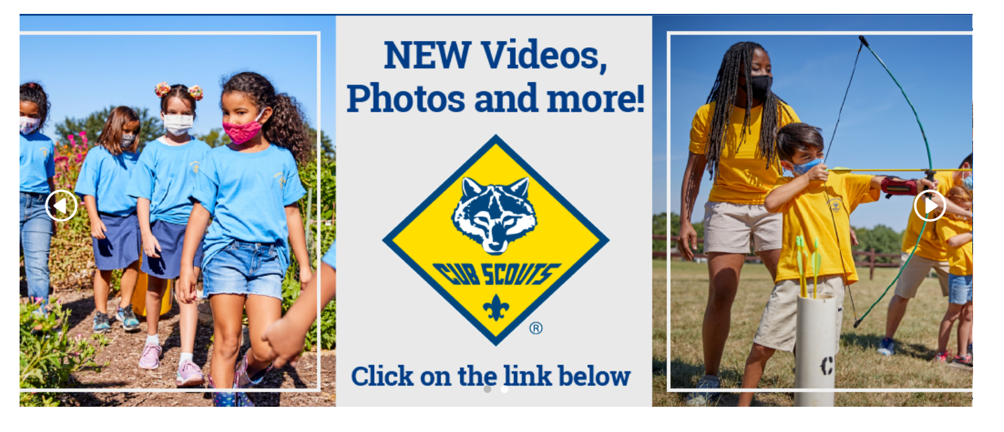
Marketing Hub of Information
BSABSA Brand Center (webdamdb.com)
Marketing and Membership : Scouting Wire

Slide 20
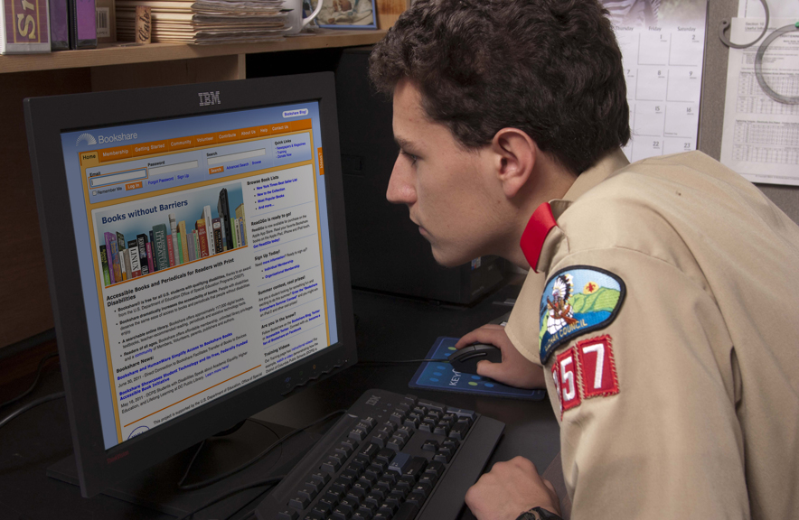
Be Found on the Internet!
National website - https://beascout.scouting.org/ paid advertising by National & council drives traffic to this URL
A “google” search drives traffic to this url
You need to capture and win those that come!

Slide 21
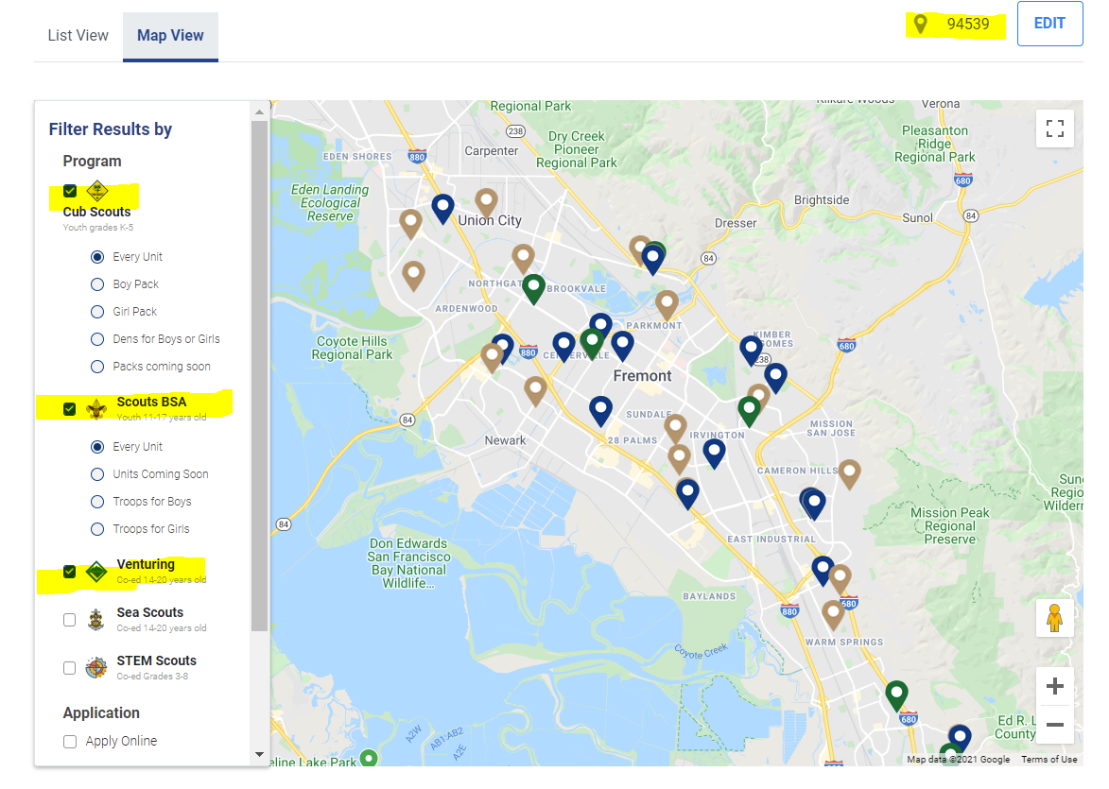

Slide 22
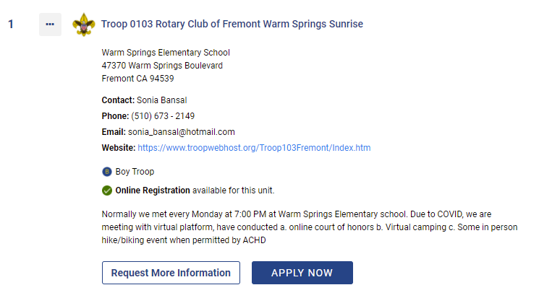
Unit Key3 can edit this data

Slide 23
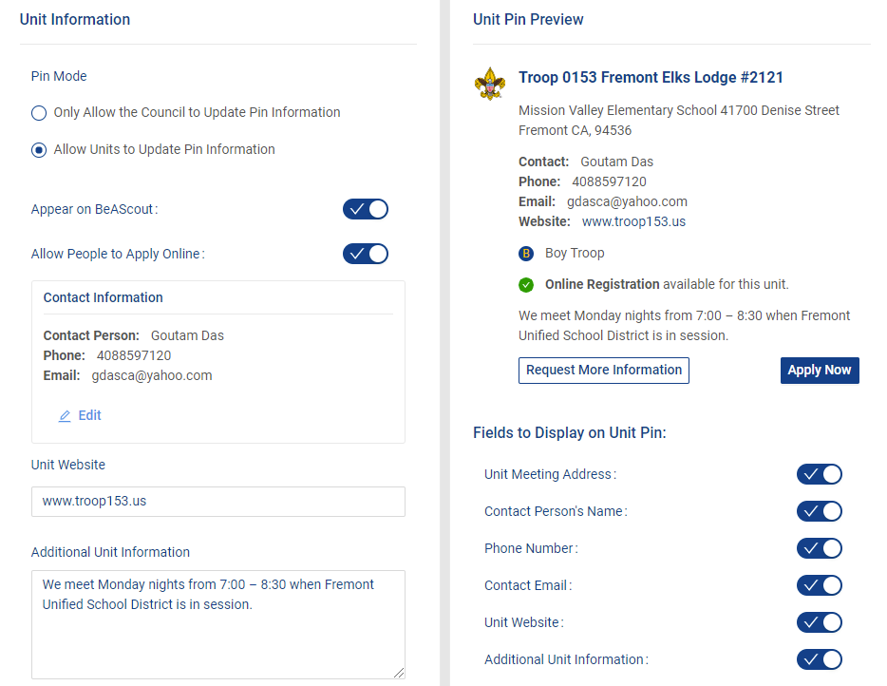
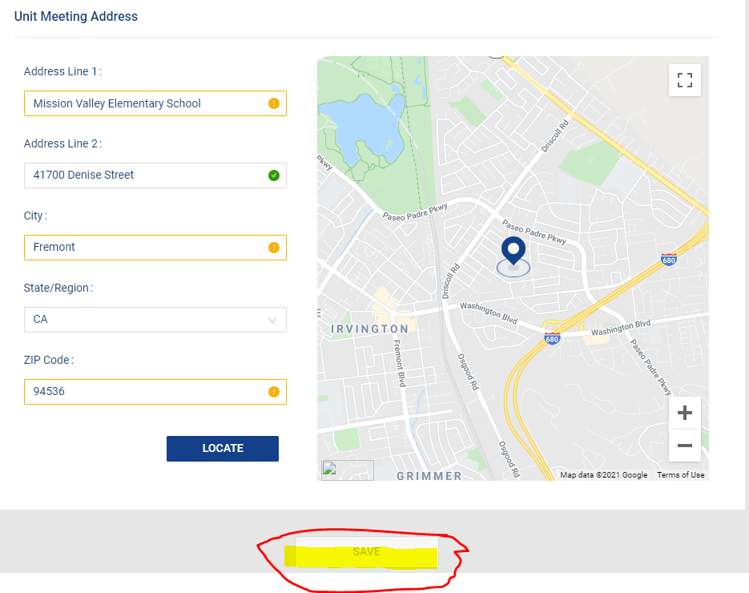
How to update your pin data
Login to my.scouting.org
Choose Roster
Select Unit Pin
Update information & scroll down to Save

Slide 24
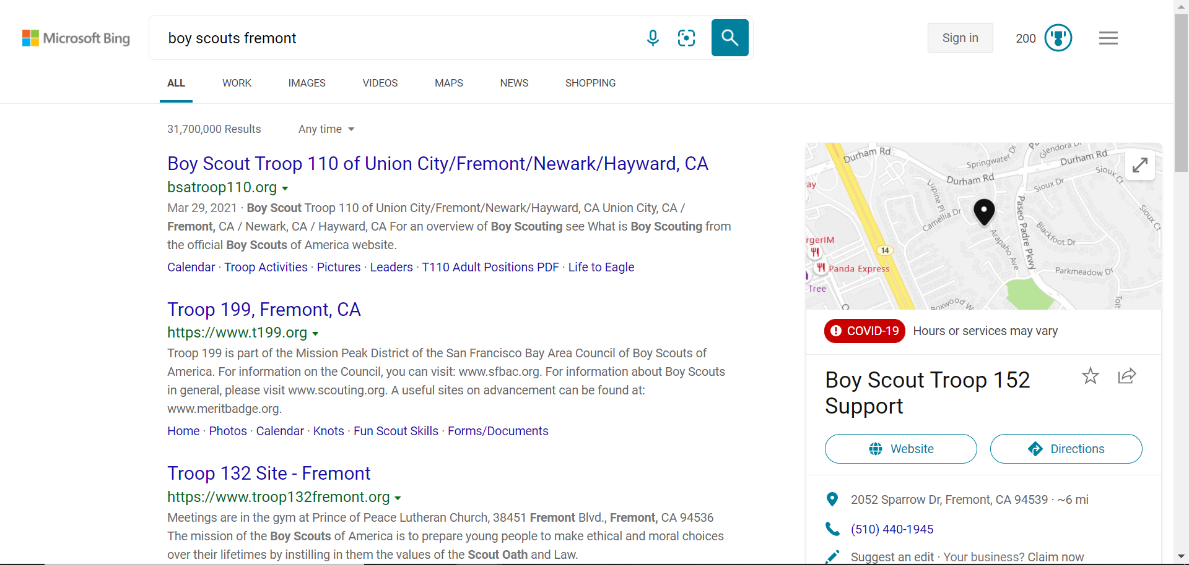

Slide 25
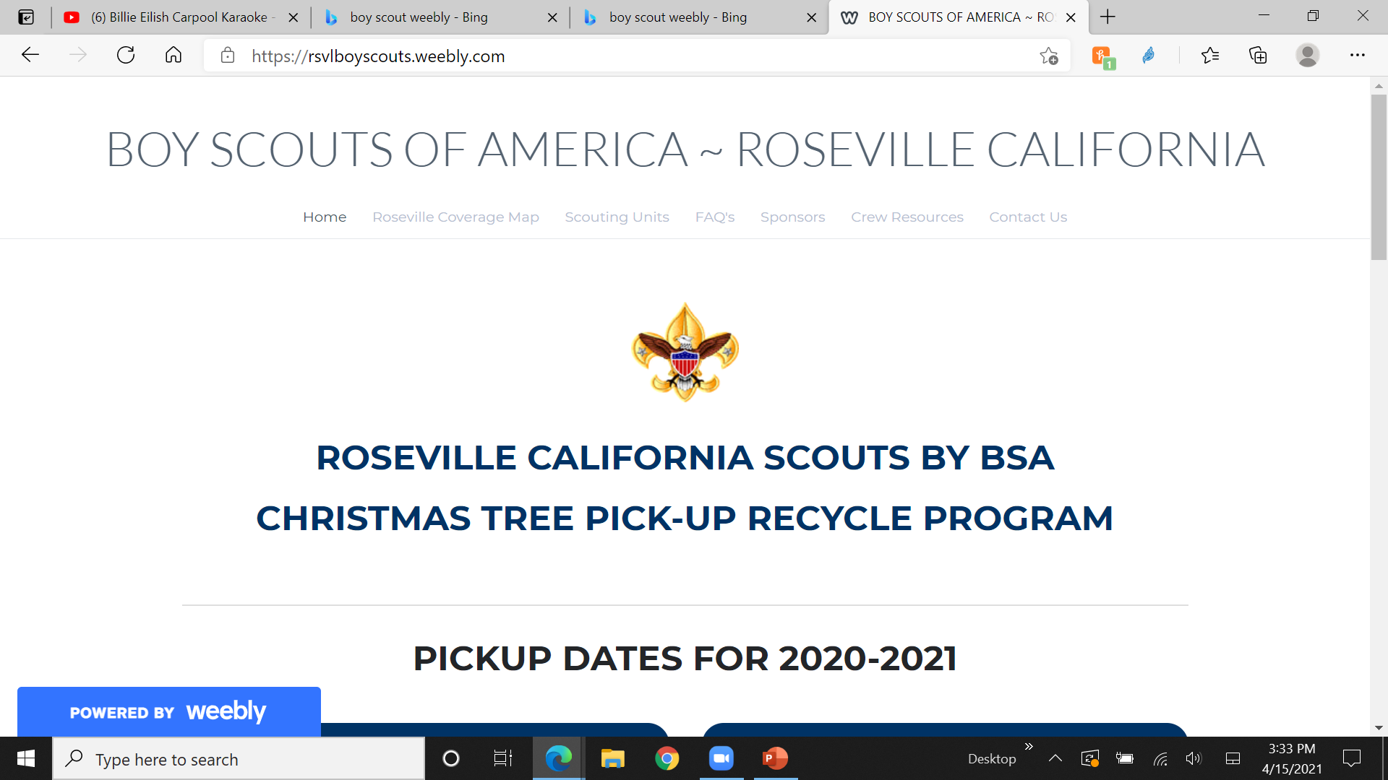
Creating an information Website
BOY SCOUTS OF AMERICA ~ ROSEVILLE CALIFORNIA - Home (weebly.com)

Slide 26
Demo of Application & invitation Manager by Skip Phair
Skip walked through how to manage incoming inquiries & applications as well as how to send invitations. Both tools are found on my.scouting.
This website has several short videos that show similar information
https://www.scouting.org/resources/online-registration/

Slide 27
Summary for Recruiting Tips
Appoint someone to be the Recruiting Committee
Have a booth/tent at community/school events
Organize an Open House Scout event
Have fun events and activities
Troop/Pack Memorabilia for the guests
Follow up with Guests/Parents
Cross market information with sports/other activities
Establish a Facebook presence
Join us with marketing allies
Update your Be a Scout page online
Establish an Information website

Slide 28
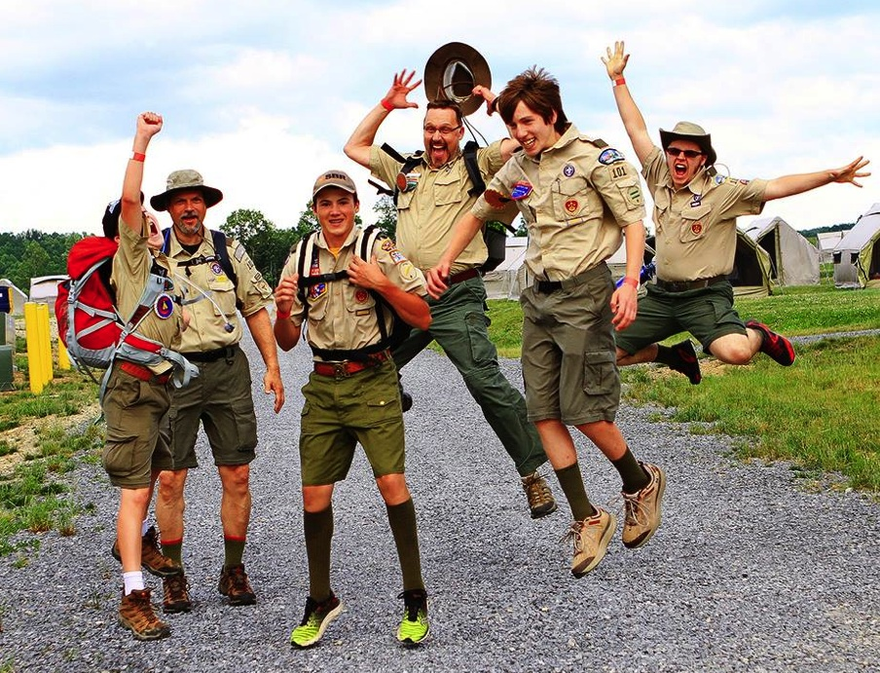
Time to have More FUN and More Scouts!

