Slide 1
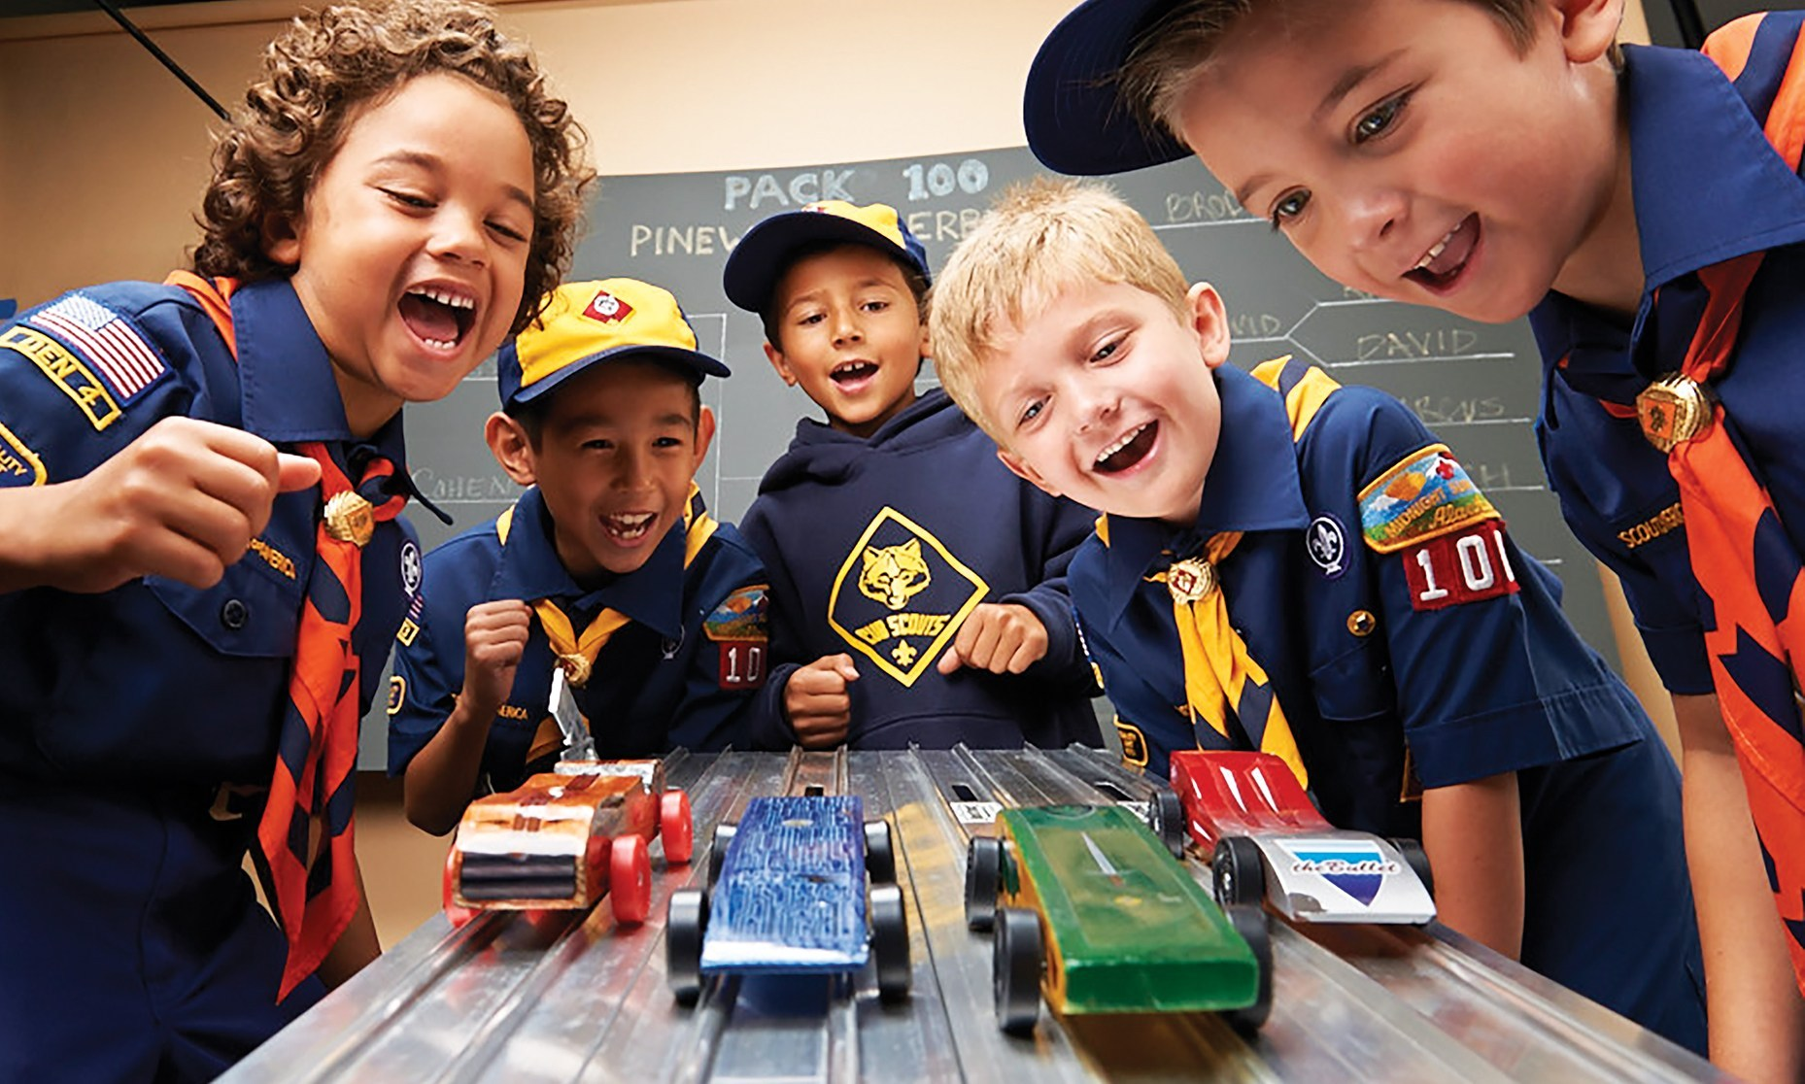
How to host a
Pinewood Derby during COVID
February Roundtable Meeting
Mission Peak Council
Eve Marie Ruhlman

Slide 2
Pinewood Questions before starting
What do parents and Cub Scouts like about this event?
What can you do to make it special this year?
How do you want them to feel when it is over?
Be prepared to make changes in the event.

Slide 3
Current COVID StatuS
With the current loosening of current the COVID shelter-in-place health order. Here are the biggest takeaways:
OUTDOOR Small family gatherings of NO MORE THAN 3 Households; families should avoid Super Bowl Parties and other large gatherings
Family Camping (one family per website) NO GROUP FAMILY CAMPING
Maintain all previous socially distancing guidelines: masks, 6 ft apart, gloves, use hand sanitizer
The Council Policy is that we take analyze all 7 County Health Orders in our District and choose the most restrictive as our guide to what we allow.

Slide 4
Two MAIN OPTIONS
HOST VIRTUAL EVENT
HOST SOCIAL DISTANT RACE EVENT

Slide 5
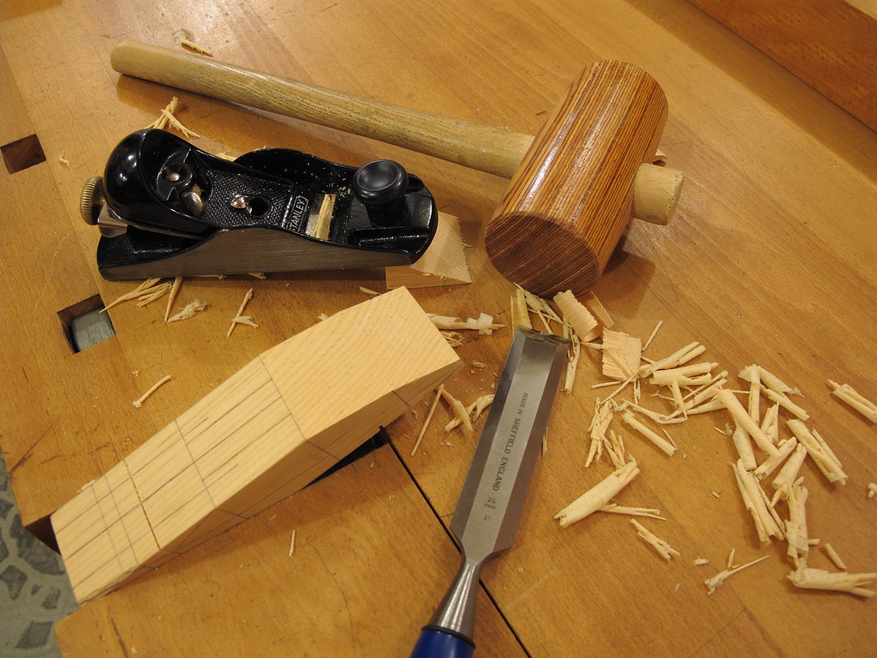
Safely Making the Derby Cars
Home Depot Help
Scheduled Drop-off and Pick-ups
HEAVY Parent Involvement?
Other ideas?

Slide 6
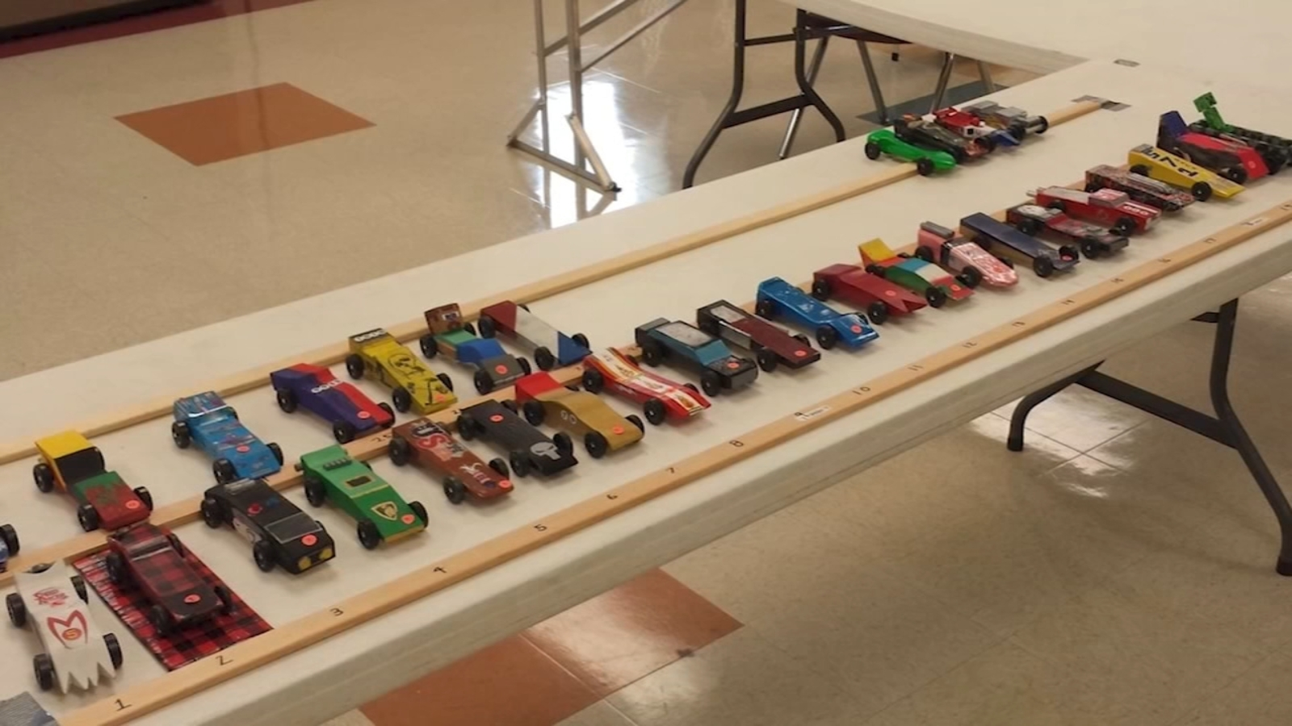
HOSTING VIRTUAL EVENT
1) CHOOSE VIRTUAL PLATFORM
Zoom or Facebook Live Event
2) PICK RACE CAR WITH CARE
Great Camera Angles and Bright Lights
Big area – Indoor and Outdoor Options?
Great Internet Connection
3) GOOD RECORDING ELECTRONICS
Something better than Phone Cameras

Slide 7
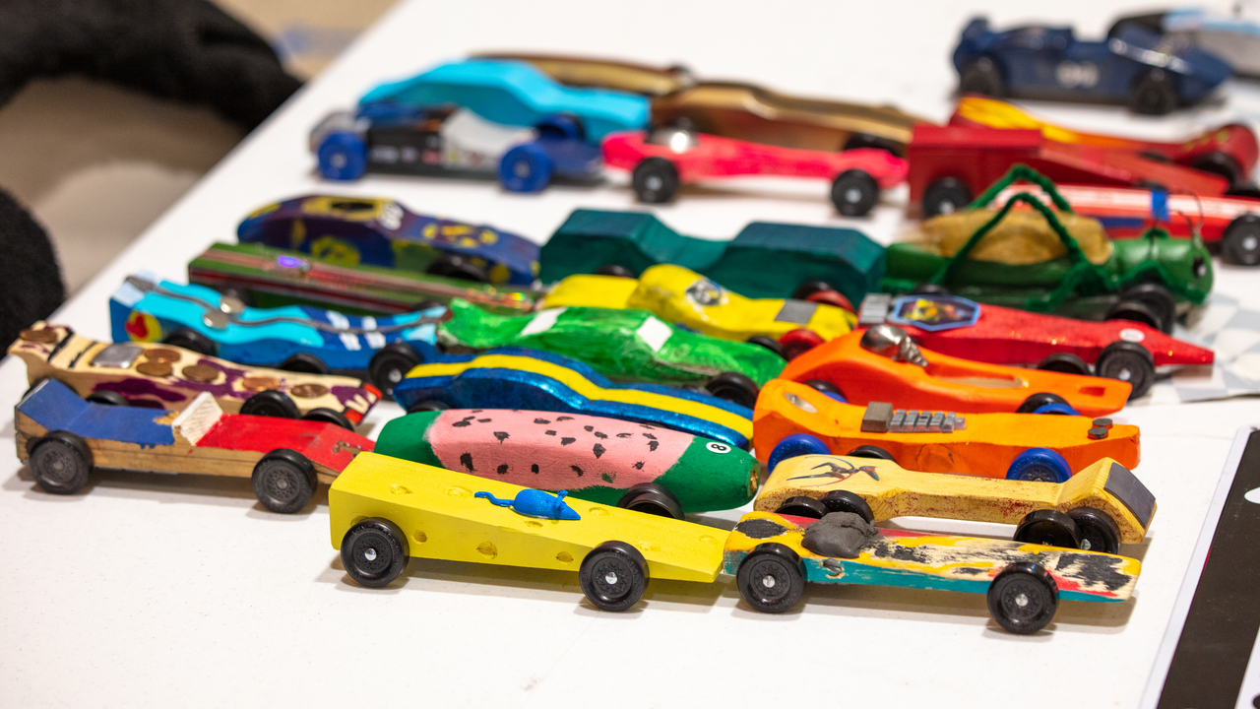
HOSTING VIRTUAL EVENT
4) STRONG LOGISTICS
Good Drop-off Location/Time/Schedule Contact Free
5) GOOD EMCEES
Someone to keep the kids’ attention during races and bouncy voice to keep their focus.

Slide 8
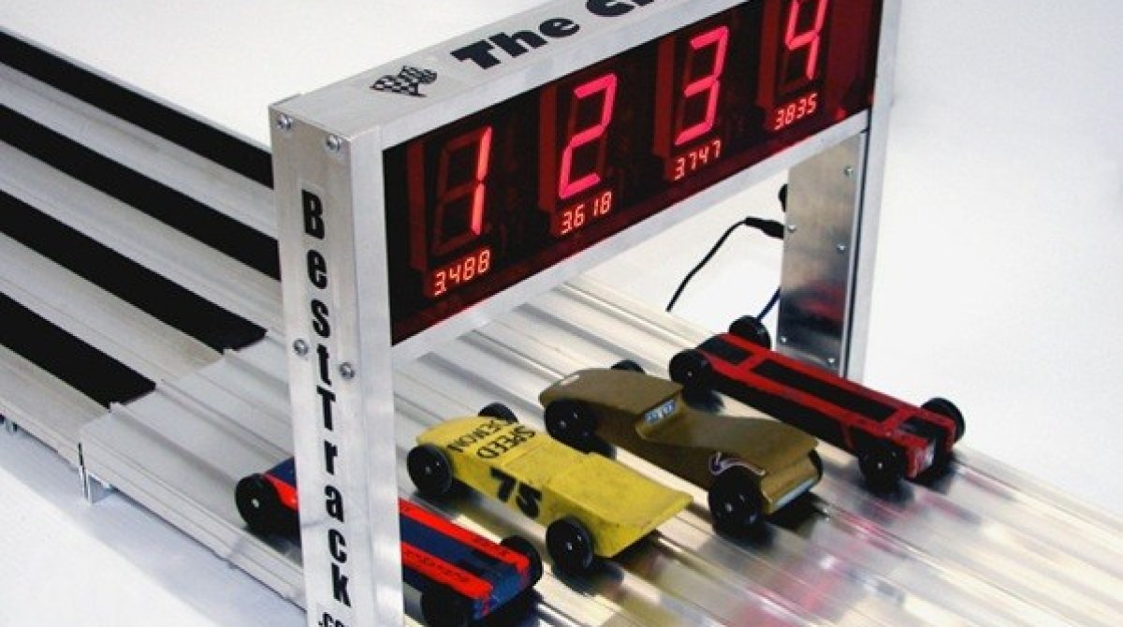
ADDITIONAL IDEAS FOR HOSTING VIRTUAL EVENT
6) *** PRE-RACE SHOWCASE ***
Display and fun announcements of new cars
Showcase and fun zoom in of cars
Live or Recorded Video
7) *** FUN RACE INTERVALS ***
Fun Jokes, Revolving PowerPoint of Derby cars at different angles, adult skits, etc.

Slide 9
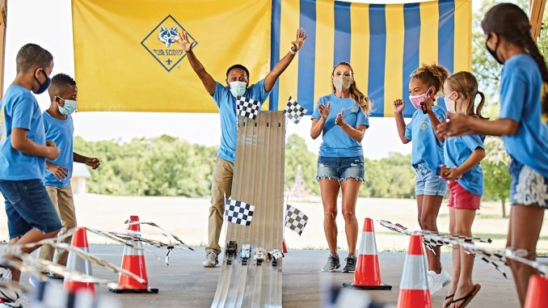
Host Social Distant Race Event
1) PREPLAN, PREPLAN, PREPLAN!
Government Regulations and CDC Guidelines and updated check-off list
2) LOCATION SELECTION
Local Park or large outdoor location so area to spread out 6 feet apart
Use Cones or Markers to set-up family “bubbles” with camp chairs

Slide 10
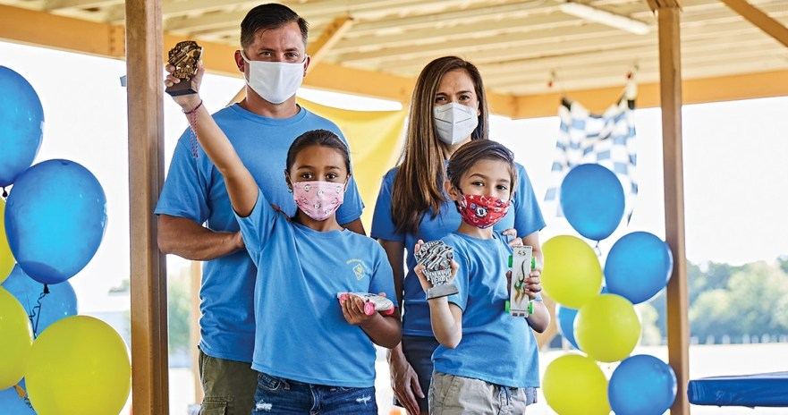
Host Social Distant Race Event
5) RACE LOGISTICS
See this more as a show for the scouts and their families to come watch rather than participate in.
One Person in charge of handling ALL of the cars with gloves, one at the beginning and one at the finish line with transportation in the middle.
Any other ideas?

Slide 11
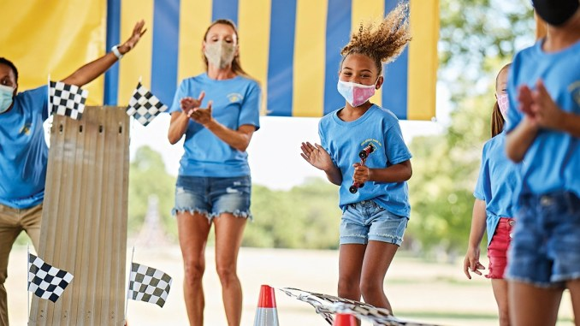
Host Social Distant Race Event
4) PRE-SET AND PRE-SEND RULES FOR RACES
Set-up rules and regulations for the race and send them to the scout families prior to the race such as:
Send COVID Symptom Check-off list to families
Families only, guests can watch online/on video
Sanitizer available and used to disinfect equipment between groups
Face Masks are required (of course)
NO Buffet like food setting, BYOB

Slide 12
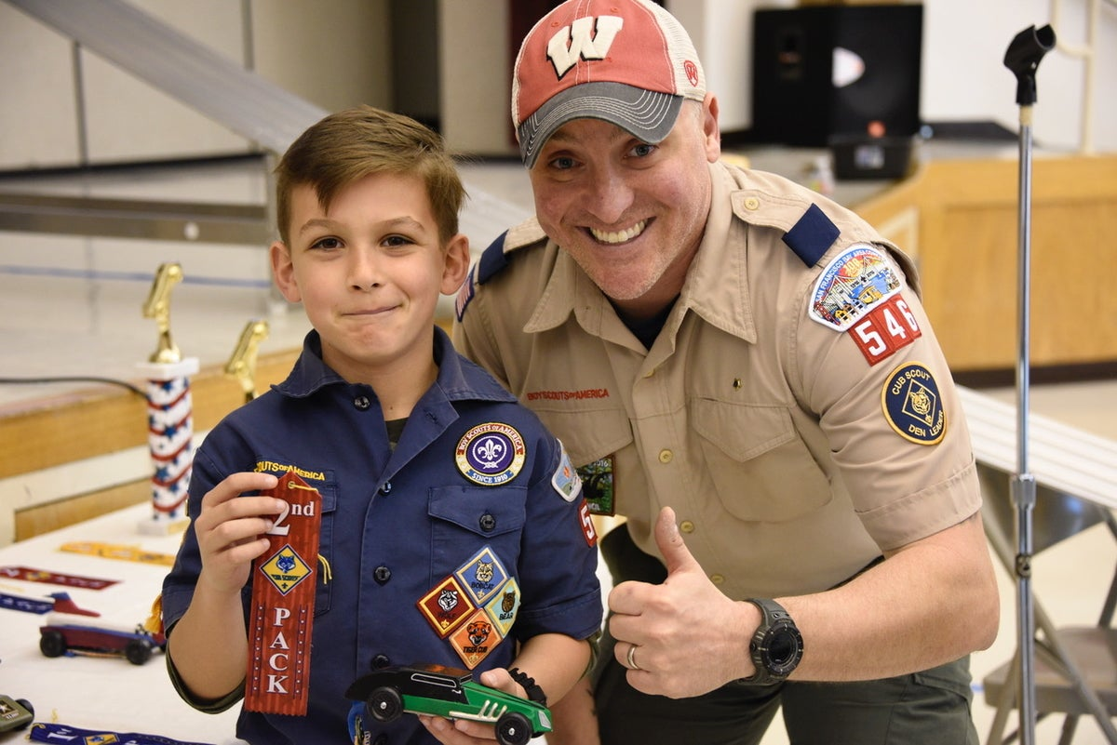
Host Social Distant Race Event
5) RACES BY RANKS
For larger Packs, select times that Bears, Webelos, Tigers, etc compete against each other, decreasing the number of attending people.
Have a videographer filming (and later editing the video) for the rest of the scouts to watch.
Award prizes at the end of the heats and clear and sanitize the area until next group arrives.

Slide 13
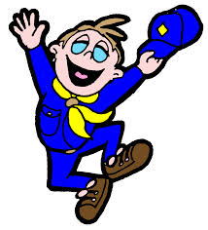
So what are YOUR goals for YOUR Pinewood Derby?
Fierce Competition?
Family Friendly Event?
Online Display Show?
Comedy and Fun Zoom event?
Pre-recorded Movie?

