Slide 1
My.Scouting Tools
Steve Conn
Mission Peak
sfconn@gmail.com
510-220-6710
01/24/21

Slide 2
Helping your Units
Unit Commissioners should train their Unit Leaders
Committee Chairs & Unit Leaders need to be “fluent”
Unit delegates need to use regularly

Slide 3
Functions Unit Key3 Can Do
Delegate Functional Rolls
View & Print Training Status Reports (including YPT)
Give Credit for Training (including YPT)
View/Print Rosters & Membership Cards
Update Member’s Contact Info
Update Unit’s Social Media Info
Unit Pin Management via BeAScout
Delegates disappear 12/31 each year but cannot be reassigned until after recharter has been “posted”
Notes:
So what does being a Key 3 really mean? It means that you can update certain contact information for members in your district down to the unit level. You can also record training, view and print training status reports, roster information and print membership cards.
You also have the ability to assign someone as a Key 3 delegate, or other functional role to give them access to certain tools – like a Training or Membership Chair or a Youth Protection Champion.

Slide 4
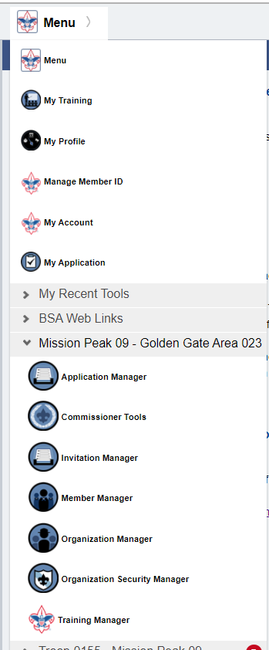
My.Scouting Unit Tools
Notes:
After logging in, click on Menu
After clicking on Menu, you may have multiple folders, click on the Unit you wish to manage
If you don’t see these tools under the Menu list, then you need to contact your registrar to ensure you’re registered correctly in ScoutNET. Once information is updated in ScoutNET, it requires an overnight synch and on the following day you’ll have access.

Slide 5
Organization Security Manager
Unit Key 3 can Assign Positions (privileges to other unit registered adults)
Allow others to access My.Scouting Tools
YPT Reports & Give Credit
Training Reports & Give Credit

Slide 6
Example of Org. Sec. Mgr. screen

Slide 7
Example of Assigning a Position
Notes:
You can only see and choose from registered adults within the organization you are managing.
End dates can be no greater than 12/31 of the current year.
You can’t do any of this until after your recharter has been successfully “posted” by the Council Registrar

Slide 8
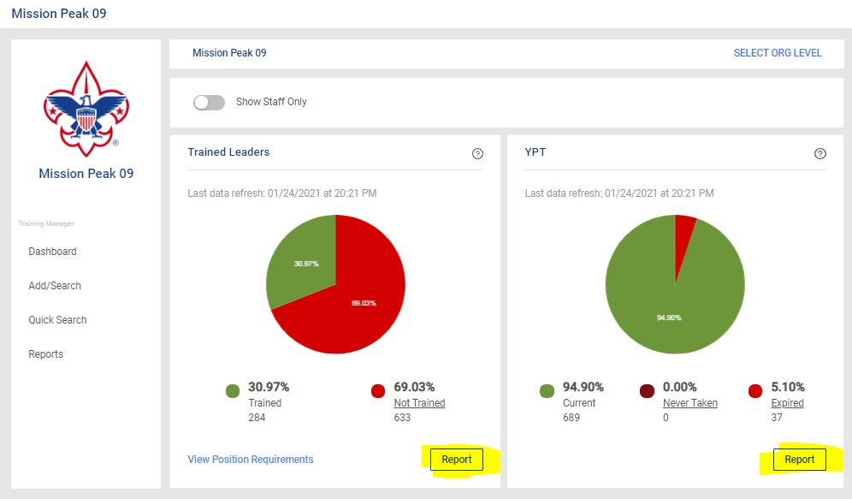
Training Manager
View & Print either YPT or Trained Leader Reports
Toggle buttons for Chart Details on screen vs. run PDF/Excel reports
Either YPT or Required Training

Slide 9
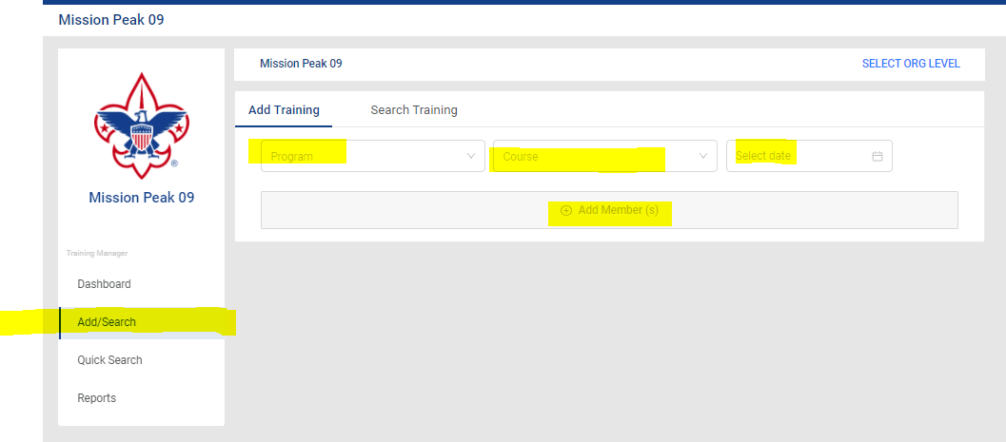
Training Manager
Can give credit for training classes taken
Click “Add Training” icon
Then in order choose:
Program
Course
Date
Add Member
Notes:
Particularly useful if someone takes YPT but the system does not recognize that they have completed it.

Slide 10
Member Manager
Update members’ mailing address, email, & phone numbers
Print rosters and membership cards
Including BSA Membership ID#’s

Slide 11
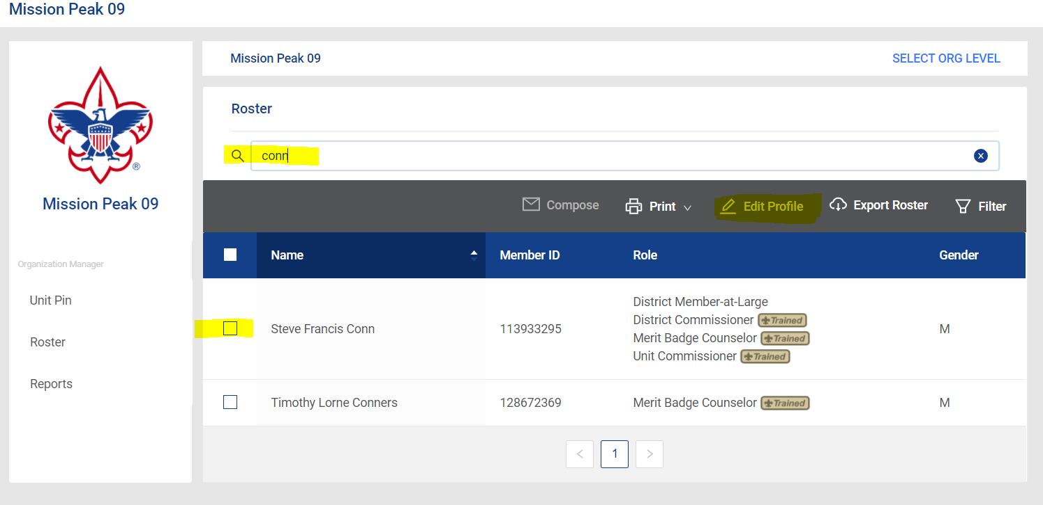
Search for the person you want, check the box, and click “Edit Profile”

Slide 12
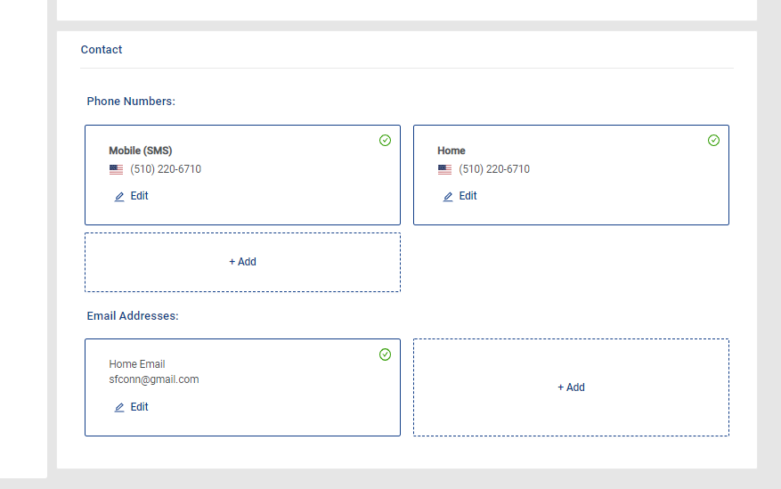
Top half of page is “grayed out” You can only edit bottom half data

Slide 13
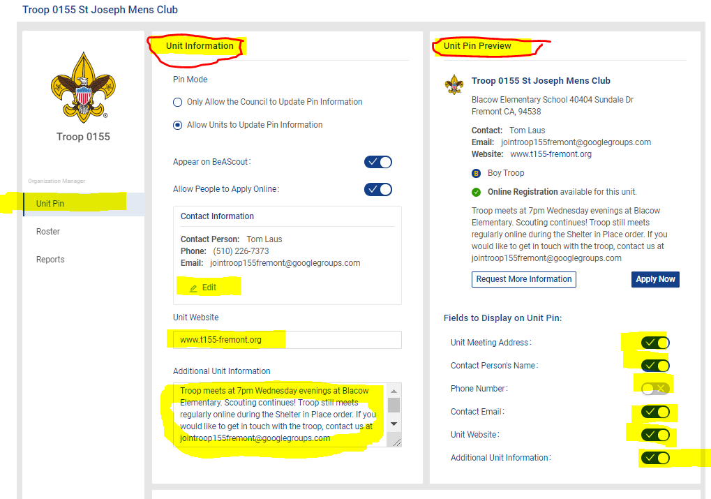
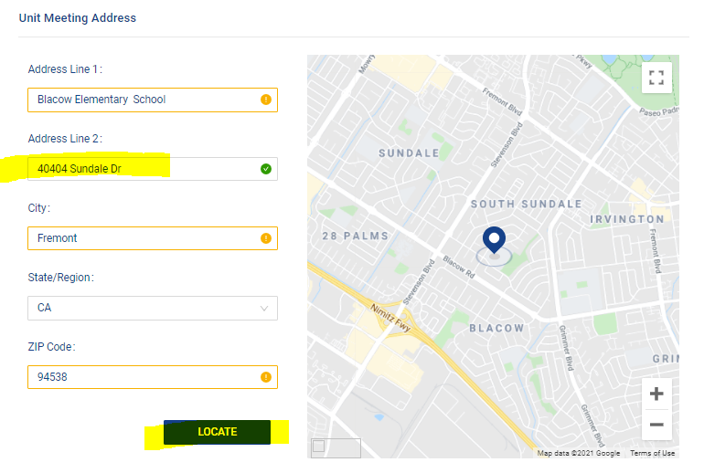
Organization Manger
Unit Pin Management for BeAScout.com
Unit’s Website URL,
Contact information: name, email, phone, other
Location of pin on map

Slide 14
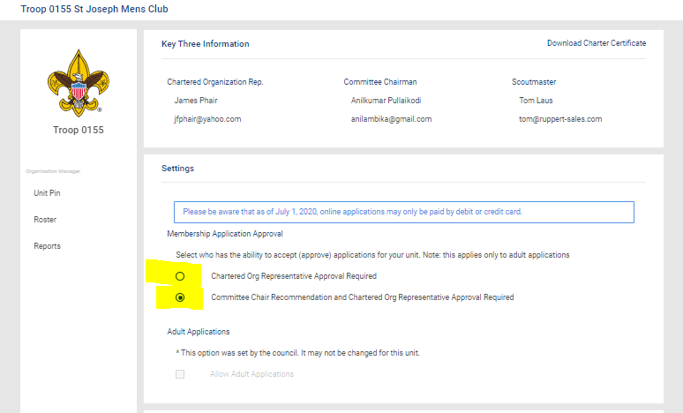
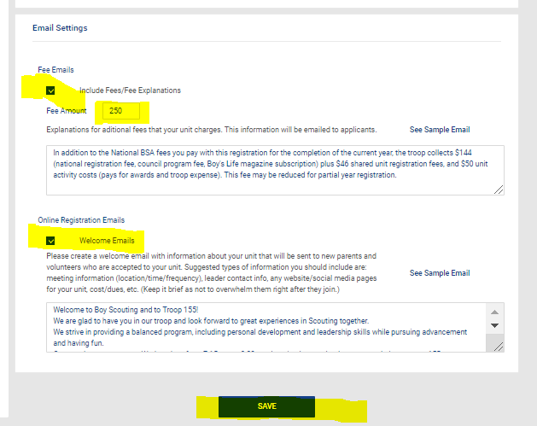
Organization Manger
Online Registration Settings:
Payment options, Unit Fee Message, Automated Welcome Email

Slide 15
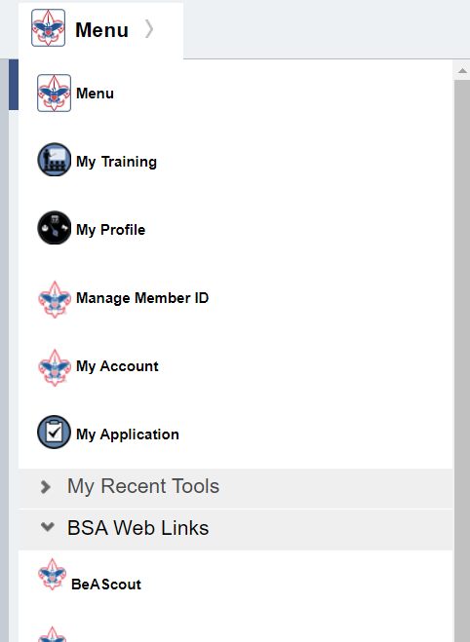
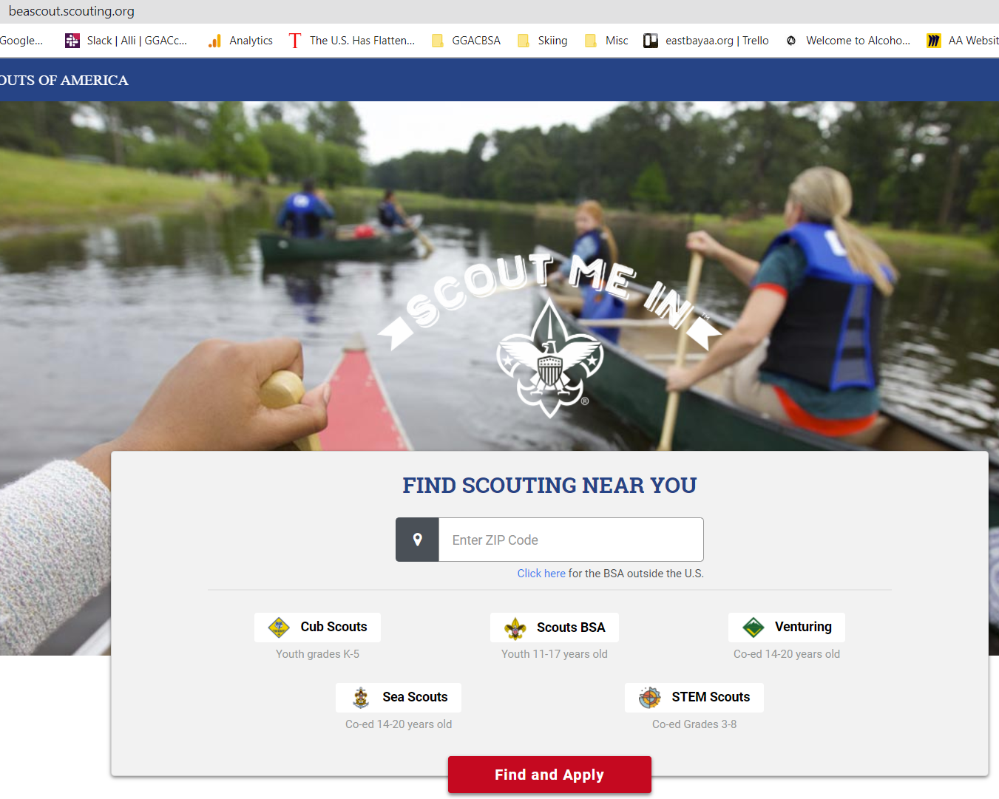
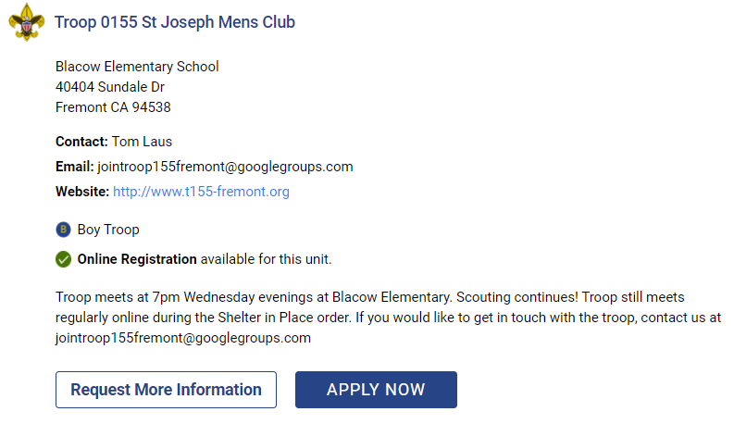
Check Your Work!

Slide 16
Thank you!

