Slide 1
Effective Annual Cub Scouts Program
How to plan and implement an
Pack 447
..while having fun and making memories for a lifetime!

Slide 2
Who are we?
Mission Peak District
Chartered Org: First United Methodist Church of Fremont
Community: Gomes Elementary School
# of Scouts: 60-70 (approx.)
Boys and Girls (starting 2019)

Slide 3
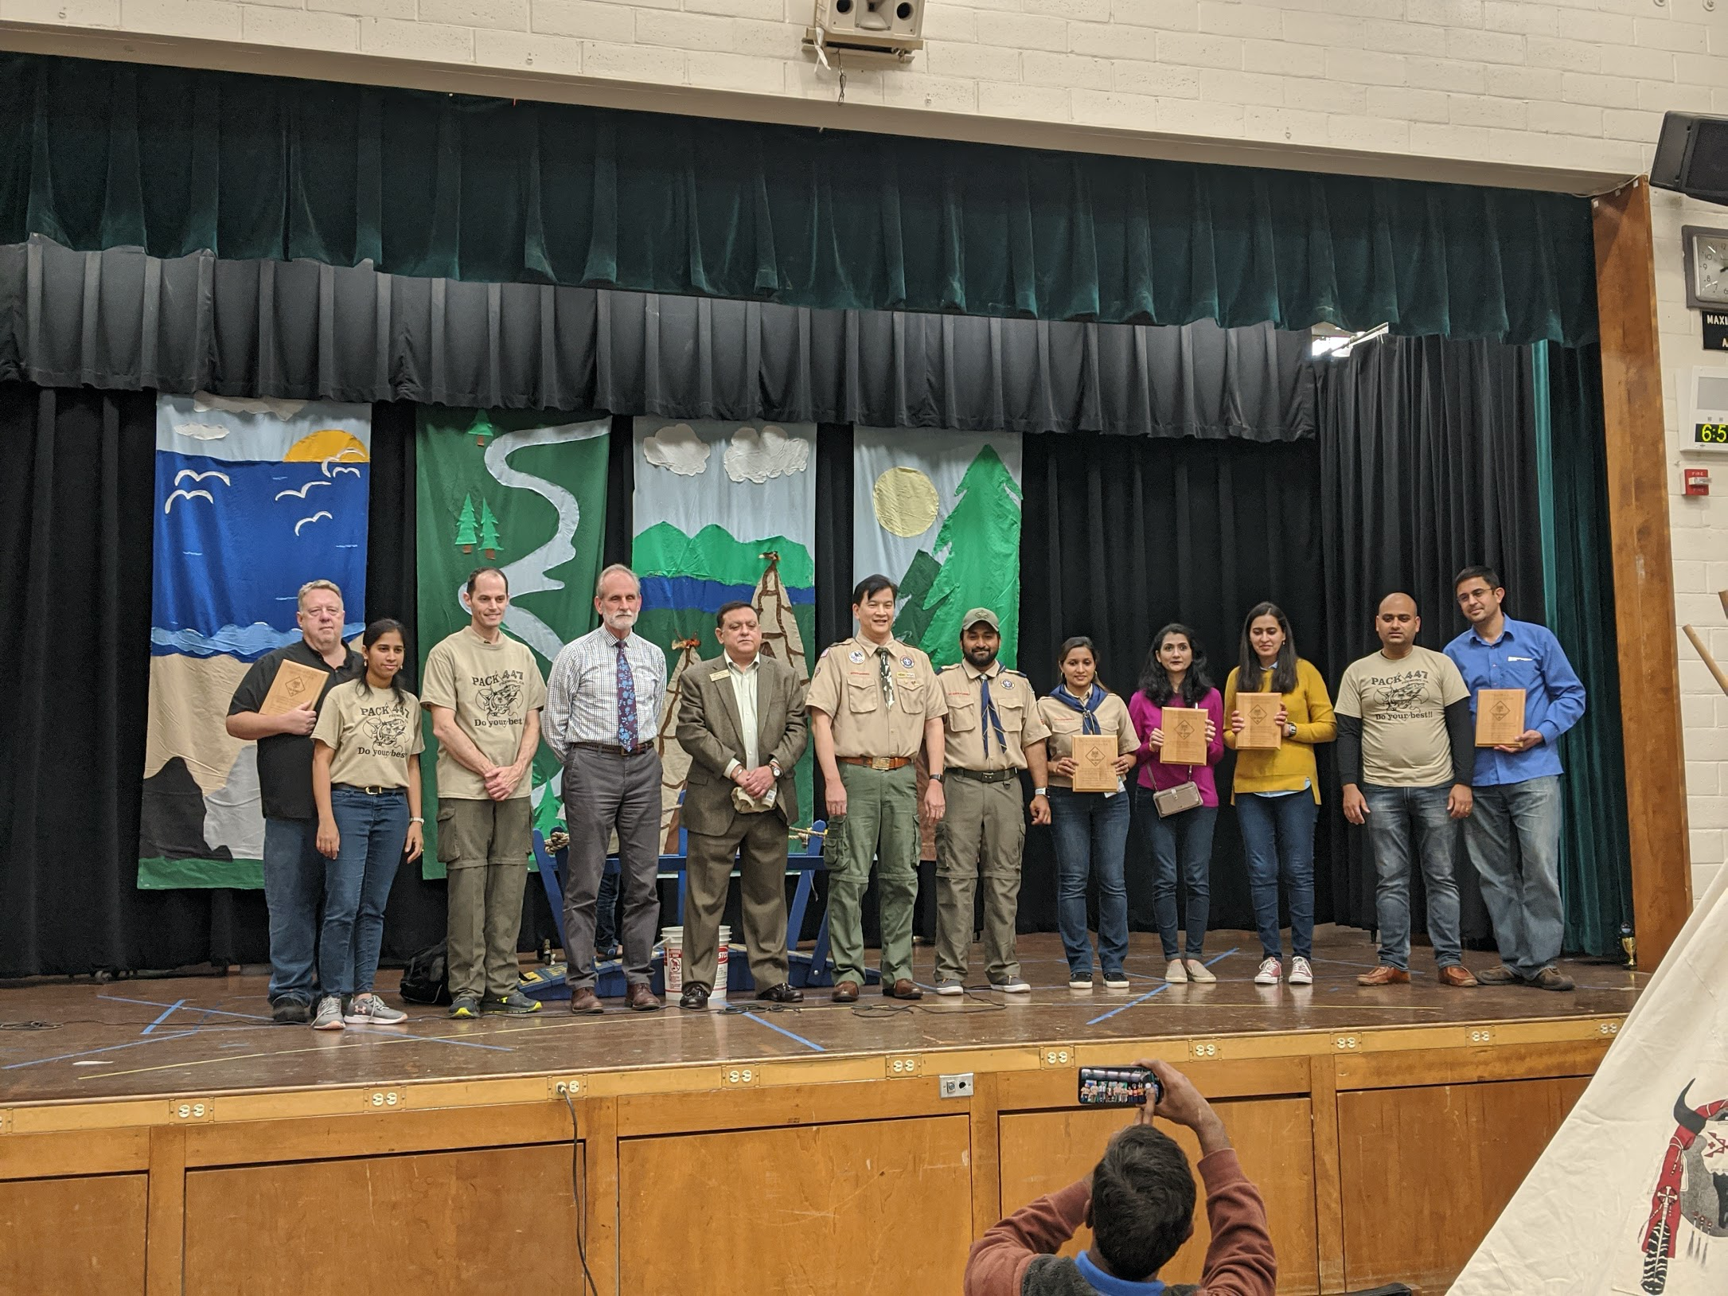
50 Years of Scouting
Paul Sethy - one of the first scouts to graduate from Pack 447 - current ACWD board member presenting award to Charter Org Chair Paul Fong with Principal Doug Whipple (fmr. Eagle scout)(in background)
Pack 447 Leaders at 50th year celebration B&G Dinner

Slide 4
Who are we?
Mission Peak District
San Francisco Bay Area Council
Chartered Organization
First United Methodist Church
Paul Fong
Pack Committee Chair / Co-Chair
Godhasree Prakash
Roopa Seetharamaiah
Treasurer
Jay
Pack Committee
Shruti, Narayan, Jignesh, Jin
Cubmaster /
Asst. Cubmaster
Rajesh Bhima / Chaitanya
Den Leaders /
Asst. Den Leaders
Jignesh, Julie, Narayan, Preethi, Wenlong, Pallavi, Kapil, Sowbhagya
Notes:
Pack Committee
Made up of parents, leaders, and other caring adults the pack committee works to support den leaders and the cubmaster.
Pack Committee Chair
The top volunteer in the pack is the Pack Committee Chair. They are responsible for ensuring enough qualified adult volunteers are in place to provide the program. They lead the pack committee meetings.
Chartered Organization
This is the organization that partners with the Boy Scouts of America to deliver a Scouting program. They adopt Scouting to serve the youth in the community.
Chartered Organization Representative
This person appoints the Pack Committee Chair and approves all adult leaders. They provide resources from the chartered organization.

Slide 5
Committee Meetings
Led by the pack committee chair and supported by the pack committee and Cubmaster
Den leaders and interested parents attend and participate
Follows a regular order:
Feedback on the previous month
Plan for the current month
Treasurer Report
Planning any other event in near future.

Slide 6
Annual Program
Annual Program
Planning starts early - June
Anchored in marquee events
Pack meetings align with School Year
Popcorn
Derby
B&G
BBQ
Planning
Jun
Jul
Aug
Sep
Oct
Nov
Dec
Jan
Feb
Mar
Apr
May

Slide 7
Pack Meetings
How do we go about it?
Opening-Awards-Activity-Announcements- CubMaster minute
Themes are around Scouting Core Values
Provide an opportunity to meet level requirements
Resources: Cub Scout Leader Book –Den & Pack Meeting Resource, Boys Life Magazine
Challenges:
Keeping Cub Scouts Engaged (New Ideas?)
Keeping order and discipline (balancing w/ fun)
Enrolling parent volunteers (New ones are tough)

Slide 8
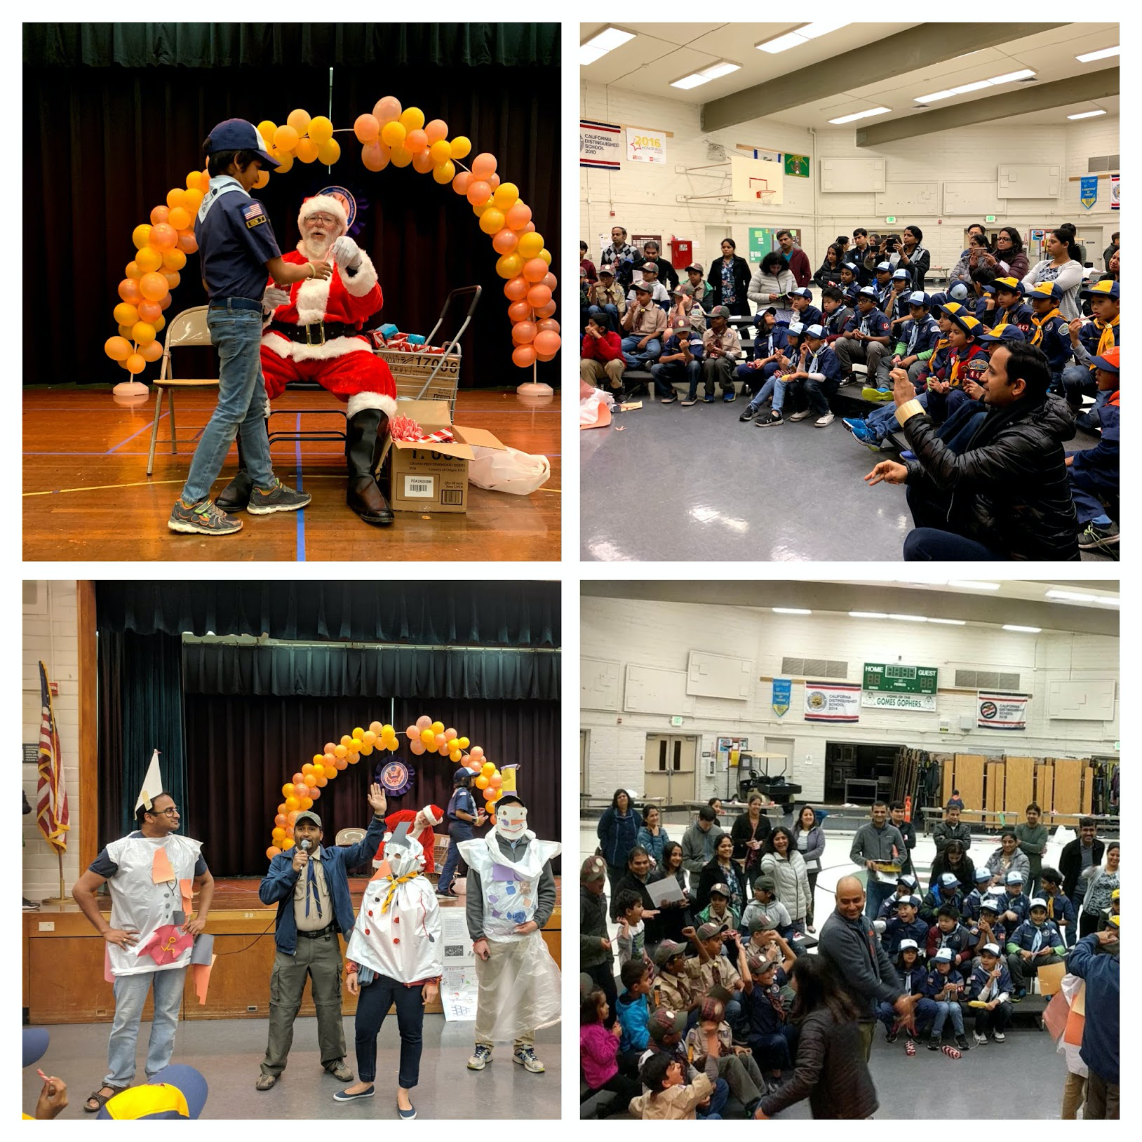
Pack Meeting Activities
Events
Opening Game Night
Halloween
Turkey Dress Up
Christmas
Pinewood Derby
Blue And Gold Annual Dinner
March To Health
Outdoor Pack Meeting
Advancement

Slide 9
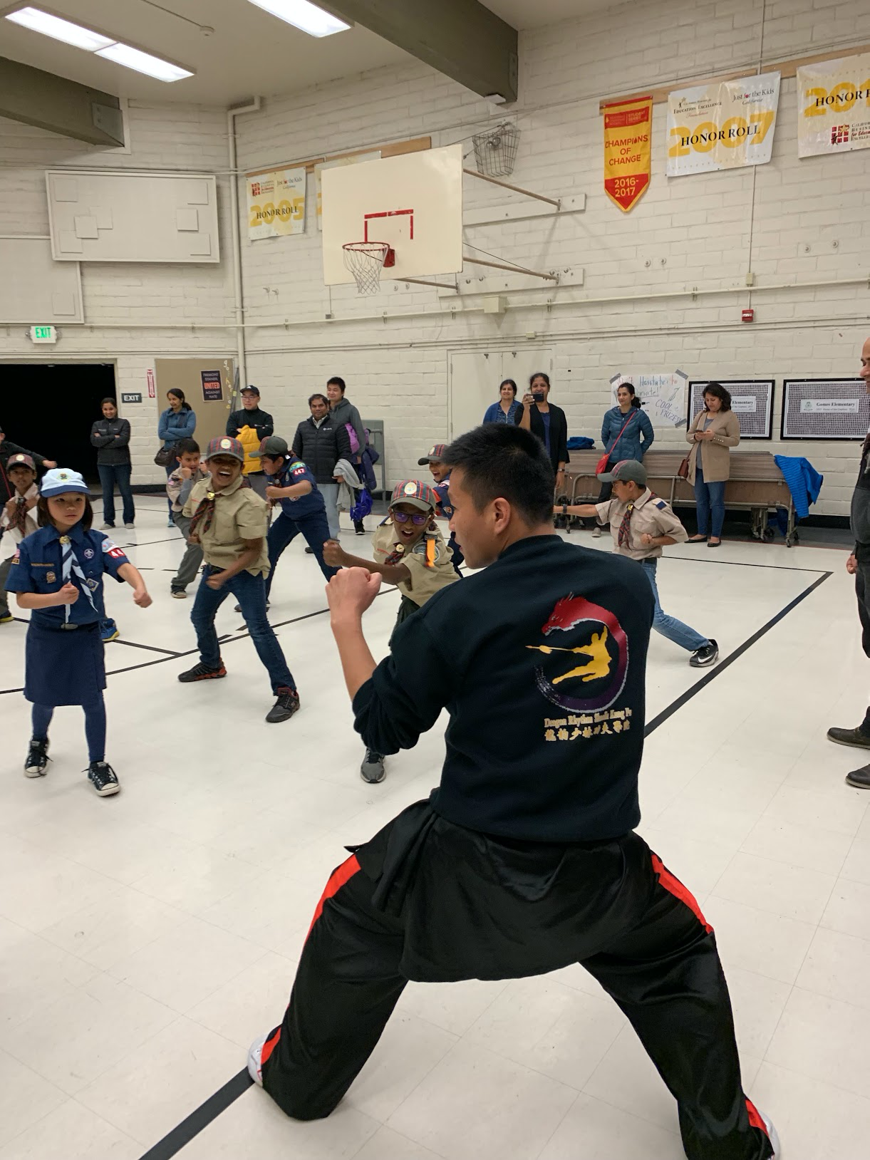
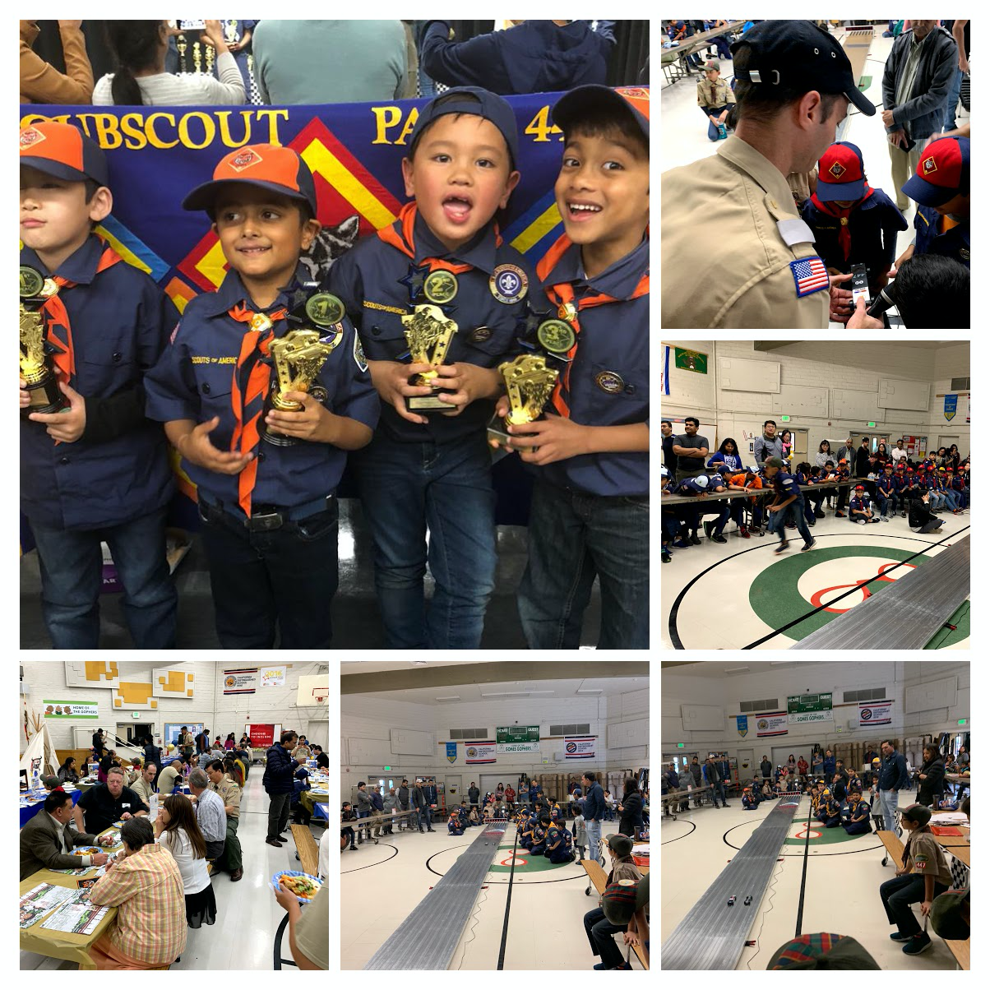
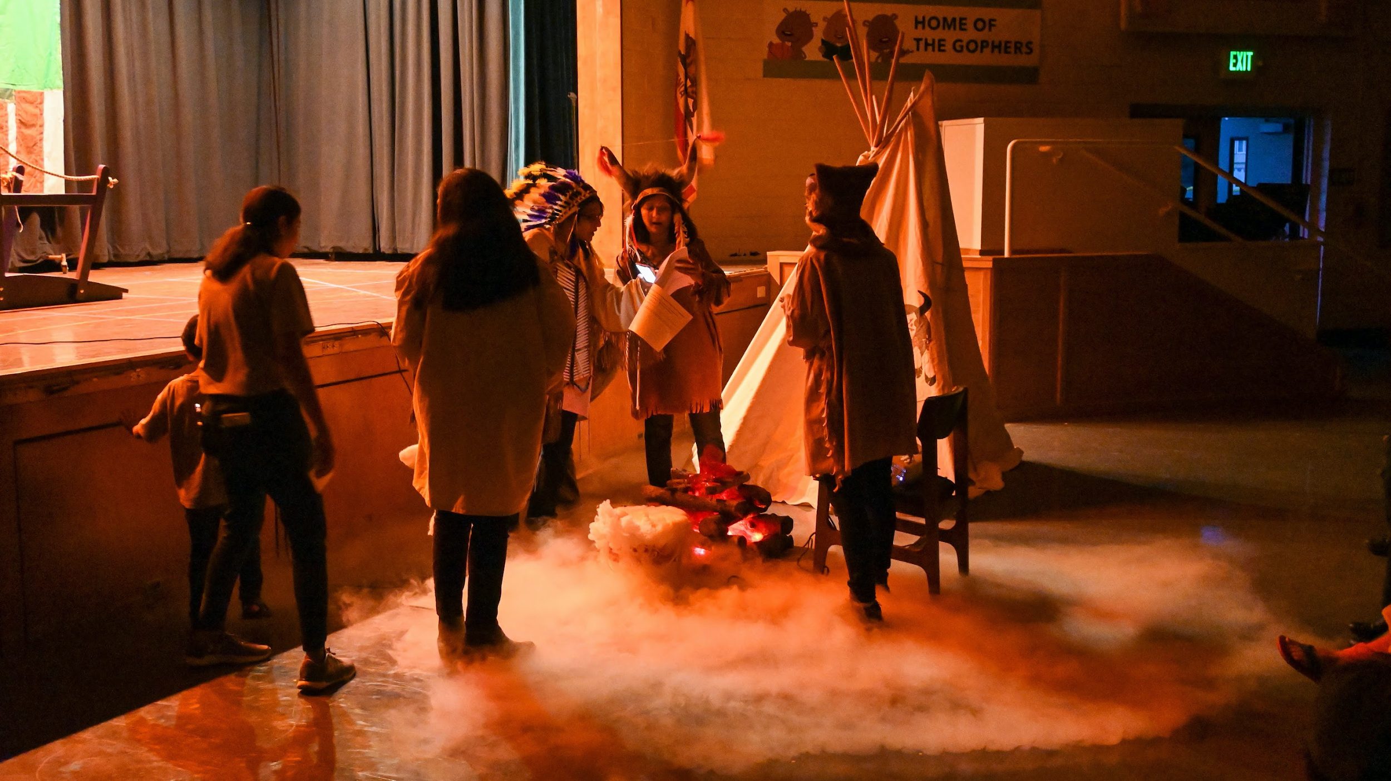
Marquee Pack Events
Special Invitee
Pinewood Derby
Flag Retirement
Blue and Gold Dinner
Chairs for the various big events are decided from every den.

Slide 10
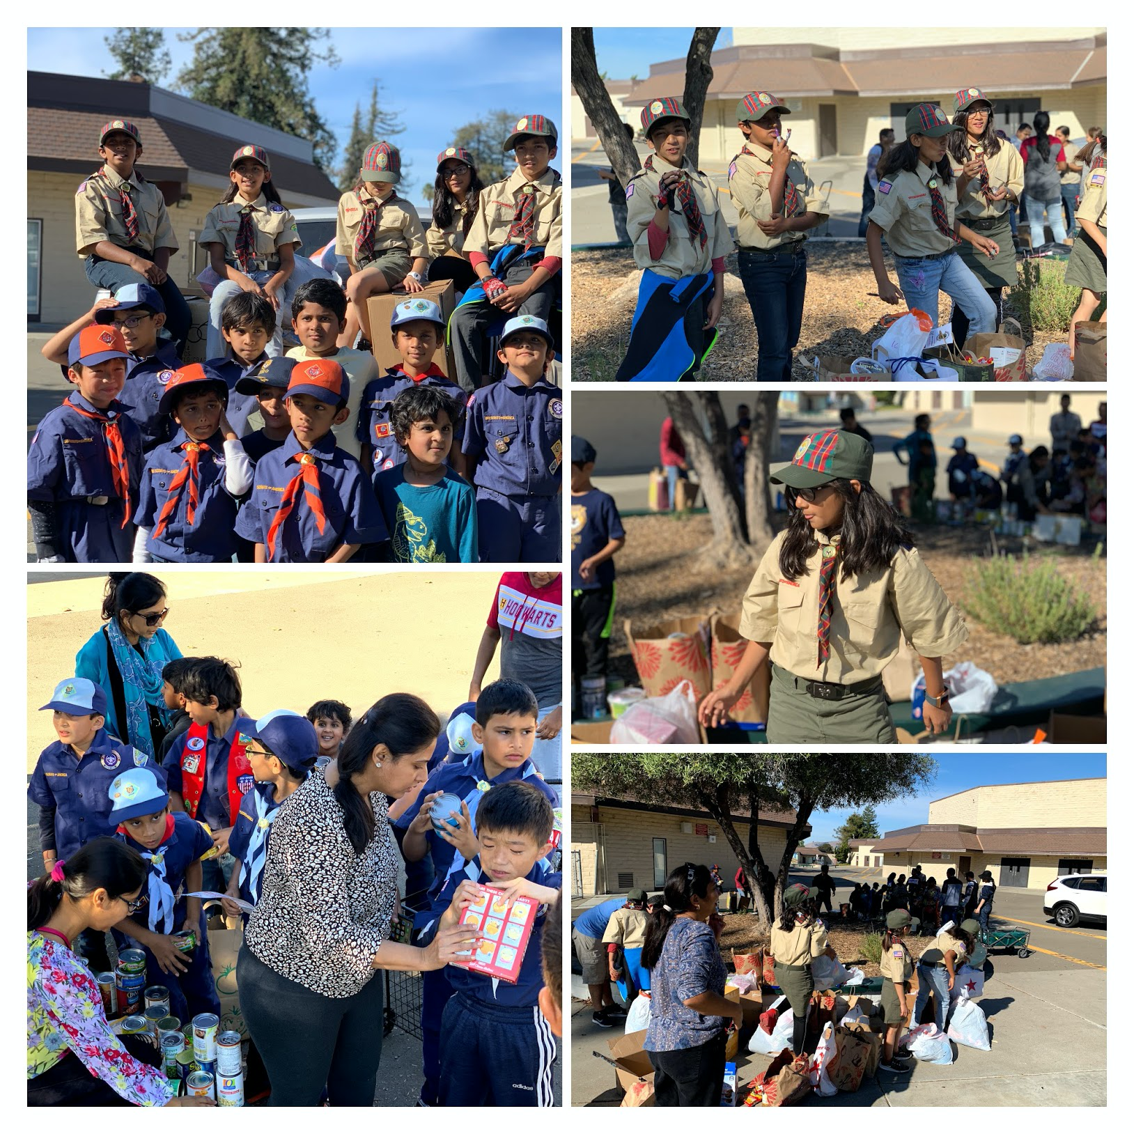
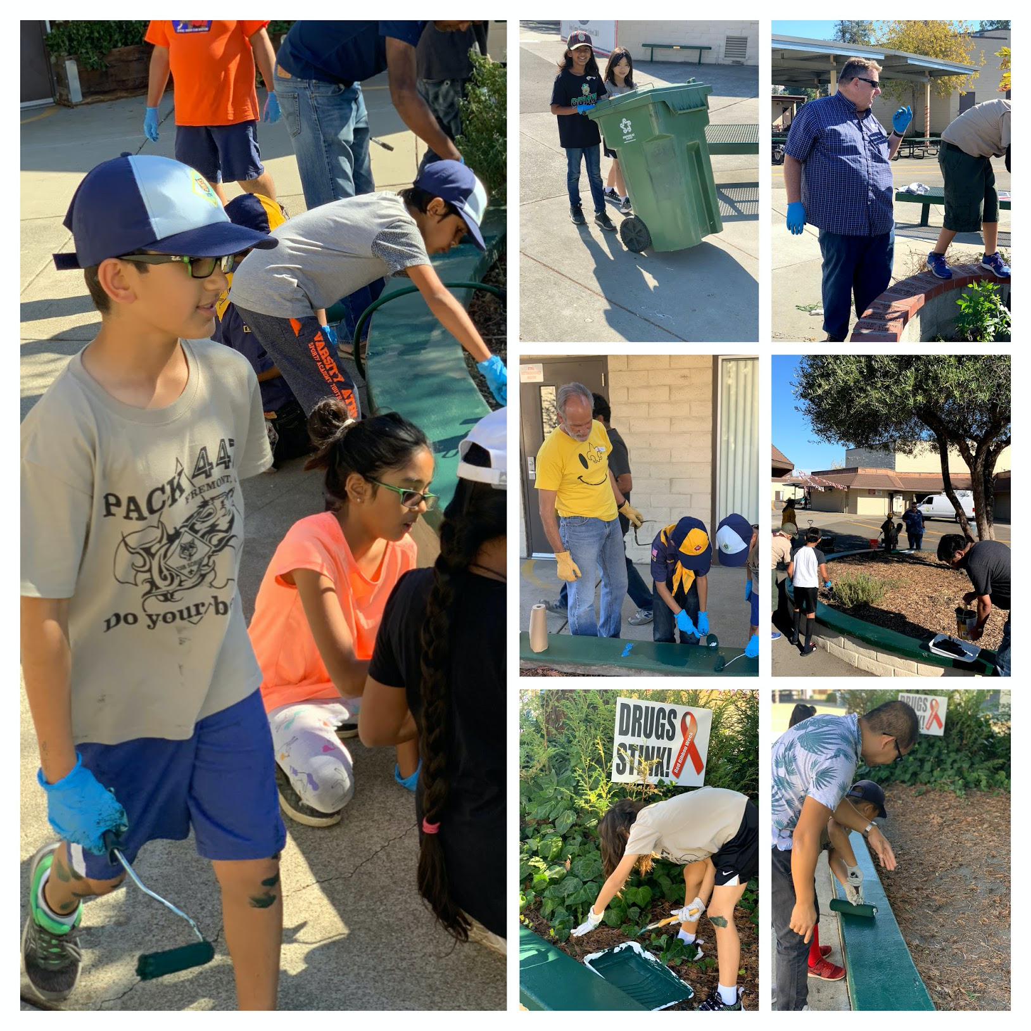
Special events - Community
Make a Difference Day
Scouting for Food
Gomes Watering and Cleanup
Flag Ceremony at Gomes
4th of July Parade

Slide 11
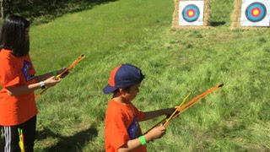
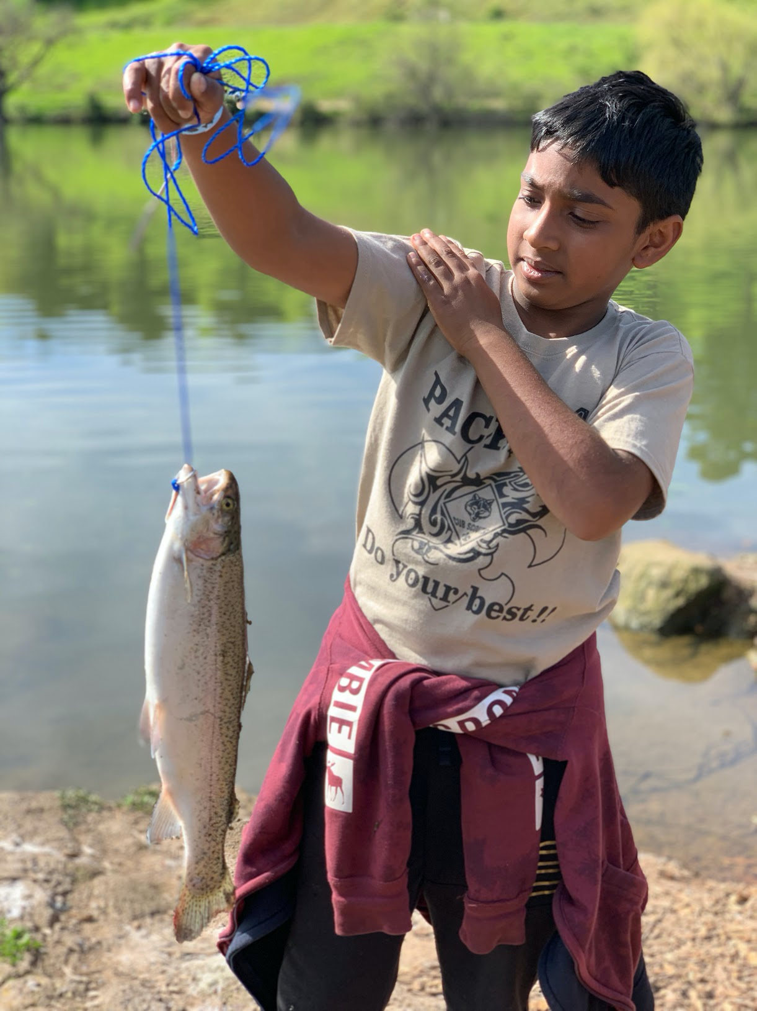
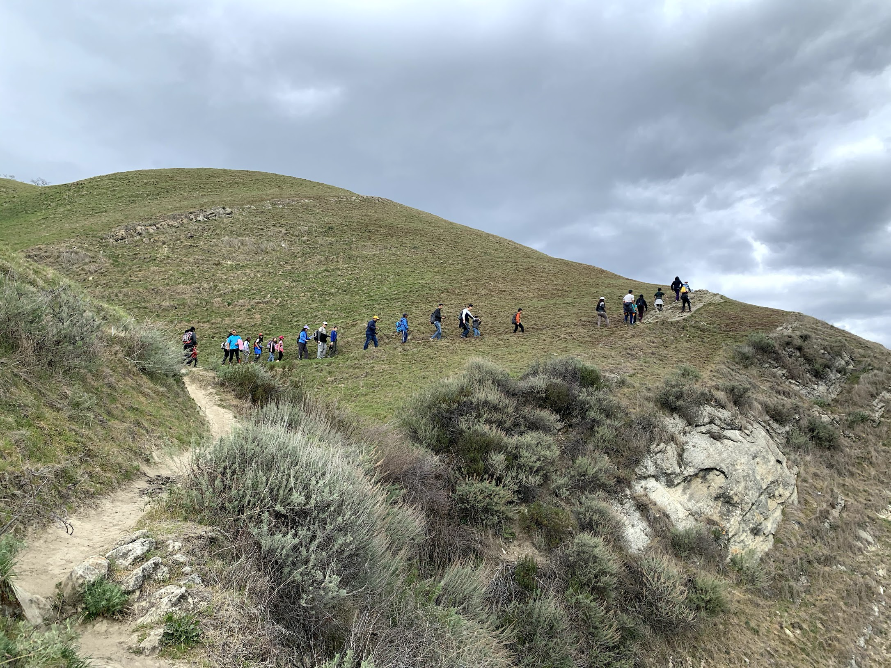
Special events - Pack Level
Overnight Camping
Hiking
Sporting events at San Jose Sharks, Stanford Football etc.
Outdoor Events
Fishing
Cycling

Slide 12
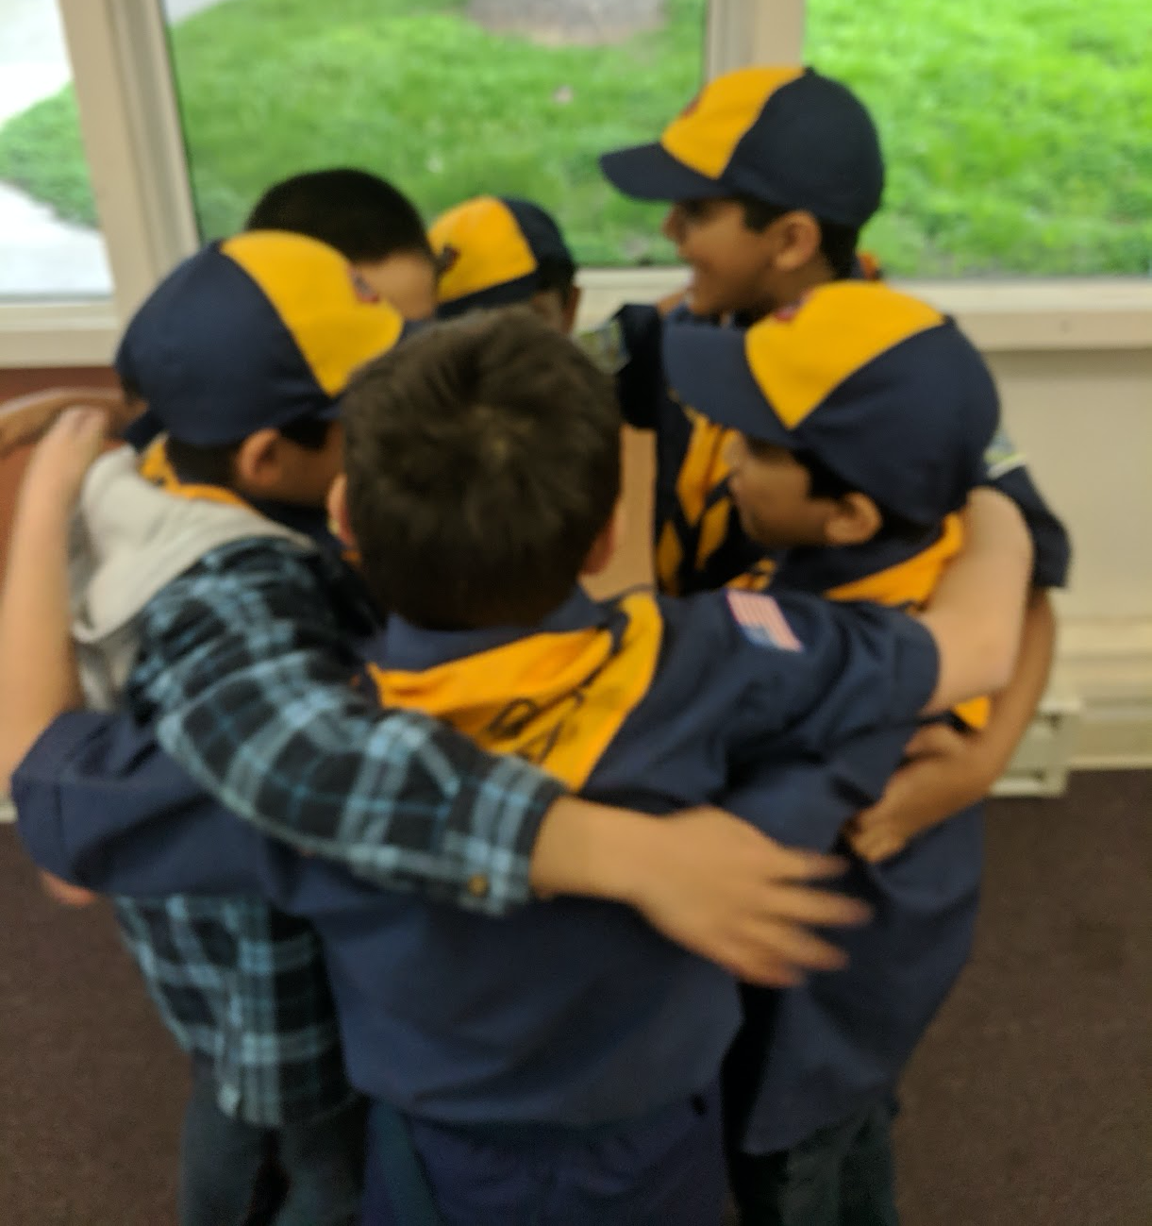
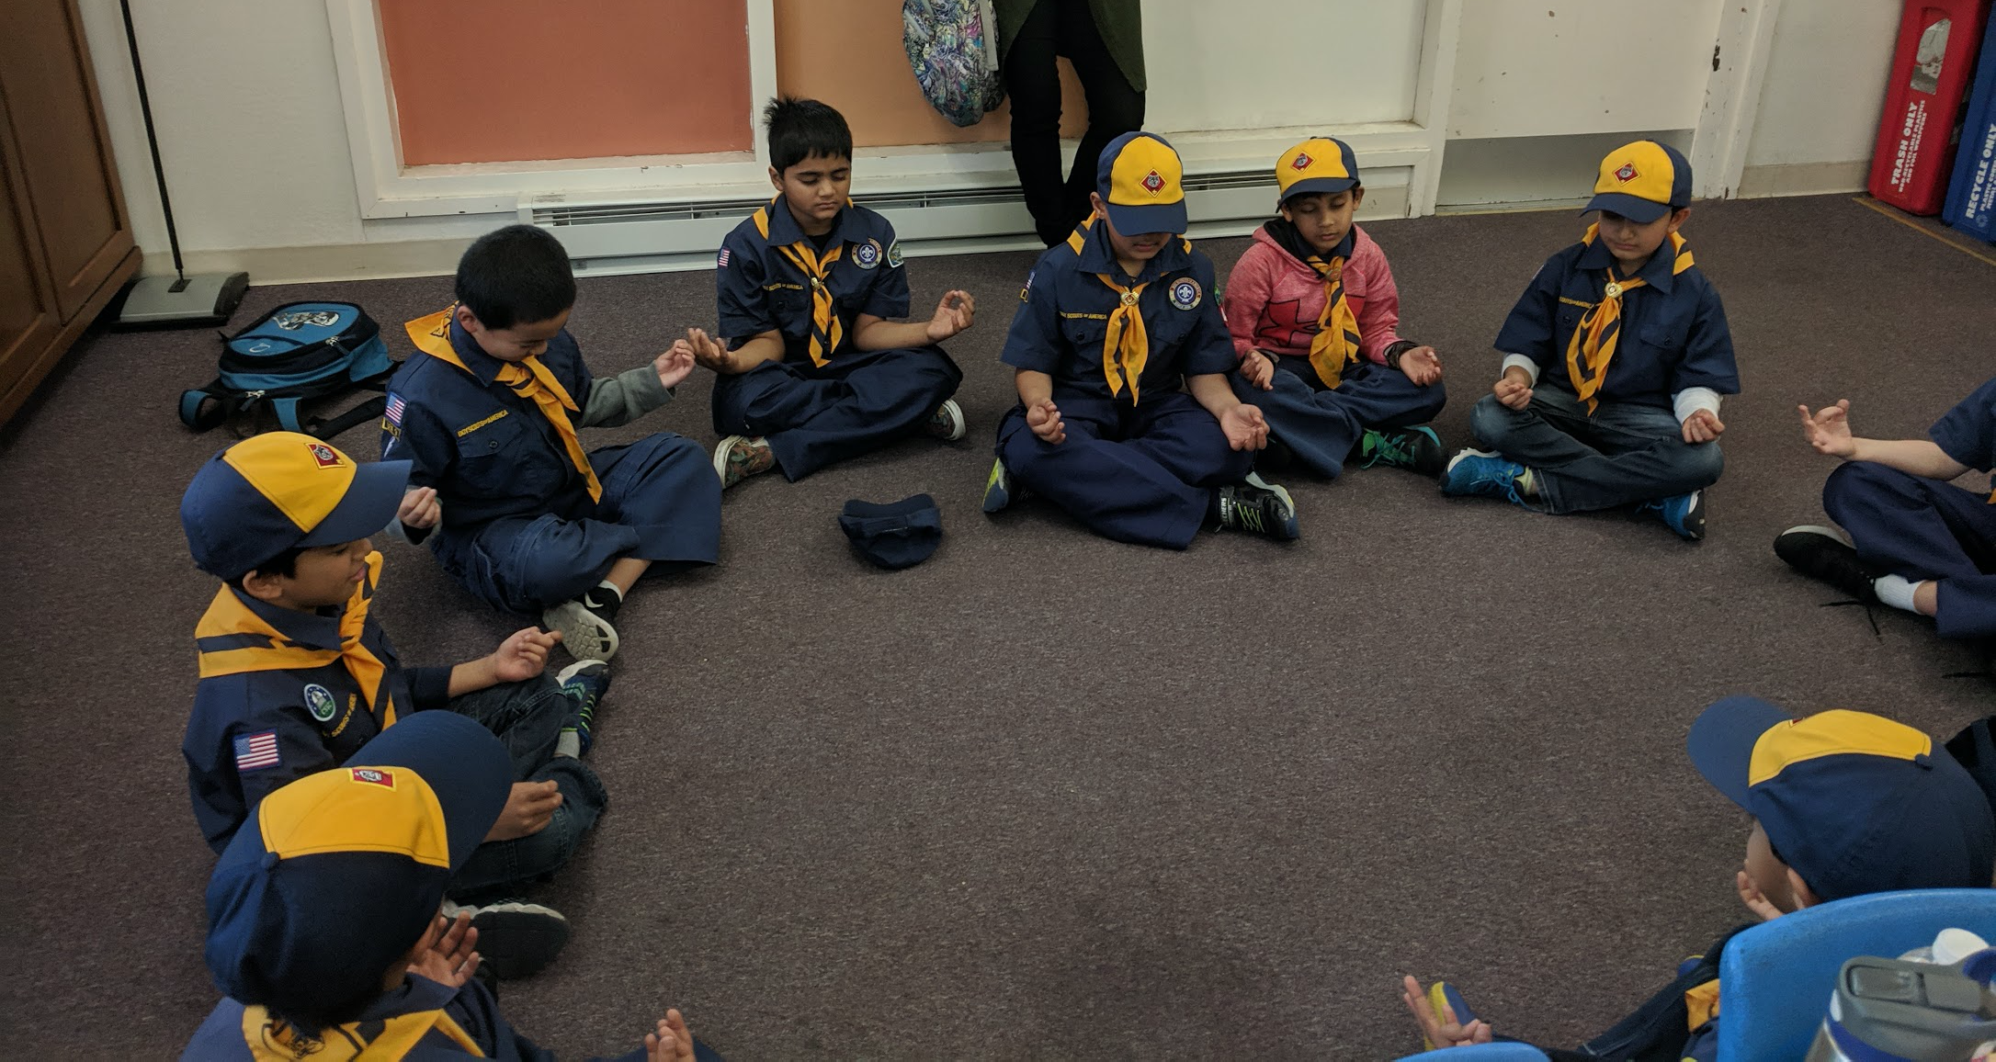
Den Meetings
How do we go about it?
Pack Committee helps in the formation of new dens.
Den chiefs are assigned for all levels.
Existing Den Leaders/Cubmaster visits the first meeting of a new den and explains how meetings work.
New Leaders and parents are encouraged to ask questions.
Work with Den Leaders to chart a path for adventure requirements fulfillment
Challenges:
Scheduling
Recruiting new Den Leaders :)

Slide 13
Recruitment
Planning for recruitment in June
set goals
Identify recruitment chair for next year
Conducted twice every year - Spring and Fall
Recruitment table arranged at the school during Maze day
Follow up and sign-ups during Information night at school

Slide 14
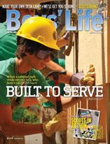
Funding!
Annual Membership Fee----- $150*
Membership includes:
Pack registration and annual fees
Boy's Life Subscription
Pack T-Shirt (for scout only)
Required badges for uniform
(Scout will need to purchase the rest of the uniform and a handbook)
Some events will require additional out-of-pocket costs
Overnight camping
Visits to Museums, etc.
…….But this is not enough... :( :(
Notes:
The treasurer prepares a budget with the previous years expenses and the committee reviews it and approves.
Plan the estimated expenditure for each pack meeting as well as large scale events such as Blue and Gold, Derby car race, fundraising goals.
Registration, boys life
Reserve Fund
Program Materials
Activities, summer picnic

Slide 15
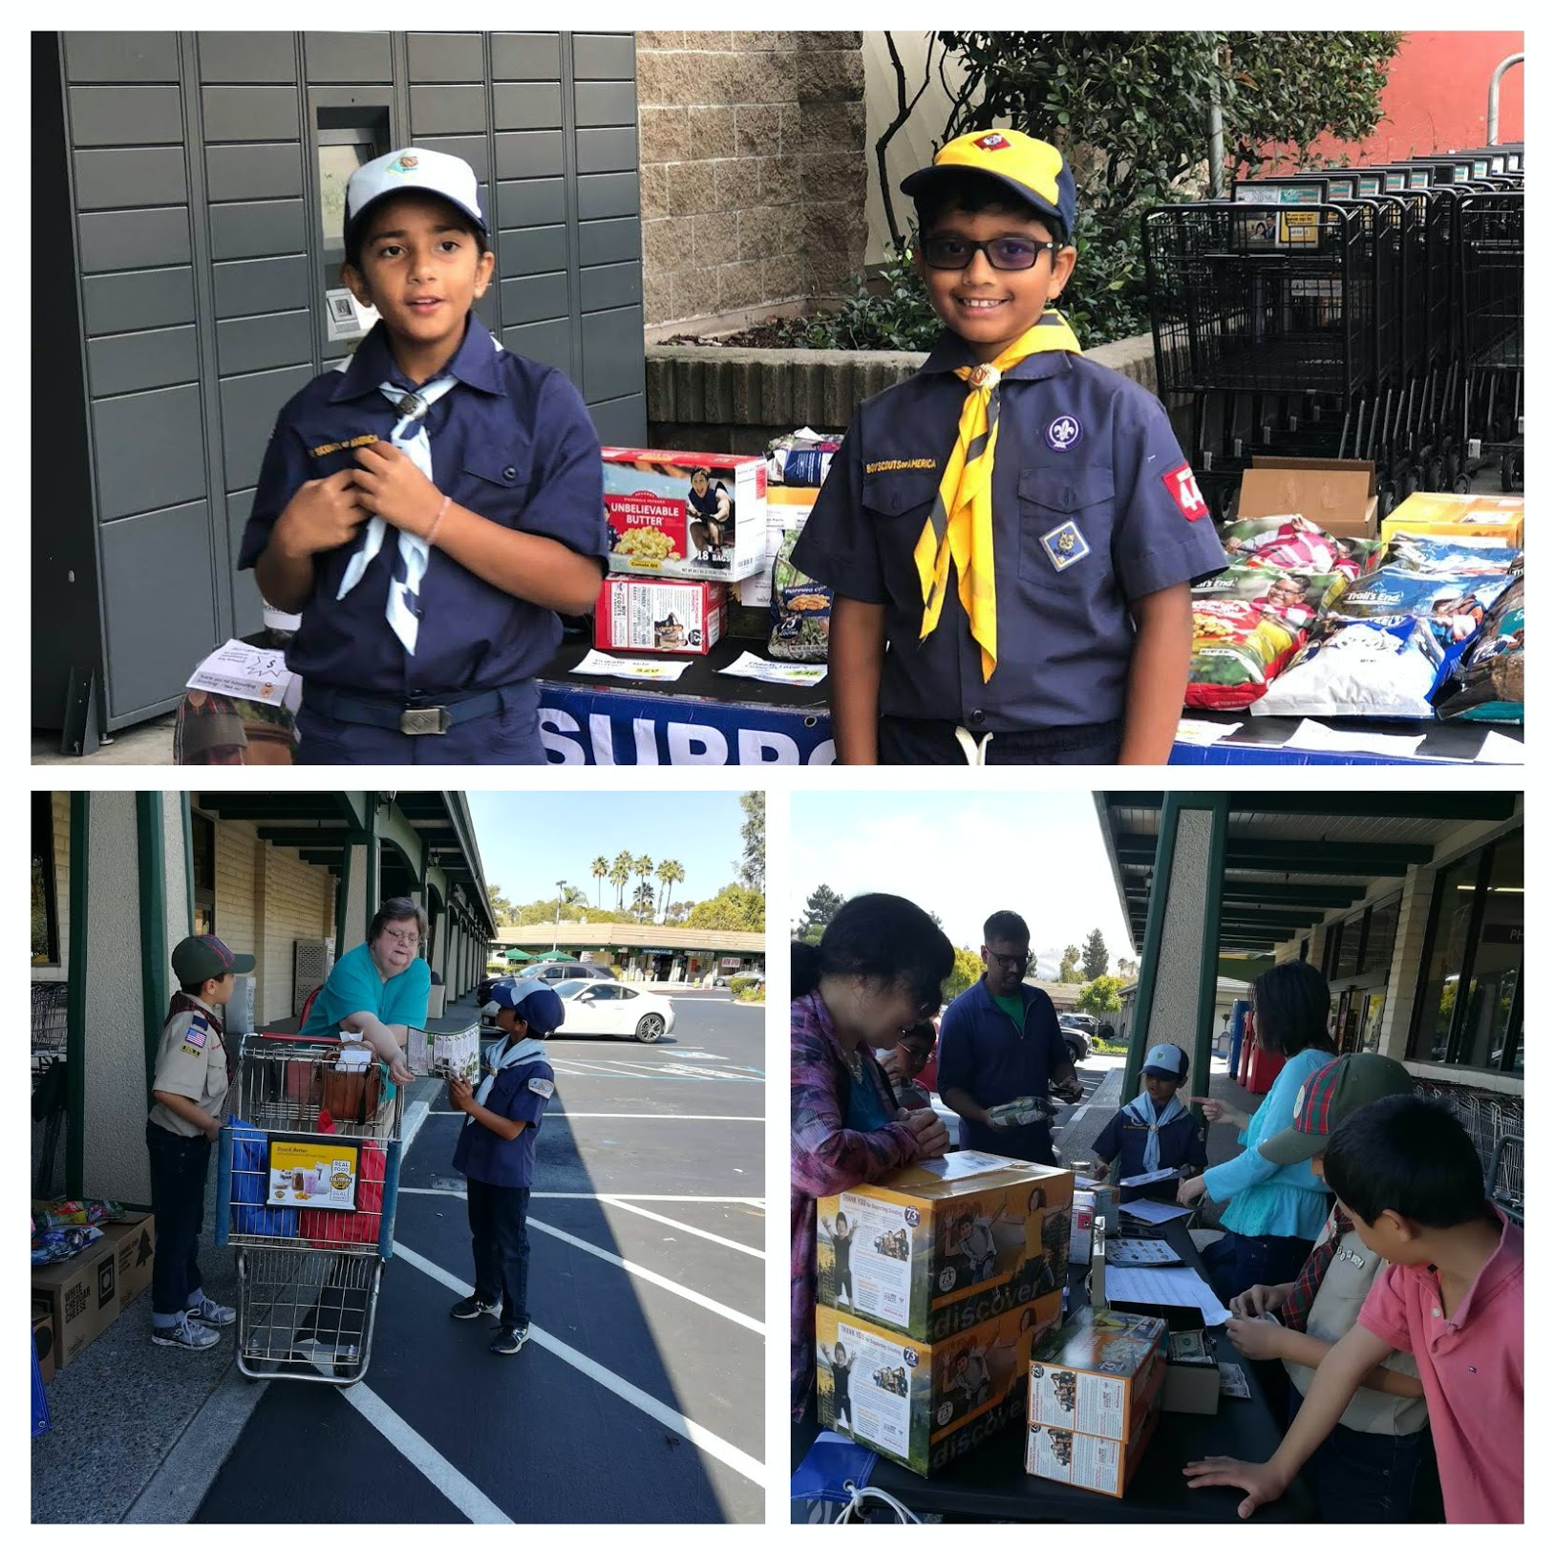
Pack Fundraiser & Fees
Trail’s End Popcorn Sale
$90 / Individual Sales
Group Sales-Storefront
PAIA (Program Assessment Insurance)
~$100 (depending on popcorn sales, pack may subsidize)
Notes:
To help pay for the many awards and activities you and your son will be participating in this year, we will be doing several fundraisers. One of our major fundraisers is the Trails End Popcorn sale. The popcorn sale along with our other fundraising projects are opportunities for your son to “earn his way” in paying for Scouting activities available to him. Product selling teaches Scouts selling and communication skills. In addition to that, you son can qualify for some fantastic prizes!
Popcorn Sales – profits cover about 50% of our pack’s operating expenses
Friends of Scouting (FoS) Donation ($100+) – keeps our various regional camps running

Slide 16
Driving Parent Involvement
Each den takes responsibility for one or two pack meetings in a year
Rotation between the dens ensures the families have fun at the other pack meetings
Family Talent Survey
Training

Slide 17
Questions!

Slide 18
Backup

Slide 19
November - Flag Retirement
December - Holiday Party – Snow Ball Fight

Slide 20
January - Pinewood Derby!

Slide 21
Planning:
Annual program planning meeting in June.
Monthly pack leaders committee meeting.
Pack meeting built around monthly Core Values. Core Values tie each pack meeting together
Utilize – Cub Scout Leader Book –Den & Pack Meeting Resource, Boys Life Magazine.

Slide 22
Pack Leadership
Den chiefs
Den Leaders
Cubmaster
Chartered Organization
Pack Committee
Notes:
Leaders take training and are updated.

Slide 23
Spring: Planning Cycle 1
Spring recruitment in April
Advancement on Scoutbook
Summer Year End Picnic
Summertime activities planning & Overnighters.
Recruitment goals

Slide 24
Annual program planning meeting in June- Led by pack committee
Pack Meeting Schedule for upcoming year
Budget for the upcoming year.
Fundraising goals.
Chairs for the various big events are decided from every den.

Slide 25
Fall: Planning Cycle 2
Information night is arranged at the school.
Pack Committee helps in the formation of new dens.
Existing Den Leaders/Cubmaster visits the first den meeting of a new den and explains how meetings work.
Leaders are encouraged to ask questions.
Den chiefs are assigned for all levels.
Communication is sent to the pack every month about key events, pack meetings

Slide 26
Monthly Committee Meetings
Led by the pack committee chair. Supported by the pack committee and Cubmaster.
Den leaders and interested parents attend and participate.
Follows a regular order:
Feedback on the previous month
Finalizing the current month
Treasurer Report
Planning any other event in near future.

Slide 27
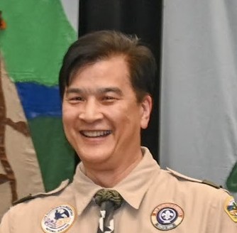
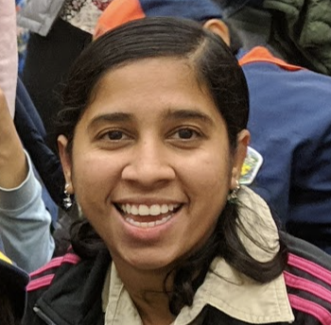
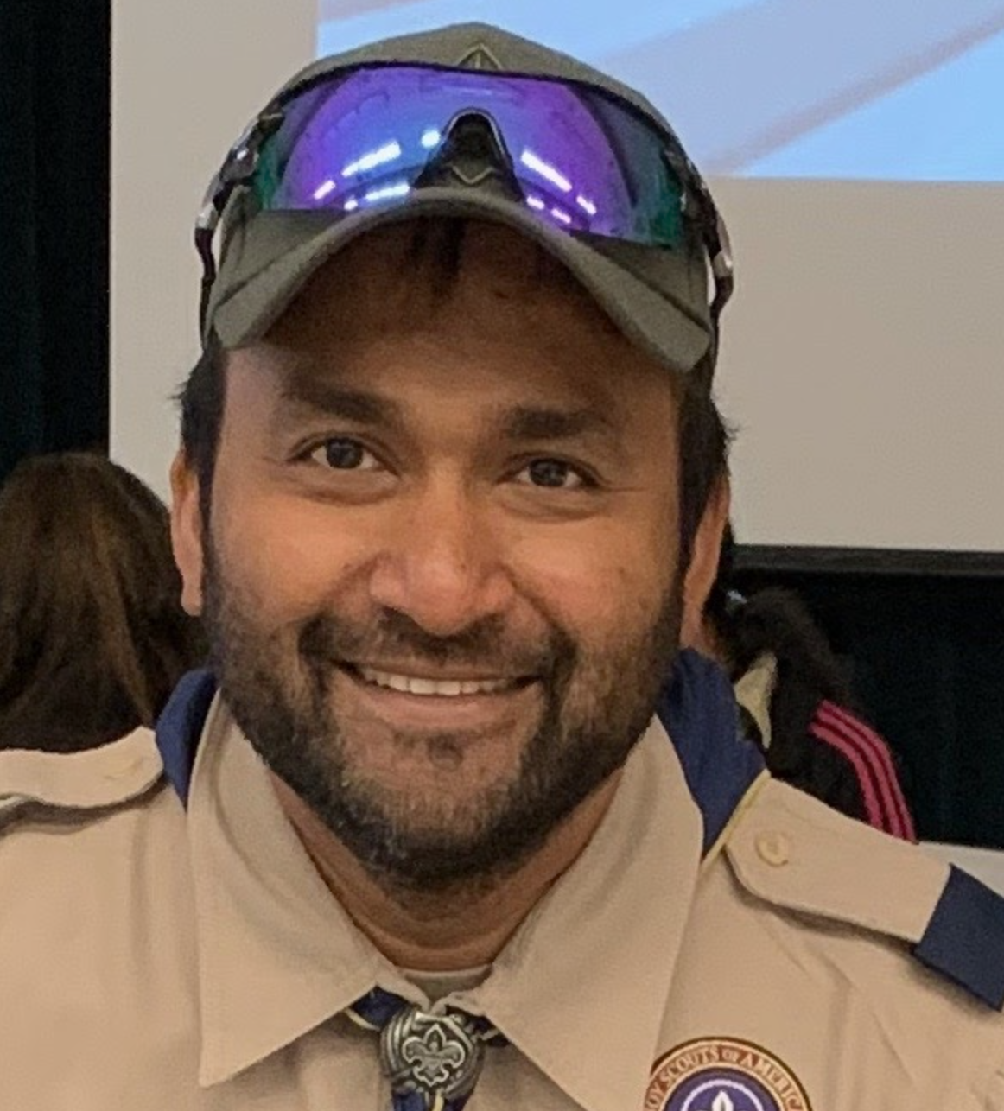
Pack 447 Leaders & Committee

Slide 28
Pack Budget:
The treasurer prepares a budget with the previous years expenses and the committee reviews it and approves.
Plan the estimated expenditure for each pack meeting as well as large scale events such as Blue and Gold, Derby car race, fundraising goals.
Registration, boys life
Reserve Fund
Program Materials
Activities, summer picnic

Slide 29
Pack Meetings:
Responsibility is shared among the various dens.
Themes for Monthly Pack Meetings are finalized at the Annual Planning Meeting
Ex: Nov: Flag Retirement,Dec: Snowball fight, Jan Derby car race.
The plan for the upcoming pack meeting is discussed in the monthly committee meetings.

