Slide 1
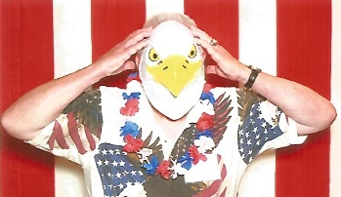

Life Scout to Eagle Scout
Merl Nygren
Mission Peak District Review Coordinator
510.651.5972
nygreme@att.net
Notes:
Obviously the cover page.
Picture taken at the Behring Museum of American History in Washington, DC on July 4th, 2015
Where are the requirements for Eagle Scout?
The Internet—run a search
Scouts BSA Handbook
Council website?
National website?
Next slide.

Slide 2


to
Requirements source
Web sites
5 Tips for Helping Scouts Reach Eagle Before Time Runs Out
Eagle Scout Rank Application & Requirements
  National Eagle Scout Association
  1 to 4
  5
  6 & 7 +

Slide 3
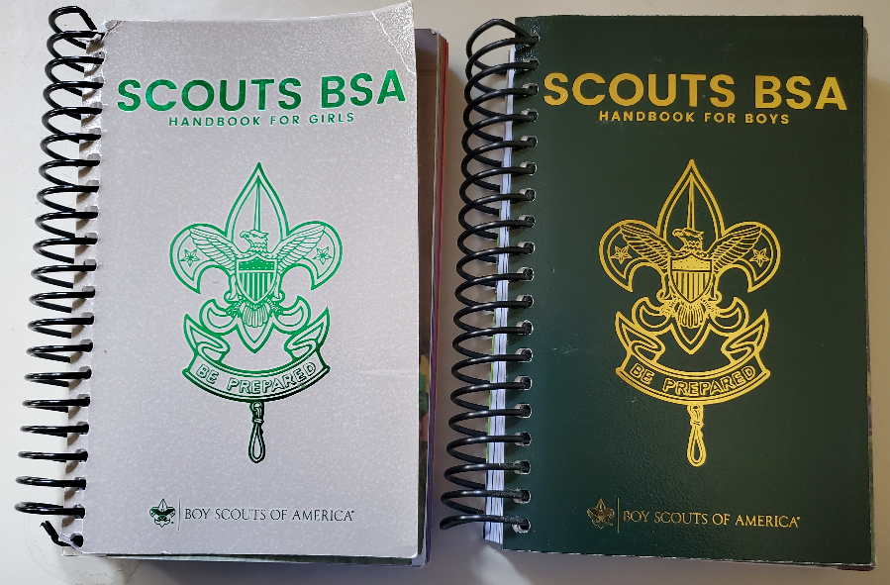
Notes:
Here are the handbooks currently available in the Scout Shop and Kindle.
Does your scout have one of these? Are they current?
No, these are 2019 editions and we are in 2020.

Slide 4
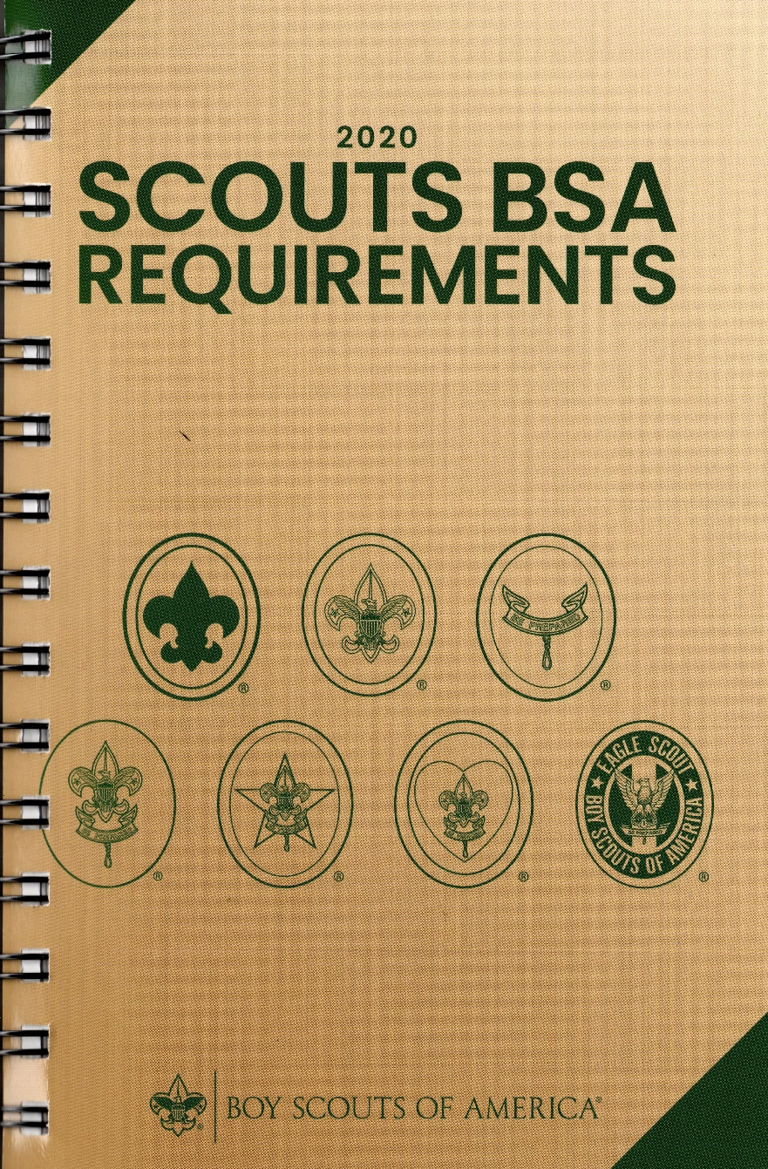
Notes:
The 2020 edition—good through this year. 2021 should be available next February.
Going to take a look at the back of the cover.

Slide 5
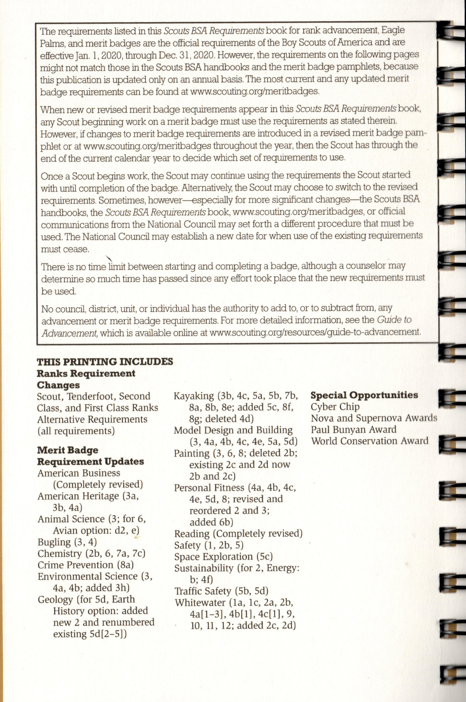
Notes:
Hard to read but I will split it looking at the bottom first. That is where changes from the 2019 requirements are listed

Slide 6
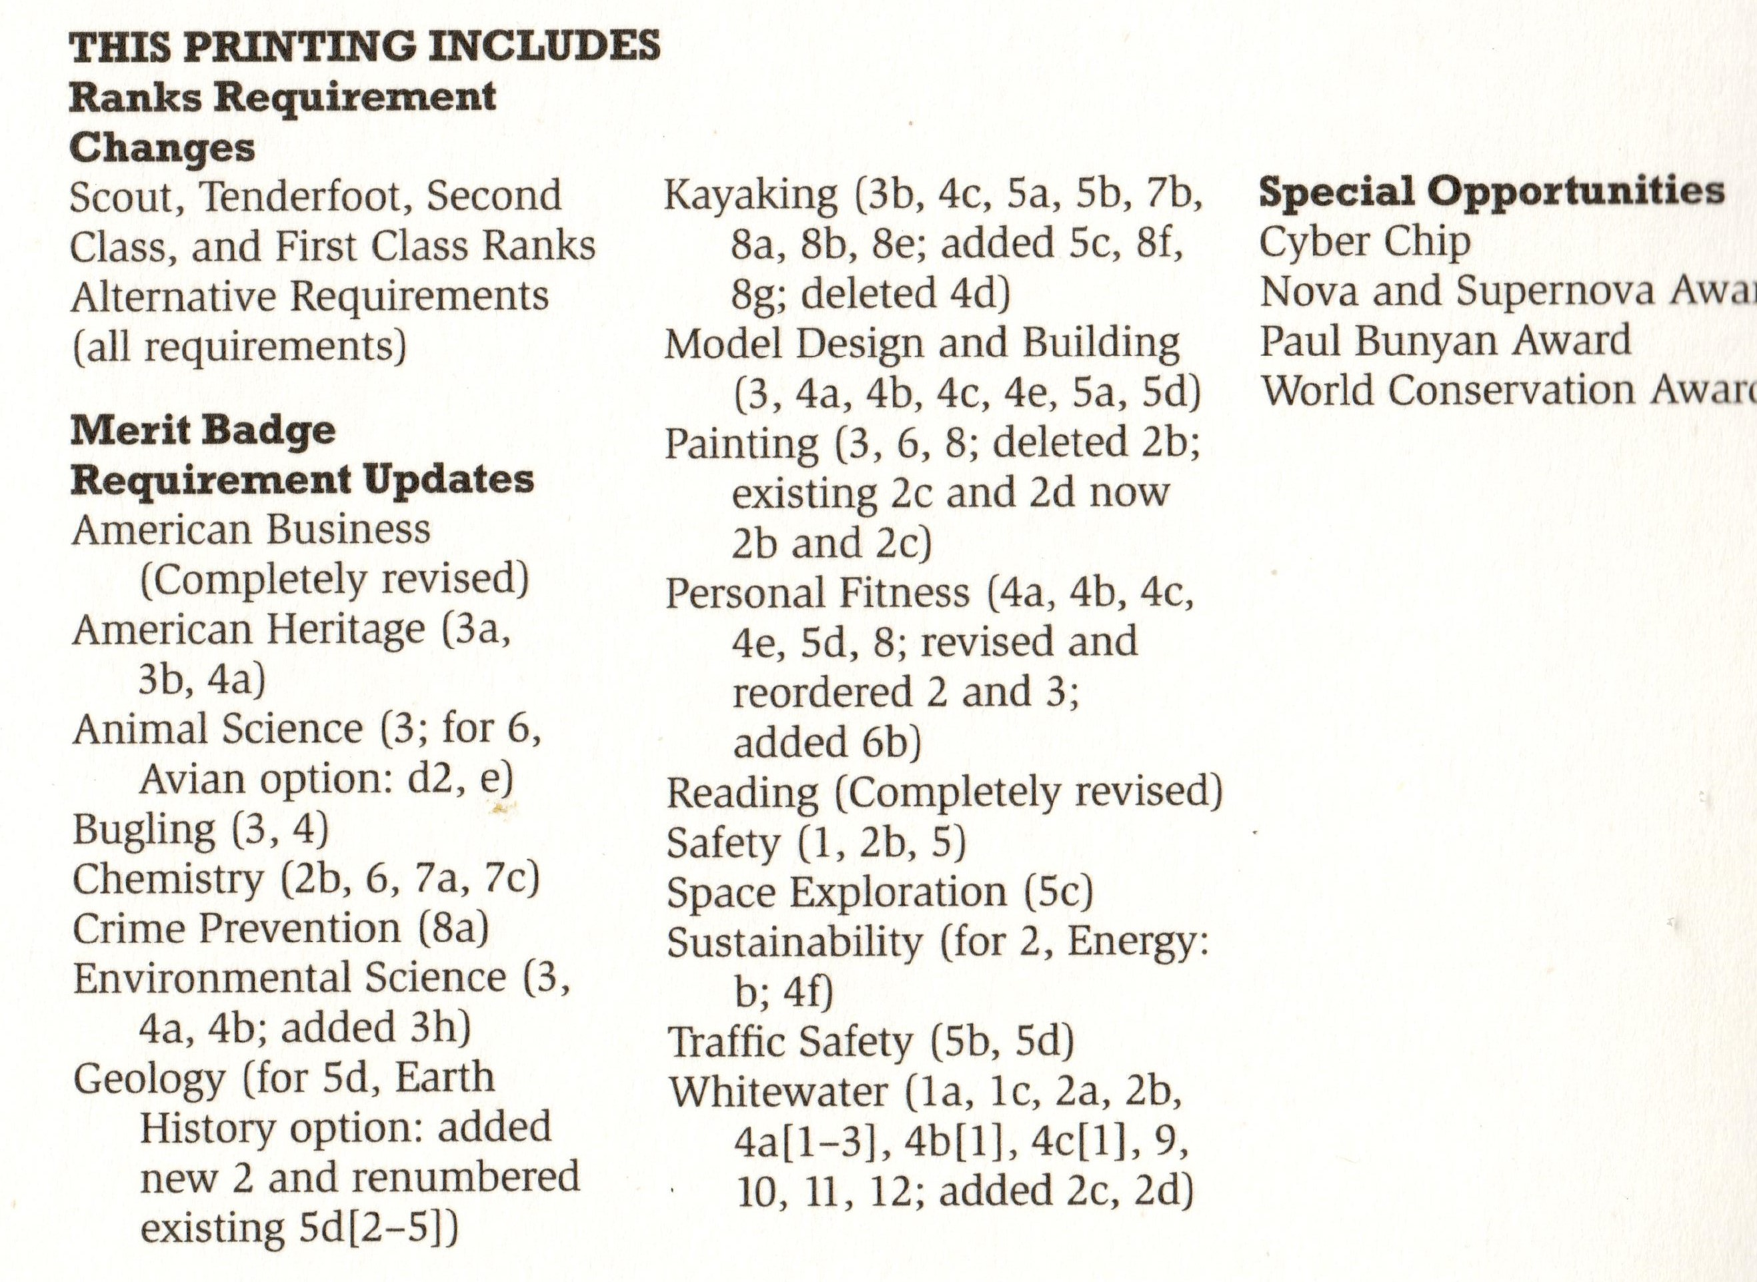
Notes:
No changes in Eagle Scout rank requirements. Changes to Scout through First Class alternative requirements only.
Merit Badge—if started before 2020, requirements of start year apply.

Slide 7
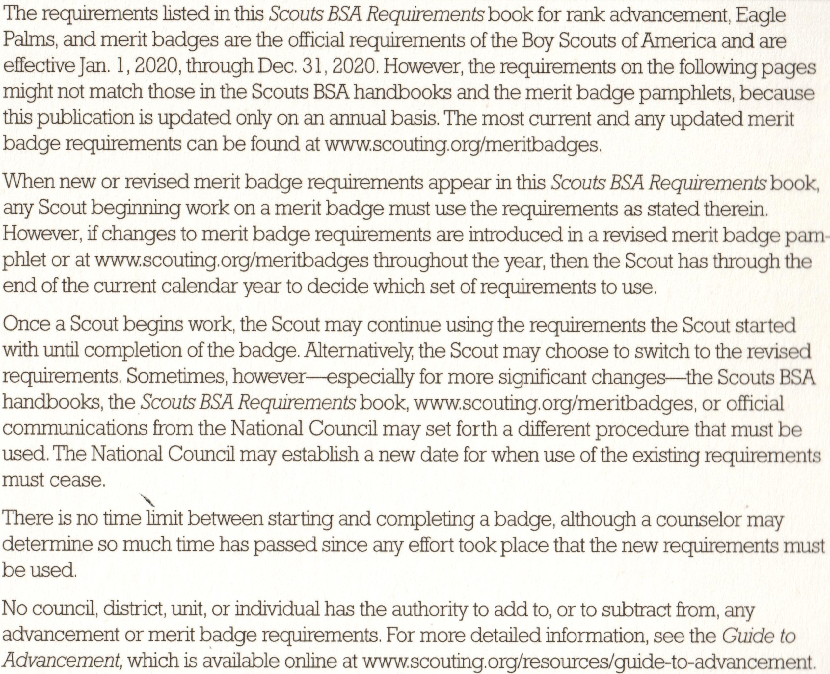
Notes:
Cravat on requirements. I will parse.

Slide 8
SCOUTS BSA RANK REQUIREMENTS
The requirements listed in this Scouts BSA Requirements book for rank advancement, Eagle Palms, and merit badges are the official requirements of the Boy Scouts of America and are effective Jan. 1, 2020, through Dec. 31,2020. However, the requirements on the following pages might not match those in the Scout Handbook and the merit badge pamphlets, because this publication is updated only on an annual basis. The most current and any updated merit badge requirements can be found at wwwscouting.org/meritbadges.
Notes:
This is an extract from the 2020 edition of the Scouts BSA Requirements. The restriction comes from the Guide to Advancement.

Slide 9
SCOUTS BSA RANK REQUIREMENTS
No council, district, unit, or individual has the authority to add to, or to subtract from, any advancement or merit badge requirements. For more detailed information, see the Guide to Advancement, which is available online at wwwscouting.org/Home/GuideToAdvancement.aspx.
Notes:
This is an extract from the 2020 edition of the Scout Requirements and the Guide to Advancement.
Have a browser open to the council advancement web site.
Show how to get to the screen using Internet Explorer.
This is what is currently posted on the council website. The council advancement committee rewrote the Eagle Candidate Letter and Instructions.
Open the letter to Eagle Candidates. Scroll through requirements, how to meet, ending with links and envelop templates.
Have https://www.scouting.org/programs/scouts-bsa open in other browser. Show where to get workbook, and application.

Slide 10
Websites
Any questions before we visit the SFBAC and National websites?

Slide 11
Eagle Scout Forms http://www.sfbac.org/programs/advancement
Service Project Planning Guide
Age Guidelines for Tool Use and Work at Elevations or Excavations
Eagle Scout Rank Process
The council Advancement Committee has prepared the Life to Eagle Candidate Letter and Instructions to explain and provide links to references and guides to the process of earning Eagle Scout. Please download and follow the instructions.
Notes:
Show how to get to the screen using Internet Explorer.
This is what is currently posted on the council website. The council advancement committee rewrote the Eagle Candidate Letter and Instructions.
DO NOT GO TO POSTED COPY—NOT UPDATED FOR GIRLS.
It then emphasizes some points in the different requirements.

Slide 12
Life to Eagle Candidate Letter and Instructions
Prologue
In the text below, there are references to a variety of documents, all of which are available through the San Francisco Bay Area Council (SFBAC) website where you obtained this document. Following each of the Boy Scouts of America (BSA) document names is its document identification number. For your convenience both the Eagle Scout Rank Application (512-728) and Eagle Scout Service Project Workbook (512-927) are fill in documents for which the contents and any content modification can be saved. As you undertake your activities for Eagle advancement, you should review each of the references to obtain information that will be useful in fulfilling the requirements.
Notes:
APPLE vs. Windows/Android
If you download the document and read it using ADOBE Reader, the links will work. At least on PCs—I don’t have an Apple.

Slide 13
Life to Eagle Candidate Letter and Instructions
“For your convenience both the Eagle Scout Rank Application (512-728) and Eagle Scout Service Project Workbook (512-927) are fill in documents for which the contents and any content modification can be saved.” needs be changed to include the option of creating the application as a SCOUTBOOK report.
Notes:
APPLE vs. Windows/Android
If you download the document and read it using ADOBE Reader, the links will work. At least on PCs—I don’t have an Apple.

Slide 14
Life to Eagle Candidate Letter and Instructions
Document | Link
Scouts BSA Requirements, BSA publication 34765 | None. Can be purchased in Scout Shop.
Eagle Scout Rank Application, BSA 512-728 | (http://www.scouting.org/filestore/pdf/512-728_WB_fillable.pdf)
Eagle Scout Service Project Workbook, No. 512-927 | http://www.sfbac.org/files/images/512-927.pdf or http://www.scouting.org/scoutsource/BoyScouts/Advanc ementandAwards/EagleWorkbookProcedures.aspx
SFBAC Advancement Committee letter to a Life Scout’s references | http://www.sfbac.org/files/images/pdfs/Eagle_reference_cover_letter.pdf
My Project Finder | http://www.myprojectfinder.com/
Scouting Magazine article on finding an Eagle Scout Service Project | http://blog.scoutingmagazine.org/2012/01/31/how-to-find-a-great0idea-for-an-eagle-scout-service-project/
Notes:
My Project Finder is an app to focus the search. Not a specific project but an area to search for one such as your elementary school, local park, etc.
Later we will see reference to blogs from the editor of Scouting magazine.

Slide 15
Life to Eagle Candidate Letter and Instructions
Document | Link
Navigating the Eagle Scout Service Project, Information for Project Beneficiaries | http://www.scouting.org/filestore/pdf/510-025.pdf
The Guide to Safe Scouting, BSA 34416 | http://www.scouting.org/scoutsource/outdoorprogra m/safety/adultsguidetosafescouting.aspx.
Service Project Planning Guidelines, BSA680-027 | http://www.scouting.org/filestore/healthsafety/pdf/680-027.pdf
Age Guidelines for Tool Use and Work at Elevations or Excavations, BSA 680-028 | http://www.scouting.org/filestore/healthsafety/pdf/680-027.pdf
BSA’s service hour data base | http://servicehours.scouting.org or re-direction from: http://www.scouting.org/scoutsource/Awards/JourneyToExcellence.aspx
Notes:
The first one is part of the workbook to be given to the beneficiary. It explains the scout’s and their unit leader’s roles.
The beneficiary signs they received it when accepting a proposal.

Slide 16
https://www.scouting.org/programs/scouts-bsa/advancement-and-awards/resources/
Notes:
This is what the National website looks like.
General Resources
Guide to Advancement
Advancement Educational Presentations
PowerPoint with speaker’s notes
Rank Advancement
Eagle Scout Service Project Workbook
Eagle Scout Rank Application
Alternate Merit Badges

Slide 17
5 Tips
Any Questions before we look at a blog?

Slide 18
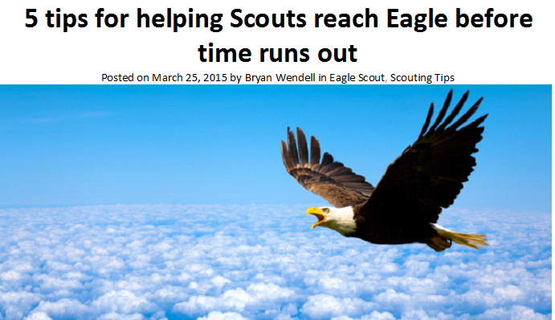
Notes:
Bryan Wendell is the editor of Scouting magazine and posted this blog in March of 2015. He has lots of blogs on Eagle Scouts and “projects of the year.”

Slide 19
http://blog.scoutingmagazine.org/2015/03/25/5-tips-helping-scouts-reach-eagle-time-runs/
5. Set a target date.
Everyone needs a deadline. Encourage target dates for completing key requirements.
For example: Have all Eagle-required merit badges completed by age 16. Have the Eagle Scout service project completed by age 17.
Notes:
This is an extract from Bryan’s 5 tips blog.
16 yoa joins Scouts. Can they earn Eagle? If an under 18 year old joined BSA or were eligible to join BSA for the first time last year, they could have requested up to 2 years of eligibility to do so. The request had to be recorded before 31 December 2019. .

Slide 20
http://blog.scoutingmagazine.org/2015/03/25/5-tips-helping-scouts-reach-eagle-time-runs/
4. Manage expectations.
Hope for the best but plan for the worst. Every step will take longer than you think.
Notes:
18th birthday anecdote-.
Obtaining district acceptance.

Slide 21
http://blog.scoutingmagazine.org/2015/03/25/5-tips-helping-scouts-reach-eagle-time-runs/
3. Take it one step at a time.
The journey to Eagle isn’t easy. So it’s best taken one step at a time.
Concentrate on merit badges first and then the service project (or vice versa), so you won’t feel overwhelmed.
Notes:
You can start on merit badges after enrollment in Scouts BSA.
Late WEBELOS to Scout transfer anecdote.
No SCOUTBOOK or Internet Advancement 2.0 entry (and submitted to Council) or paper Advancement Report submitted—didn’t happen.
They can think about an Eagle Scout Service Project anytime—they can not plan nor develop your plan until after your Life Scout board of review.

Slide 22
2. Finish the time-sensitive merit badges ASAP.
The Eagle-required Family Life, Personal Fitness and Personal Management merit badges have requirements that take three months.
Those requirements can’t be altered in any way, so a Life Scout starting on Family Life requirement 3 — “Prepare a list of your regular home duties or chores (at least five) and do them for 90 days” — two months before turning 18 would not be able to earn the Eagle Scout award.
Notes:
Beware the second bullet.

Slide 23
1. Remember your role.
This one is for unit leaders and parents.
Notes:
Youth’s role is to plan, develop and give leadership to others in a project benefitting a community organization.
Define Leadership!!
Parents and unit leaders coach or mentor. ANY TRICKS OR HINTS??
They ensure that applicable BSA’s policies and procedures are followed:
Tool use
Working at elevations
Working in excavations
Service Project Planning Guide—health and safety emphasis
Guide to Safe Scouting

Slide 24
Eagle Scout Rank Application
Any questions before look at the Eagle Scout Rank Application?

Slide 25
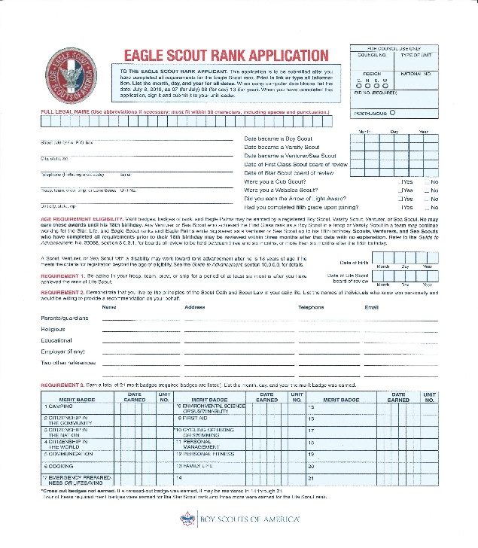
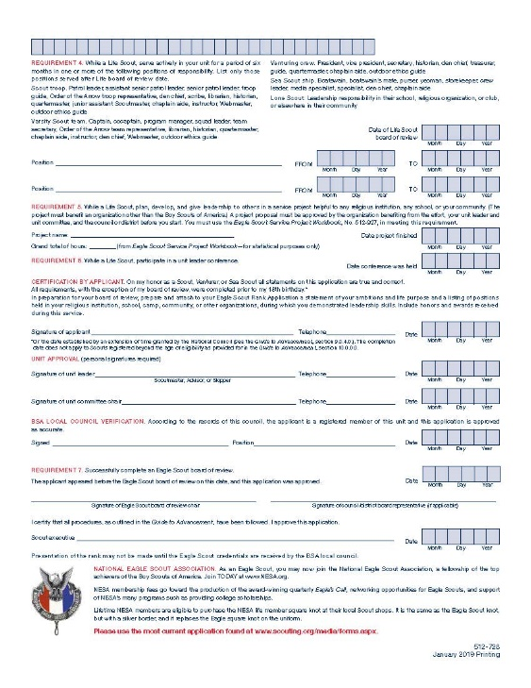
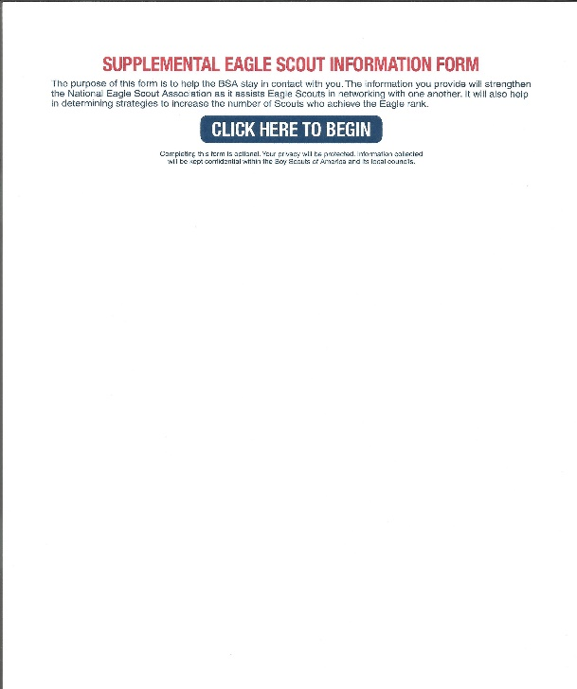
Eagle Scout Rank Application pdf fillable sized for computer completion
Notes:
Emphasis header. Form designed for 8 or 9 point type. How big is that?
CAN YOU WRITE THAT SMALL? CAN YOUR PEN? CAN YOUR YOUTH?
First thing is to look in the page 2 bottom right hand corner.

Slide 26

Page 2, Bottom Right
Notes:
Is this the correct form??
How many editions can you find with an internet search? How many are correct?
Remember, early on, I said that requirements for ALL Scout ranks are in SCOUTS BSA REQUIREMENTS. They change each year. This year the change removed the Varsity Scout positions of responsibility.

Slide 27
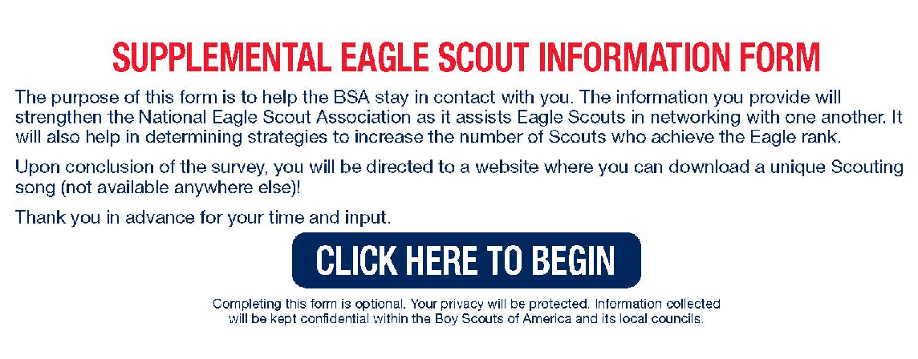
NESA
Notes:
This is an optional page that goes directly to the National Eagle Scout AssociationIt is explained on the next couple of slides.
Only two requirements to join NESA:
Earn Eagle Scout
Pay Dues

Slide 28

Why NESA
NATIONAL EAGLE SCOUT ASSOCIATION. As an Eagle Scout, you may now join the National Eagle Scout Association, a fellowship of the top achievers of the Boy Scouts of America. Join TODAY at www.NESA.org
NESA membership fees go toward the production of the award-winning quarterly Eagle’s Call, networking opportunities for Eagle Scouts, and support of NESA’s many programs such as providing college scholarships.
Lifetime NESA members are eligible to purchase the NESA life member square now at their local Scout shops. It is the same as the Eagle Scout knot, but with a silver border, and it replaces the Eagle square knot on the uniform.
Notes:
They award scholarships.

Slide 29
Scholarship Deadline
The 2020 NESA scholarship cycle opens on August 1, 2020, with a deadline of October 31, 2020. Recipients will be notified by mail on July 15, 2021.
All NESA scholarship applications must be submitted online. Copies from previous years are out of date and will not be accepted.
You may access the NESA scholarship application here: https://nesa.academicworks.com/
The Scholarship FAQ has been compiled to answer the most common questions.
Notes:
I think that there were $600,000.00 worth awarded in 2016.

Slide 30
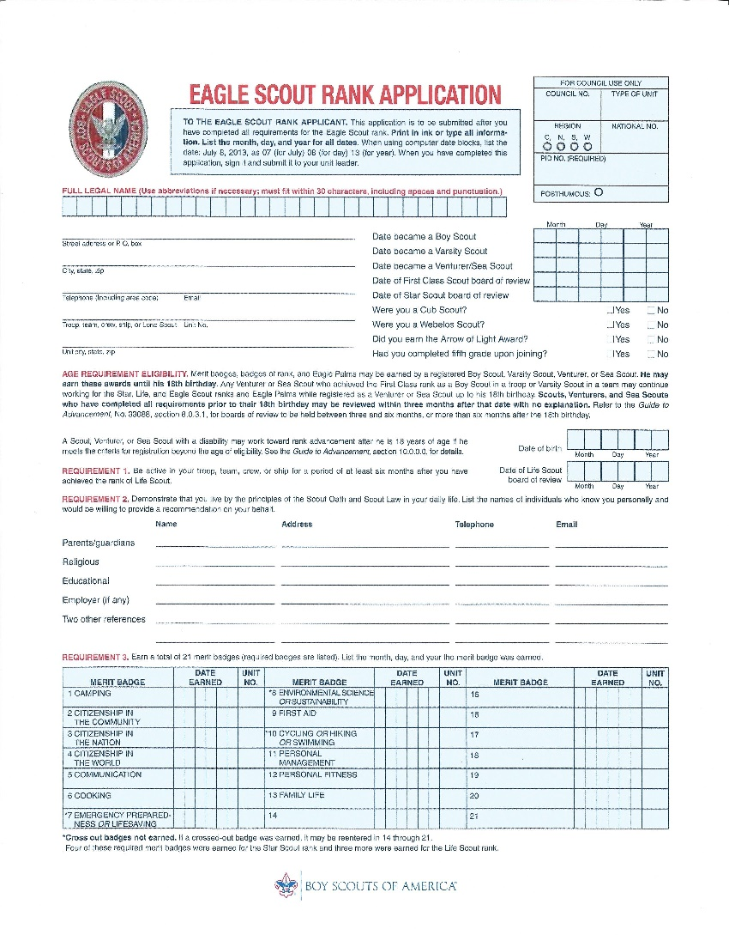
Before Starting
Visit your unit Advancement Coordinator and obtain a Member Profile (listing of dates, ranks, and merit badges) from INTERNET ADVANCEMENT 2.0 or SCOUTBOOK
Data submitted MUST MATCH
Coordinator can correct if wrong
Notes:
Here is a hint that could save a lot of time. The Eagle Scout Rank Application certification program apparently is the only part of the advancement systems that checks award (merit badges, ranks) dates against enrollment dates. All awards must be earned after first enrollment in Scouts BSA. It also checks Life and Star board of review dates for minimum tenure for the rank.
Internet Advancement 2.0 and SCOUTBOOK are the unit accesses to SCOUTNET database. The council staff has another method to access the database. I MAY USE THE TERMS INTERCHANGEABLY AS I WORK WITH BOTH SIDES OF THE HOUSE.

Slide 31
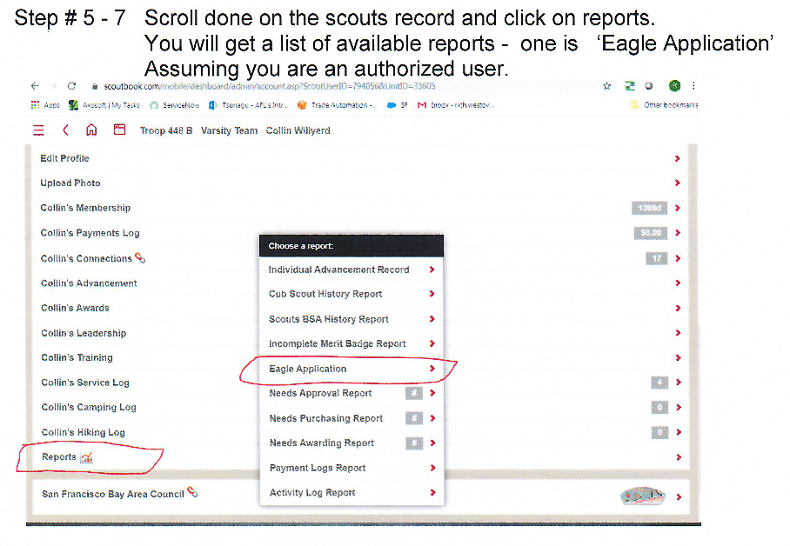
Scoutbook-Roster-Scout-Reports

Slide 32
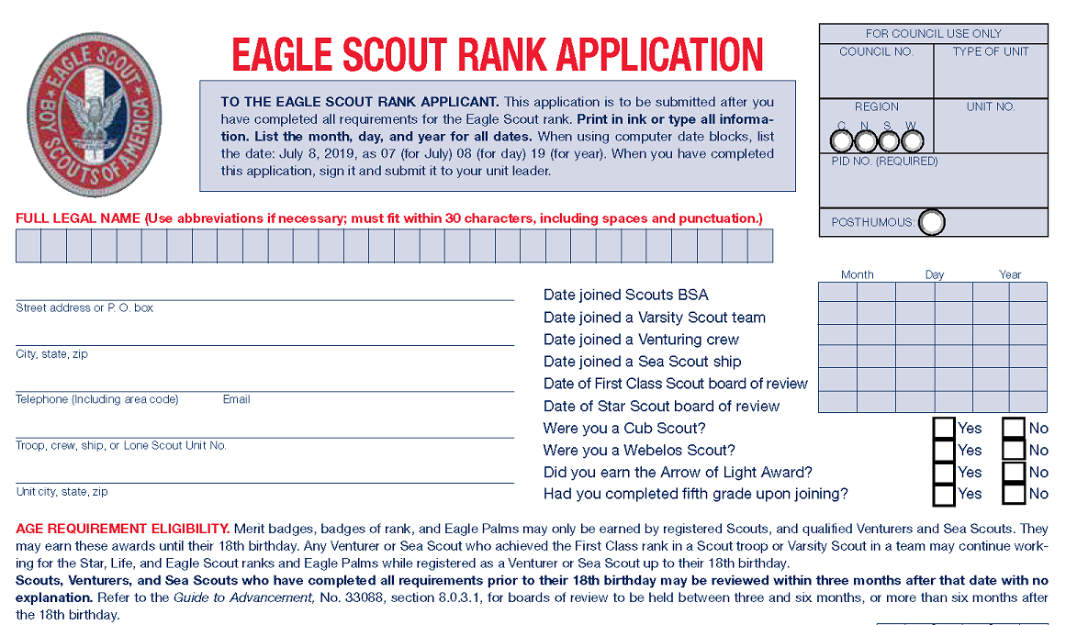
Page 1
Notes:
Filling out this downloadable fillable pdf document ensure legibility. Spacing is such that most cannot print legibly small enough to include all the information. Data entered electronically on the first page carries over to the second.
The name, including spaces, is limited to the number of boxes.
Anecdote about 40 characters.

Slide 33
AGE REQUIREMENT ELIGIBILITY.
Merit Badges, badges of rank, and Eagle Palms may be earned by registered Scouts, and qualified Venturers and Sea Scouts. They may earn these awards until their 18th birthday. Any Venturer or Sea Scout who achieved the First Class rank in a Scout Troop or as a Lone Scout may continue working for the Star, Life, and Eagle Scout ranks and Eagle Palms while registered as a Venturer or Sea Scout up to their 18th birthday.
Scouts, Venturers and Sea Scouts who have completed all requirements prior to their 18th birthday may be reviewed within three months after that date with no explanation. Refer to the Guide to Advancement, No. 33088, section 8.0.3.1, for boards of review to be held between three and six months, or more than six months after the 18th birthday.
Notes:
However, due to the circumstances that existed on March 19th, National granted our Scout Executive the authority to grant extensions under the limitations outlined below. This authority exists through September 30, 2020. Authority to Grant of extensions post marked after that date remains with the National Council.
1. The Scout, the Scout’s parent or guardian, the unit leader, or a member of the unit committee may submit a letter request, identifying the scout and signed and dated by the author to the San Francisco Bay Area Council, 1001 Davis Street, San Leandro, CA 94577-1514 Attention COVID-19 via the U. S. Postal Service. It should be sent by registered or certified mail so a record of sending and receiving is made. Responses will be after the office is reopened.
2. The request must document the circumstances. Provide a summary of action needed to complete a requirement or project and the impact of the civic restriction. Make and keep a copy in a safe place.
3. SFBAC can grant a 3 month extension under limitations established on March 19, 2020:
It is established that COVID-19 disruptions were the only circumstances that delayed work on Eagle Scout/Summit/Quartermaster project of merit badge requirements.
Eagle extensions will only be granted to youth in Scouts BSA who have already achieved Life rank.
A written response of the outcome of the request will be mailed to the youth. This response must be attached to their Eagle/Summit/Quartermaster rank application. For Eagle, the extension will be for 3 months from the youth’s 18th birthday; for Summit/Quartermaster, the extension will be for 3 months from the youth’s 21st birthday.
Upon turning 18, the Scout must submit a completed adult application and successfully complete Youth Protection Training.
The authority for councils to grant extensions is temporary, lasting only through Sept. 30, 2020.

Slide 34
Age Requirement continued
A Scout, Venturer, or Sea Scout with a disability may work toward rank advancement after their 18th birthday if they meet the criteria for registration beyond the age of eligibility. See the Guide to Advancement, section 10.0.0.0 for details.
Notes:
Include your district review coordinator and district advancement chair in this process.

Slide 35
Requirement 1
Be active in your troop, team, crew, or ship for a period of at least six months after you have achieved the rank of Life Scout
Notes:
What does active mean?
Nationally, the most important is registration—a great topic as we are doing our annual re-charter. The scout must be registered in the unit from which he reports a Position of Responsibility. A scout may be multiple registered with the unit leaders agreeing which is mentoring advancement.

Slide 36
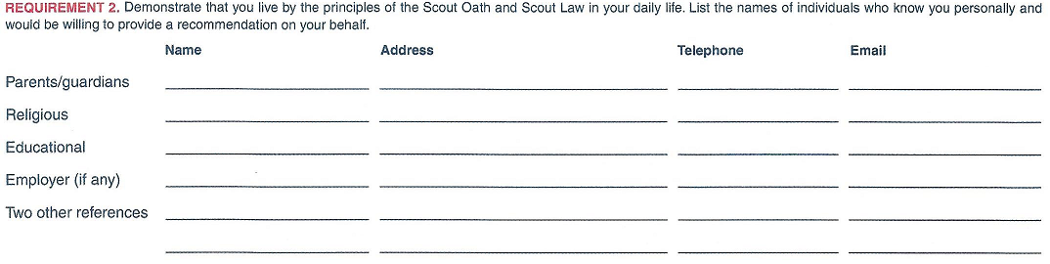
Requirement 2
Demonstrate that you live by the principles of the Scout Oath and Scout Law in your daily life. List the names of individuals who know you personally and would be willing to provide a recommendation in your behalf.
Notes:
Same as all other ranks. Difference is where the board of review is held. All other ranks (and Eagle Palms) are unit committee boards of review. Eagle Scout boards are convened by the district. These recommendations, along with the statement and workbook introduce the youth to the board.

Slide 37
Eagle Scout Rank Process
The Eagle Reference Cover Letter is an explanation of the Scout Oath and Scout Law to be shared with the persons from whom references are requested to meet Requirement number 2. It is recommended that a printed copy be given to each individual who agrees to provide a reference. DO NOT have reference letters sent to the council service center. They are to be mailed directly to the Review Coordinator for your district. Failure to do so can cause delay in scheduling your Board of Review. There is a template to prepare envelopes in the Life to Eagle Candidate Letter and Instructions.
Notes:
A sample of the template in use is after the next slide..

Slide 38
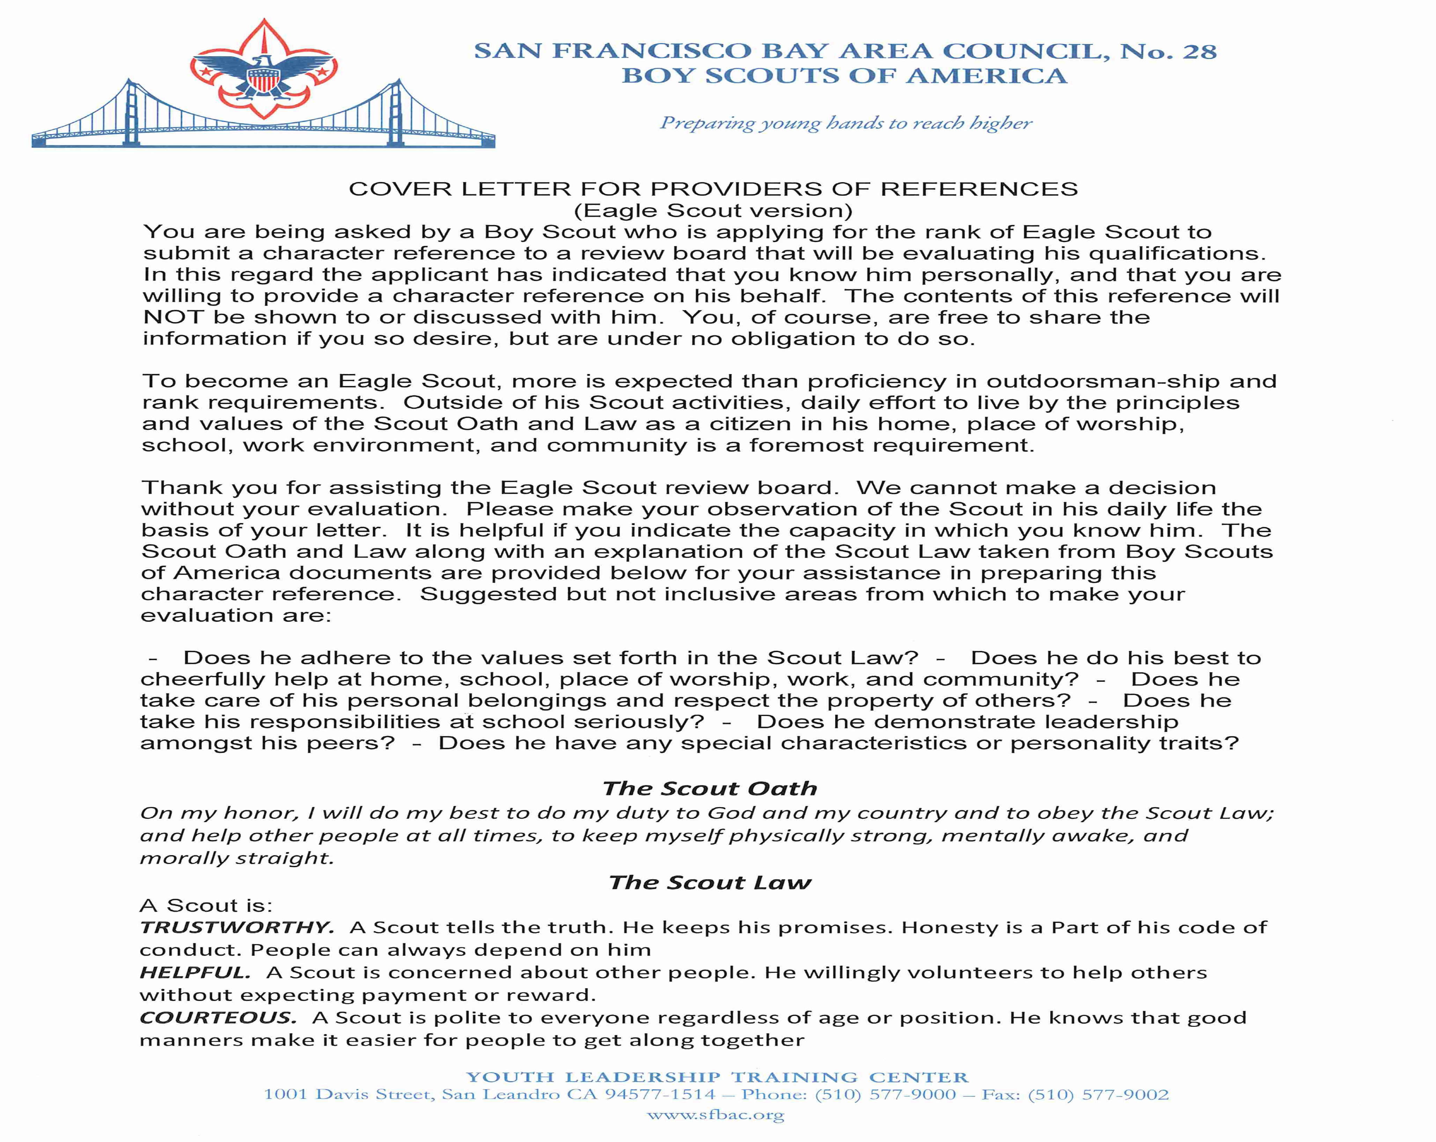
Notes:
This documents has been re-written to be gender neutral and that will be posted after the staff can return to the service center.

Slide 39
Reference Letter Envelope
Notes:
A sample of the envelope created from the Mission Peak District template. There is a template for each of the six San Francisco Bay Area Council District Review Coordinators.

Slide 40
Reference Letter Envelope
Notes:
Key point here is that the letter is addressed to the San Francisco Bay Area Council. Federal Law requires the letter to be held for the council in the form of the board of review.
The letter will be used in the advancement process and then destroyed. Boards are instructed not to share the contents with the Eagle candidate.

Slide 41
Reference Letter Envelope
Notes:
Information needed to delivered a sealed envelop to the Board of Review.

Slide 42
Reference Letter Envelope
Notes:
Recommended that the scout prepare the envelops, after agreement with the reference and provide postage. They cannot be involved in the delivery of the letters.

Slide 43
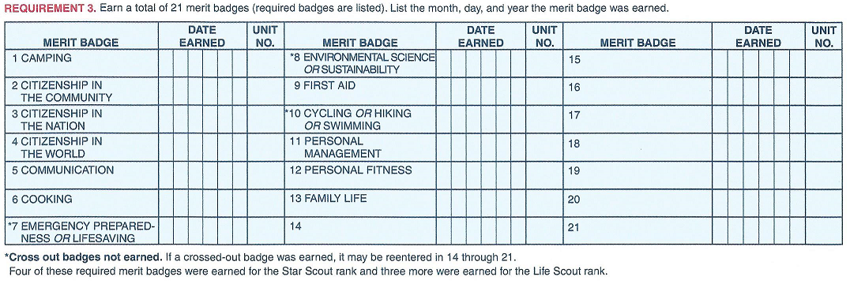
Requirement 3
Earn a total of 21 merit badges (required badges are listed). List the month, day, year and unit number where the merit badge was earned.
Notes:
Numbers 7, 8 and 10 have options. The ones crossed out in those boxes can be entered in a blank box. These dates must agree with those in SCOUTNET and can be checked by the unit Advancement Coordinator using Internet Advancement.

Slide 44
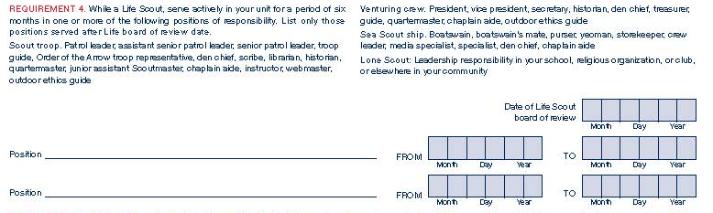
Requirement 4
While a Life Scout serve actively for a period of six months in one or more of the following positions of responsibility. List only those positions served after Life board of review date.
Notes:
The position or positions must be in a type unit that the scout is registered in. If they is only registered in a troop, then only troop positions are viable. If they is registered in both a crew and a troop during the period of service then both sets of positions are viable.
Unit leaders agree as to which is going to manage the youth’s advancement.

Slide 45
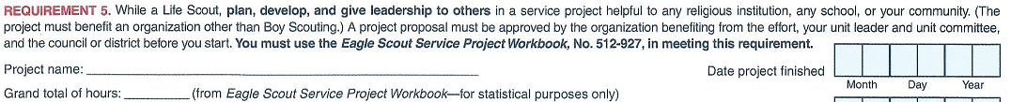
Requirement 5
While a Life Scout, plan, develop, and give leadership to others in a service project helpful to any religious institution, any school, or your community. (The project must benefit an organization other than the Boy Scouts of America.) A project proposal must be approved by the organization benefitting from the effort, you unit leader and unit committee and the council or district before you start. You must use the Eagle Scout Service Project Workbook, No. 512-027 in meeting the requirement.

Slide 46
Only the Official Workbook May Be Used
Eagle Scout candidates must use the official Eagle Scout Service Project Workbook, No. 512-927, as produced by the BSA and found at www.scouting.org/advancement. Although it is acceptable to copy and distribute the workbook, no council, district, unit, or individual has the authority to produce or require additional forms, or to add or change requirements, or to make any additions, deletions or changes in the text, outlines, links, graphics, or any other elements of the workbook.
Notes:
If you search the internet for Eagle Scout Project Workbook, how many different versions will you find?
Which one is current?
The one with a print date on or after the Life Board of Review date. Work on a project cannot start until then.
The SFBAC website link to the national website will get you the current version.

Slide 47

Eagle Scout candidate's full legal name
Please give a name to your project
EagleScoutServiceProject WorkbookNo. 512-927 January 2019
Notes:
Here is what the pdf fillable document looks like. Data entered on the cover will transpose to the section header pages.
Notice the small writing.

Slide 48
Check the date
Check the date
Check the date
    Eagle Scout Service Project Workbook No. 512-927
    January 2019
o
Notes:
The current version. It has undergone extensive revisions since it replaced the printed Eagle Scout Leadership Service Project in 2010. All those revisions are available on different websites. The reason for using the link on the SFBAC website or going directly to the national BSA site.

Slide 49
Scouts and Parents or Guardians
Please read "Message to Scouts and Parents or Guardians" on pages 5 and 6. This includes excerpts and summaries from the Guide to Advancement that may help ensure requirements are properly administered according to national BSA policies and procedures. Please note, also, that when a Scout submits a project proposal they promise they have read this entire workbook. Doing so will be important to their success.

Slide 50
Table of Contents
Message from the Chief Scout Executive 2
How to Use This Workbook
  Meeting Eagle Scout Requirement 5 4
  Eagle Scout Requirement 5 4
  Project Purpose 4
  Choosing a Project 4
  Restrictions and Other Considerations 4
  Collecting Service Project Data 4
Message to Scouts and Parents or Guardians 5
Excerpts and Summaries from the Guide to Advancement 6

Slide 51
Table of Contents
Workbook Forms
Eagle Scout Service Project Proposal
  Instructions for Preparing Your Proposal
  Contact Information
Eagle Scout Service Project Plan
Eagle Scout Service Project Fundraising Application
  Procedures and Limitations on Eagle Scout Service Project Fundraising
Eagle Scout Service Project Report
Navigating the Eagle Scout Service Project, Information for Project Beneficiaries

Slide 52
Attention: Unit, District, and Council Reviewers
Eagle Scout projects must be evaluated primarily on impact-the extent of benefit to the religious institution, school, or community, and on the leadership provided by the candidate. There must also be evidence of planning and development. This is not only part of the requirement but relates to practicing the Scout motto, “Be Prepared”. However, in determining if a project meets Eagle Scout requirement 5, reviewers must not require more planning and development than necessary to execute the project. These elements must not overshadow the project itself, as long as the effort was well led and resulted in otherwise worthy results acceptable to the beneficiary.

Slide 53
Guide to Safe Scouting
Use the following forms to aid in your planning for any BSA service project:
Service Project Planning Guidelines 680-027
Age Guidelines for Tool Use 680-028

Slide 54
Requirement 6
Any questions before we go on to Requirements 6, 7 and the signatures?

Slide 55
Requirement 6
Take part in a unit leader conference
  Also known as a scoutmaster conference.
Notes:
No different than any other rank.

Slide 56
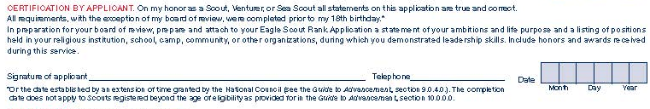
Certification
Notes:
Will break this down.

Slide 57
CERTIFICATION BY APPLICANT
On my honor as a Scout, Venturer, or Sea Scout, all statements on this application are true and correct. All requirements, with the exception of my board of review, were completed prior to my 18th birthday.*

Slide 58
CERTIFICATION BY APPLICANT
In preparation for your board of review, prepare and attach to your Eagle Scout Rank Application a statement of your ambitions and life purpose and a listing of positions held in your religious institution, school, camp, community, or other organizations, during which you demonstrated leadership skills. Include honors and awards received during this service.

Slide 59
CERTIFICATION BY APPLICANT
Signature of applicant______Telephone_______
* Or the date established by an extension of time granted by the National Council (see the Guide to Advancement, section 9.0.4.0.). The completion date does not apply to Scouts registered beyond the age of eligibility as provided for in the Guide to Advancement, section 10.0.0.0.
Notes:
Digital signatures are allowed until September 30, 2020.

Slide 60
UNIT APPROVAL (personal signatures required)
Signature of unit leader_______Telephone_____
Scoutmaster, Coach, Advisor, or Skipper
Signature of unit committee
chair________________ Telephone________
Notes:
Unit approval is also a recommendation that the scout has completed all the first six requirements.
Digital signatures are allowed until September 30, 2020 but there is no method to submit the digitally assigned application to the council office. During the time the office is closed the application should be mailed through the U. S. Postal Service. Certified or registered mail is recommended for a record of sending and receiving is made.

Slide 61
Council Verification
According to the records, the applicant is a registered member of this unit and this application is approved as accurate. Signed and dated by the San Francisco Bay Area Council Registrar.
Notes:
If this doesn’t happen, those unit leaders are contacted to fix the problems.

Slide 62
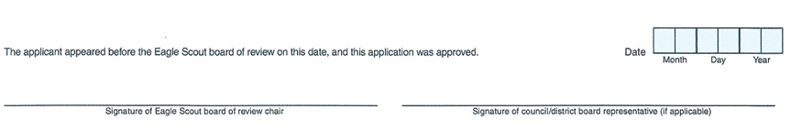
Requirement 7
Successfully complete an Eagle Scout board of review.
Notes:
Remember the limitations—the board can be held within the period of three months after the Scout’s 18 anniversary of birth. Permission to hold a board within three and six months after the anniversary must be requested from the council Advancement Committee. Permission to hold boards after 6 months must be requested from the National Advancement Team. Your Review Coordinator and district Advancement Chair can assist in this process.

Slide 63
Council Certification
The council Scout Executive certifies that all procedures as outlined in the Guide to Advancement have been followed.
Registrar enters the rank.

Slide 64
Further actions
National reviews and if approved, creates Eagle Scout credentials
Credentials mailed to council
  Registrar notifies unit leader of receipt.
  Eagle Court of Honor can be held
  Regalia can be purchased in Scout Shop

Slide 65
Life Scout to Eagle Scout
Merl Nygren
Mission Peak District Review Coordinator
510.651.5972
nygreme@att.net

